Slide 1



Welcome!
Please check-in, fill out a name tag, and sit with your parents.

Slide 2

Opening Prayer

Slide 3

Lesson 28

Slide 4

Lesson 28
Lesson 28: Faith in Life – Saved by Grace Through Faith

Slide 5

Grace Activity

Slide 6
Do you think God is more interested in requirements or relationships? What’s the difference?

Slide 7

Video
“What is Grace?”

Slide 8


Slide 9
Grace = undeserved love

Slide 10
Faith = a relationship with God that is a gift from the Holy Spirit

Slide 11

Read Ephesians 2:8-9
What does it mean to be saved by grace through faith?
What are we saved from?

Slide 12
Read John 3:17
What was God’s motive in sending Jesus to earth?
What do you think John means by “that the world might be saved through him?”

Slide 13
Application of John 3:17
How does this verse help you understand what God is all about?
How might this verse help you on a day when you’re feeling like you aren’t “good enough?”

Slide 14
Read The Third Article (SC pg. 17)
How does this article connect with our lesson today?

Slide 15
Reflection Questions
- If someone asked you if you’re saved, how would you respond?
- What makes you “good enough” for God?
- How can you tell or show others about God’s grace?

Slide 16

GRACE!
Everyone received an extra Sermon Note! Yay!
Some now have 16! Wow!

Slide 17
Lesson 29

Slide 18

Lesson 29
Lesson 29: Faith in Life – Sharing Your Faith
Define the KEY Words on your worksheet.

Slide 19
Key Words
EVANGELISM:
Sharing faith through words and actions.
THE GREAT COMMISSION:
The command Jesus gave to His disciples, “to make disciples of all nations,” (Matthew 28:19).

Slide 20

Big Question:
“I’m just a kid, so how can I help others follow Jesus?”

Slide 21

Read John 3:1-17
  Who is Nicodemus?
  Underline John 3:16 in your Bibles
  Draw the message of John 3:16
  How would you explain John 3:16 to someone who doesn’t know Jesus?

Slide 22

Read Matthew 28:19
  “Make”
  What is the Holy Spirit’s role in making disciples?
  Why is baptism important?

Slide 23

Prepared for Evangelism
  Read Colossians 4:2-6
  Read 1 Peter 3:15-16
  How do you prepare to share your faith?
  What’s the most difficult part of evangelism?
  Christ promised He will always be with you! (Matthew 28:20)

Slide 24

Upcoming Confirmation Test
Sunday, May 10
72 points possible + 3 extra credit points
Use the Study Guide, White Binder, and Small Catechism to prepare for the test!
No-one has ever failed… you’ll be fine!
This is for you to reflect on what you’ve learned this school year!

Slide 25
Reminders!
15 Sermon Notes & 15 Service Hours due in the blue box by May 1st!
Bring a mobile device for our Kahoot Review Game next Sunday!

Slide 26
Announcements
Join us for Sunday Night FLY TONIGHT at 7-8:45pm
  Topic: “You Matter”
  Invite a friend and come learn how you and other people matter in God’s eyes!

Slide 27
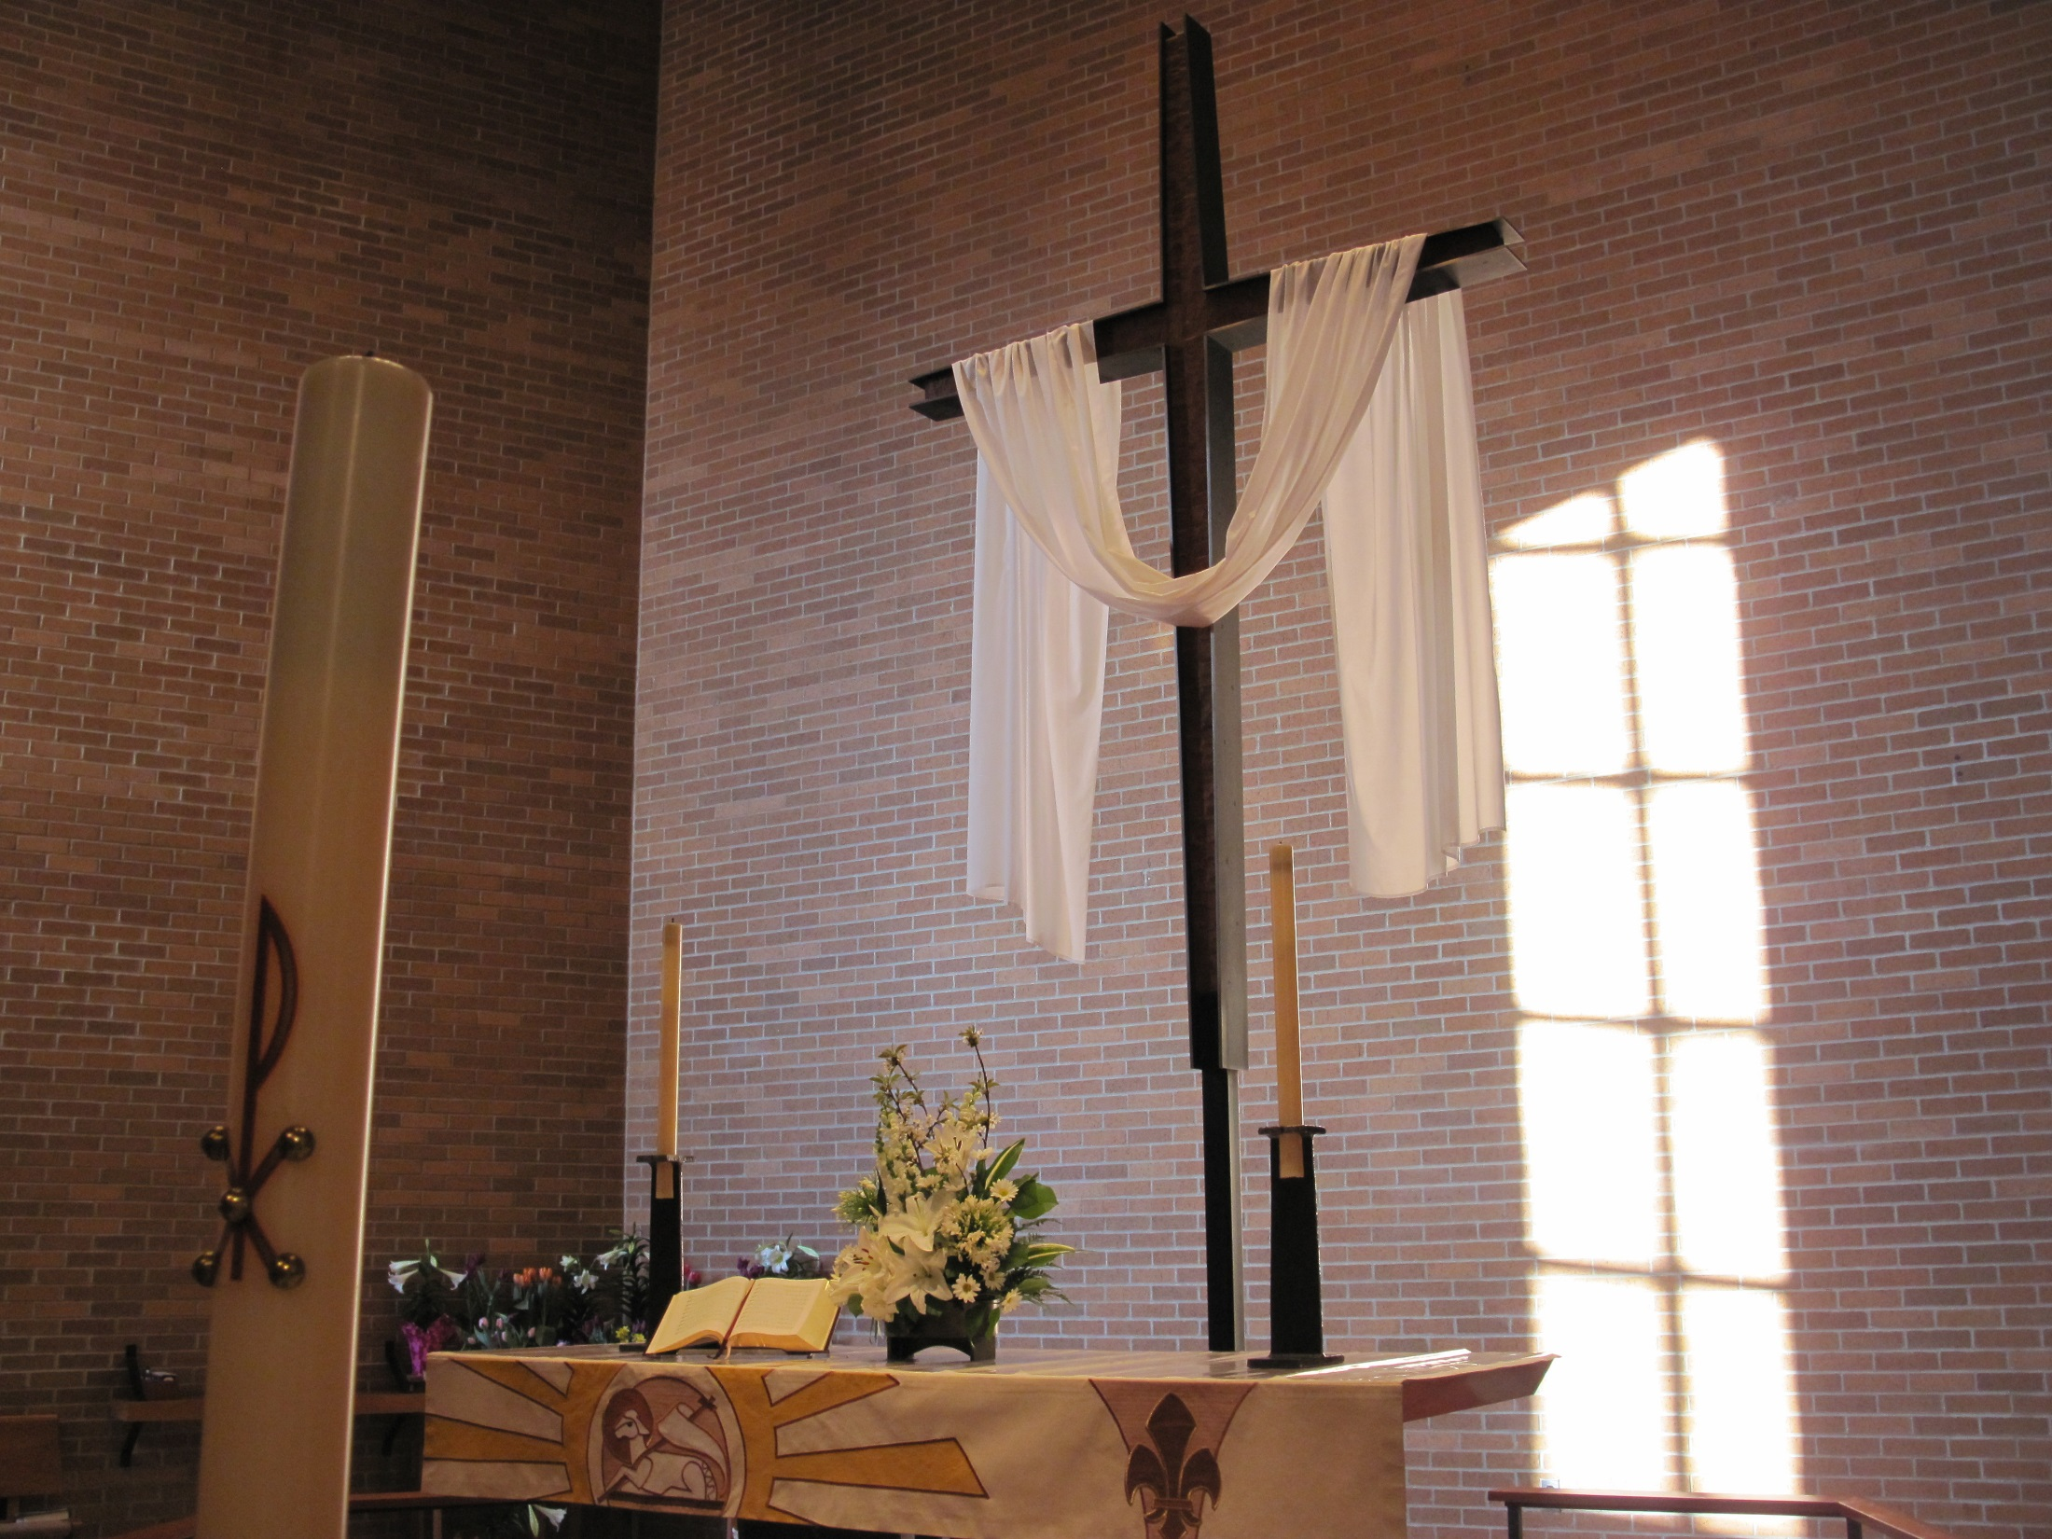

CLOSING
PRAYER

