Slide 1



Welcome!
Please check-in, fill out a name tag, and sit with your parents.

Slide 2

Opening Prayer

Slide 3

Quiz
(on Baptism)

Slide 4

1. The Word is:
Jesus Christ
Spoken words that point us to Christ.
Written words that point us to Christ.
All of the above
Baptism Quiz!
←

Slide 5
2. A Sacrament:
Is the 4th commandment
Combines elements & the Word
Can only be done at church
All of the above
←
Baptism Quiz!

Slide 6
3. Who was healed by washing himself seven times in the Jordan River?
Elisha
John the Baptist
Naaman
Moses
Baptism Quiz!
←

Slide 7
4. We are joined to Jesus’ death and resurrection through:
doing good things.
coming to church.
Baptism.
All of the above
Baptism Quiz!
←

Slide 8
5. True or false: We are commanded by Jesus to go and baptize.
←
Baptism Quiz!

Slide 9
6. True or false: You can baptize without using God’s Word.
←
Baptism Quiz!

Slide 10
7. True or false: Eternal life is a benefit of baptism.
←
Baptism Quiz!

Slide 11
8. True or false: The whole Trinity was involved in Jesus’ baptism.
←
Baptism Quiz!

Slide 12


Today’s Lesson
Sacraments – Communion
With a partner, define the Key Words together.

Slide 13

Key Words
PASSOVER
The Jewish celebration of the night God passed over Egypt, killing the firstborn in every Egyptian household. God spared the Hebrews, who were protected by the blood of the lamb.
LAST SUPPER
The Passover celebration Jesus shared with his best friends on the night he was betrayed.
EUCHARIST
Greek word for: “thanksgiving.” The communion meal Christians share that remembers Jesus’ Last Supper.

Slide 14
SKIT

Slide 15

Skit Reflection Questions
    Why do you think the girl was having such a hard time being convinced?
    Do you know anyone who struggles with feeling forgiven? Do you think the words of Jesus at his last supper would help this person experience God’s forgiveness?
    What evidence (things you can touch, see, hear, taste, and smell) do you believe you have that supports your faith?

Slide 16
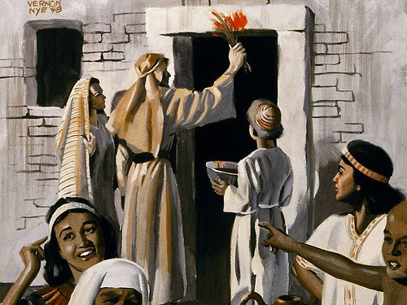
Summarize the Passover
(Exodus 12:1-36)

Slide 17
Read Luke 2:41-42
  Why did Jesus and his family celebrate the Passover? Why was it important?

Slide 18
Read Matthew 26:17-29
  Underline “bread, wine, body, and blood” in your Bibles
  How can Christ’s body and blood bring forgiveness of sins?

Slide 19
Read 1 Cor. 5:7
  How does Paul connect Jesus with the Passover?
  What does Paul mean when he’s talking about yeast?

Slide 20
Read Small Catechism pg. 31
  What are the benefits of the Eucharist?

Slide 21

Reminders!
15 Sermon Notes & 15 Service Hours due by May 1st!
Sign-up online at faithpenfield.org to be an acolyte or crucifer on Sundays!

Slide 22
Announcements
-Join us for Sunday Night FLY “Lenten Journey” TONIGHT at 7pm! We’ll explore the meaning of Lent by visiting different stations. Plus, we’ll play a game & also fill Easter Eggs for Faith’s Egg Hunt!

Slide 23


Closing Prayer

Slide 24
Have a wonderful week! Go in peace and serve the Lord!

