Slide 1



Welcome!
Please check-in, fill out a name tag, and sit with your parents.

Slide 2

Opening Prayer

Slide 3
Quiz
(on last week’s lesson)

Slide 4

1. Vocation is:
a vacation.
a holy calling.
a sin.
a band.
←
Vocation Quiz!

Slide 5
2. Who gives us our vocations?
Pastor Peter
Parents
God
Friends
Vocation Quiz!
←

Slide 6
3. True or false: A shoe has a purpose.
←
True
False
Vocation Quiz!

Slide 7
4. What is the purpose of our God-given gifts?
Help others
Serve God
Glorify God’s name
All of the above.
Vocation Quiz!
←

Slide 8
5. True or false: We all have different gifts.
←
True
False
Vocation Quiz!

Slide 9
6. True or false: Each of us has only one vocation.
True
False
←
Vocation Quiz!

Slide 10

Today’s Lesson
Faith in Life
  Theology of the Cross & Theology of Glory
As a group, let’s define today’s Key Words.

Slide 11

Key Words
THEOLOGY:
The study of God.
THEOLOGY OF GLORY:
The study of God that emphasizes human effort and conforms to cultural expectations of God and believers.
THEOLOGY OF THE CROSS:
The study of God that emphasizes God’s work – rather than human work – and overturns cultural expectations of God and believers.
EGOTISM:
The excessive use of “I” and it’s all about me.
GRACE:
Undeserved love.

Slide 12
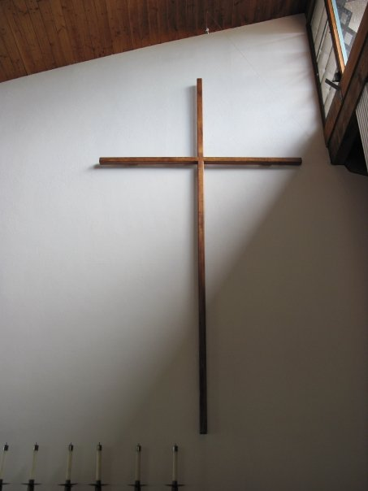
Skit

Slide 13

Skit Reflection Questions
    What differences did you notice between the theologian of the cross and the theologian of glory?
    How would you describe the theologian of glory's relationship with God?
    How would you describe the theologian of the cross' relationship with God?

Slide 14
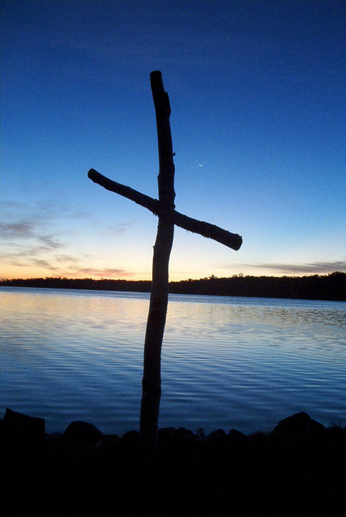
What’s so great about the cross?
Isaiah 53:4-6
Rom. 6:23
1 Cor. 1:18

Slide 15
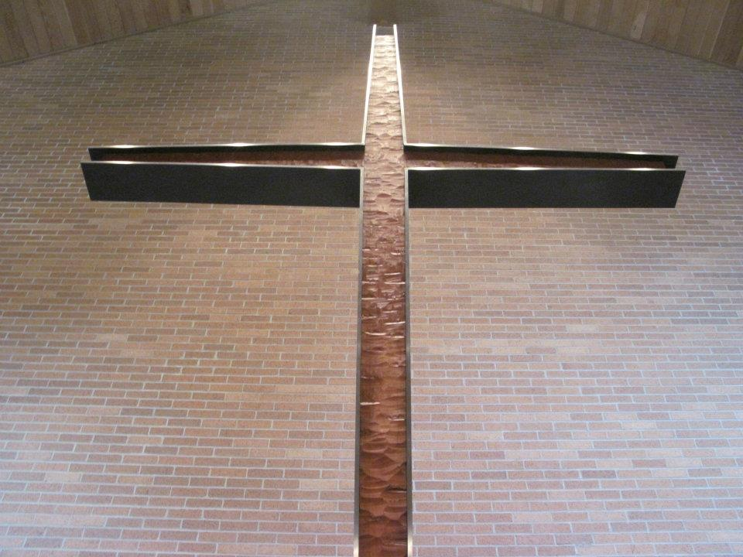
What’s the connection between the cross and my life?
Rom. 6:3-5
Luke 9:23

Slide 16
Read 1 Cor. 1:18-31
How does God use the cross to change the way we think about God, our neighbors, and ourselves?
Many Christians have come to believe that worldly success is a sign of God’s favor – how does the theology of the cross contradict this?

Slide 17
Worksheet Instructions

Slide 18

At your table,
reflect with these questions:
How is God and our relationship with Him different than what we might expect?
Is it hard or easy to make “theology of glory” statements? Why?
How would you talk to a friend who has a theology of glory?

Slide 19

Reminder
15 sermon notes
& 15 service hours due by May 1st!

Slide 20


Slide 21


Slide 22

Closing Prayer

Slide 23
Have a wonderful week! Go in peace and serve the Lord!

