Slide 1

WELCOME!

Slide 2

Opening Prayer

Slide 3

Quiz Show!

Slide 4

1. The definition of covet is:
to destroy
to desire
to gossip
to play
←

Slide 5
2. It’s okay to covet something if…
you’re just thinking about it.
you know you could never have it.
you don’t do anything about getting it.
none of the above.
←

Slide 6
3. The Tenth Commandment is about coveting…
cool stuff.
food.
living things.
nothing.
←

Slide 7
4. Contentment is…
Like coveting.
An act you do to become popular.
An inner sense of calm and peace.
None of the above
←

Slide 8
5. The Ninth and Tenth Commandments help us to…
put the needs of our neighbors first.
not scheme and plot.
both of the above.
none of the above.
←

Slide 9
6. Coveting = worrying =
←
not trusting God
cheating
not praying enough
murder

Slide 10

Lesson 7
Faith in Life – Law, Gospel, Sinner, Saint
Key Words: Law, Gospel, Sinner, Saint
At your table, define the Key Words together on your Student Worksheets.

Slide 11
Key Words
LAW:
What we should and should not do to be safe and live peacefully in community.
GOSPEL:
Because we cannot keep the Law, God gives us the Gospel. Gospel means, “Good News!” The Good News is that, through Christ, we are freely saved, loved, and forgiven!
SINNER:
All people are sinners, regardless of how good or bad they are.
SAINT:
All baptized Christians are saints, regardless of how good or bad they are.

Slide 12

We’re going to skip the Skits today… sorry!

Slide 13
Open your Bibles to:
Luke 19:1-10
How was Zacchaeus both sinner and saint?
Luke 22:54-62
How was Peter both sinner and saint?

Slide 14
Romans 5:1-11
Reconciliation – to be made whole again; a friendship is restarted.

Slide 15
Small Catechism (pgs. 51-52)
What does God teach and do in the Law?
What does God teach and do in the Gospel?

Slide 16
Matthew 22:37-40
Jesus replied: “‘Love the Lord your God with all your heart and with all your soul and with all your mind.’ This is the first and greatest commandment. And the second is like it: ‘Love your neighbor as yourself.’ All the Law and the Prophets hang on these two commandments.”

Slide 17
Lesson 8
Faith in Life – Love Your Neighbor
Key Words: Neighbor, Charity, Social Justice
At your table, define the Key Words together on your Student Worksheets.

Slide 18
Key Words
NEIGHBOR:
Someone who lives nearby. In God’s terms: all people.
CHARITY:
Short-term response to address an immediate need.
SOCIAL JUSTICE:
Long-term response to address the root cause of the need.

Slide 19
Open your Bibles to:
Luke 10:25-28
The religious law expert wanted to test Jesus’ knowledge. “Who is my neighbor?”
Jesus’ response is the parable of the Good Samaritan.

Slide 20
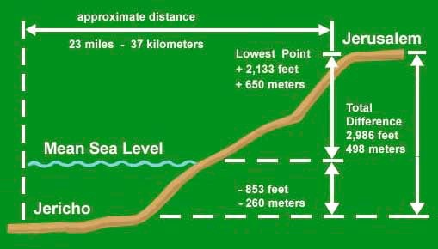
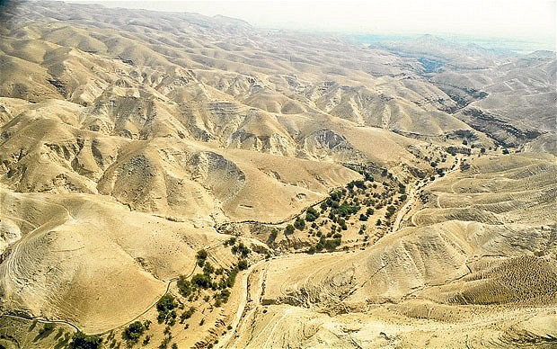

Slide 21
Luke 10:29-37
What are the reactions of the high priest and the Levite?
Samaritans were “hated foreigners”
How does Jesus define “neighbor” in this parable?

Slide 22
Matthew 5:43-44
Make a list of who you might consider to be enemies.
Pick someone from your list and write a prayer for that person.

Slide 23
Charity & Social Justice
Think of ways your family can serve others short-term and long-term. List your ideas on your worksheet.

Slide 24
Next Sunday:
  NO HOMEWORK! (You’re welcome!)

Slide 25
Announcements
Thanks to everyone who is helping with the Bake Sale this morning!
Jr. FLY Switch Party - Sunday, Nov. 9 @ 5:30pm
  Enjoy dinner & playing MarioKart and Gang Beasts tournaments for prizes!
Sunday Night FLY - Sunday, Nov. 9 @ 7pm
  “Cookies for College Students”
  Bring 2 dozen cookies and we’ll create care packages for college students, and play games!
  Start inviting your friends!

Slide 26

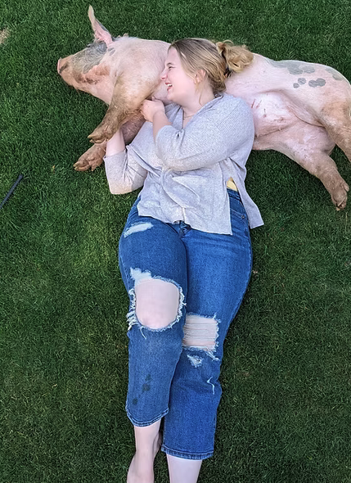
Meet our new DCE Intern!
  Ella Gilzean!
  From California, goes to college in Nebraska!
  Loves youth ministry, music, hiking, Ren Faires, reading, martial arts, mission trips, and more!
  She’ll be with Faith for a year starting in January!
  She’ll be helping to lead our Children’s & Youth Ministries!

Slide 27
Closing Prayer

Slide 28
Have a wonderful week! Go in peace and serve the Lord!

