Slide 1

WELCOME!

Slide 2

Opening Prayer

Slide 3

Quiz Show!

Slide 4

1. Jesus is…
Savior.
Messiah
God.
all of the above.
←

Slide 5
2. Jesus was born…
to the Virgin Mary.
fully human and fully divine.
a and b
50% God and 50% man
←

Slide 6
3. Salvation…
is earned through good works.
is a free gift.
belongs only to those who believe the right things.
is given only to those who have not sinned.
←

Slide 7
4. “Righteousness” is what…
you can achieve by hard work.
you can achieve by much prayer.
you can achieve by trying your very best.
Christ gives by his death and resurrection.
←

Slide 8
5. Redemption is…
what the bank does when you deposit money.
the opposite of crucifixion.
being rescued from sin and death.
a goofy word.
←

Slide 9
6. The longest article in the Apostles’ Creed is…
the first article.
the second article.
the third article.
none of the above; they are all the same length.
←

Slide 10
7. Emmanuel means:
Emma’s real name.
Ruler of all.
God with us.
Jesus’ middle name.
←

Slide 11
8. Jesus defeated:
Sin
Death
Power of the devil
All of the above
←

Slide 12

Today’s Lesson
Apostles’ Creed – Article Three
Key Words: Counselor, Pentecost, Enlighten, & Sanctify
At your tables, define the Key Words on your Student Worksheets.

Slide 13

Key Words
COUNSELOR:
An advisor or teacher.
PENTECOST:
The day that comes fifty days after Easter, the coming of the Holy Spirit, and the birthday of the Church.
ENLIGHTEN:
To give knowledge; instruct.
SANCTIFY:
To make holy.

Slide 14

Open your Bible to John 14:15-17
Jesus is speaking about the Holy Spirit and Pentecost.
  Jesus says we know the Holy Spirit, how do we know Him?
    Through His Word & Sacraments
How is the Holy Spirit our Counselor?
  “Someone who helps another person in trouble with the law” – a legal term.

Slide 15
Pentecost – Acts 2:1-13
Summarize what’s happening.
Many people were in Jerusalem from all over the world and all could hear the Gospel in their native languages.
Pentecost = birthday of the Church Baptism = spiritual birthday for Christians

Slide 16
Small Catechism (pg. 17)
The Holy Spirit:
  Calls: God has invited us to the great banquet. *Luke 14:16-17
  Enlightens: By the Gospel, the Holy Spirit gave us the saving knowledge of Jesus. *2 Cor. 4:6
  Sanctifies: By faith, the Holy Spirit works in us to give us new attitudes and desires in life. *Rom. 8:9

Slide 17
Small Catechism (pg. 152)
Read the answer to Question 161.
What are the blessings?
  Flip to pg. 155 and read the answer to Question 164.
  The Holy Spirit freely gives us:
    Faith in Christ
    Forgiveness of sins
    Eternal life

Slide 18

Think about your average day. What are some places where the Holy Spirit might be active?
Take a moment to answer on your worksheet.

Slide 19

Announcements
Thanks to everyone who came to Sunday Night FLY last Sunday!
FLY Ornament FUNdraiser – TODAY & Next Sunday
  Thank you to everyone who signed up to help on the FLY Bulletin Board!
Next Sunday Night FLY – “Christmas Party” on Dec. 14!
  Start inviting your friends to the BIGGEST Christmas Party of the year!

Slide 20
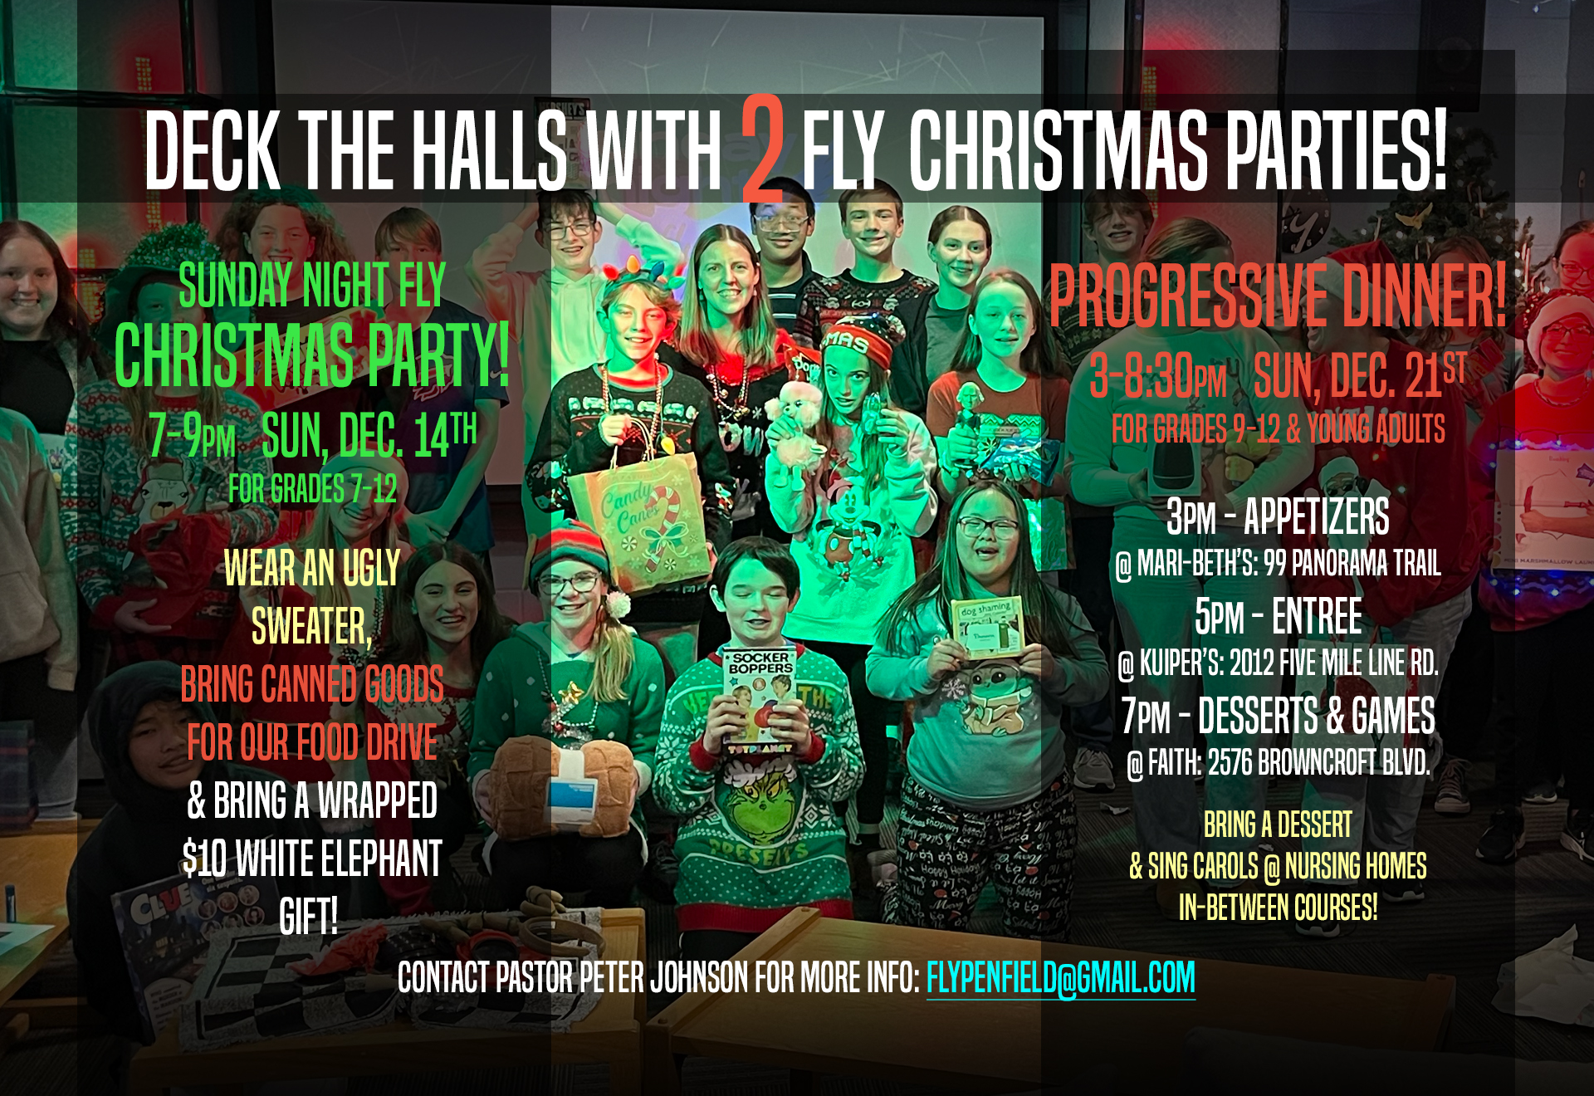

Slide 21
Closing Prayer

