Slide 1

WELCOME!

Slide 2

Opening Prayer
Leader: Creator God,
Group: You created me and all I have.
Leader: Creator God,
Group: You provide me daily with all I need for life.
Leader: Creator God,
Group: You made us all stewards of your creation.
Leader: Creator God,
Group: Help make us better stewards
Leader: So that where there is hunger, homelessness, and despair,
Group: There may be food and shelter and hope.
All: Amen.

Slide 3

Quiz Show!

Slide 4

1. Which of these is not the name of a creed?
a. Apostles’
b. Athanasian
c. Exegetical
d. Nicene
←

Slide 5
2. Which of these is not one of the three persons of the Trinity?
a. Father
b. Son
c. Holy Spirit
d. Uncle
←

Slide 6
3. Gnosticism was the belief that:
A person had to have secret knowledge in order to get to Heaven.
Gnomes were an ancient Old Testament tribe.
Jesus will come back on Dec. 21, 2025.
Heaven is located near the equator.
←

Slide 7
4. A creed is…
a. an ancient altar.
b. a hymn.
c. a statement of shared beliefs.
d. another name for the pulpit.
←

Slide 8
5. The Apostles’ Creed was written by the 12 Apostles.
True
False
←

Slide 9
6. The first creeds of the Church date back to…
←
a. the very beginning of the Christian church.
the reign of Nebuchadnezzar
c. the Reformation.
the time that Lutherans first came to the United States.

Slide 10
7. Creeds are important to the Church for…
a. guarding against false teachings.
b. maintaining Christian unity.
c. teaching new believers.
d. all of the above.
←

Slide 11
8. The Church’s most basic creedal statement is:
Luther was amazing.
Jesus is Lord.
Go to church.
Be good.
←

Slide 12

Today’s Lesson
Apostles’ Creed – Article One
Key Words: Creation, Sustain, & Stewardship
DRAW the Key Words’ definitions on your Student Worksheets.

Slide 13
Key Words
CREATION:
All that exists; all that God has made.
SUSTAIN:
To keep, preserve, and maintain.
STEWARDSHIP:
Responsibility for care and proper use of God’s gifts (time, talent, & resources). It’s the lifestyle of Christians!

Slide 14
“The Known Universe”
Video

Slide 15


Slide 16
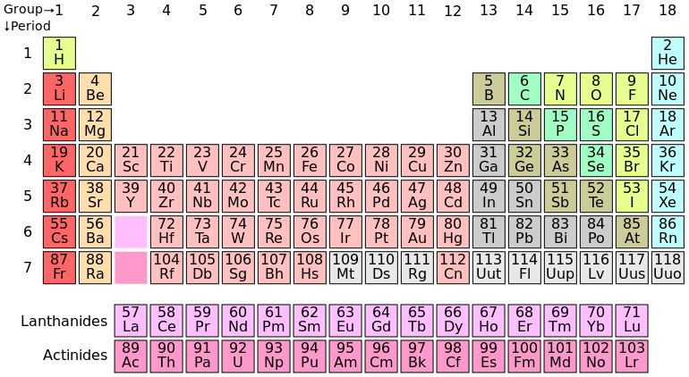
Periodic Table of Elements

Slide 17
Is there a place/person/occasion that comes to your mind when you think of God’s creation?

Slide 18
Genesis 1:1-2:3
Day 1 God created: | Day 4 God created:
Day 2 God created: | Day 5 God created:
Day 3 God created: | Day 6 God created:
LIGHT
SUN, MOON, & STARS
OCEAN & SKY
FISH & BIRDS
GROUND & VEGETATION
LAND ANIMALS & HUMANS

Slide 19
What does it mean to be partners with God in taking care of creation?
True or False – All of creation was affected by Adam and Eve sinning.

Slide 20
Read the explanation to the First Article.
Small Catechism (pgs. 15-16)
What is our response or duty according to the First Article?

Slide 21
Homework:
Read the Second Article & Meaning
(SC Pgs. 16-17)
*Pastor Peter will be teaching the next 5 weeks.

Slide 22

Announcements
Thanks to everyone who attended our Jr. FLY Switch Party & Sunday Night FLY last weekend!
Our next Sunday Night FLY is called “Armor Up” on Sunday, Nov. 23 @ 7pm!
  We’ll be using A LOT of tinfoil in our lesson! Come and find out why!
  Plus we’ll worship & play games!
  Bring your friends!
  Come early at 6:15 for dinner & games!

Slide 23
Closing Prayer

Slide 24
Have a wonderful week! Go in peace and serve the Lord!

