Slide 1

WELCOME!
Please check-in & pick up Sermon Notes

Slide 2

Opening Prayer

Slide 3

Quiz Show!

Slide 4

1. You can always tell someone is a thief by the way he or she looks.
True
False
←

Slide 5
2. Stealing is always something someone does intentionally.
True
False
←

Slide 6
3. What does gossip steal from someone?
Their money.
Their confidence.
Their brain.
Their senses.
←

Slide 7
4. According to the Small Catechism, how should we treat our neighbors?
Push them off cliffs.
Take candy from babies.
Speak well of them.
Worship them.
←

Slide 8
5. “Bearing false witness” includes betraying information that was shared with you in confidence.
←
True
False

Slide 9
6. Lying and gossiping are good ways to create reliable order and structure in society.
a. True
b. False
←

Slide 10
7. It’s easy to break these commandments. You don’t even have to say a word!
←
True
False

Slide 11

Memory Work
Confirmands should write down their memory work on a piece of paper and hand in to Mark.
At your table, define the Key Words and answer the Big Question together on your Student Worksheets.

Slide 12
Key Words
CONTENTMENT:
An inner sense of calm and peace; being thankful to God for His many blessings
COVET:
To desire something or someone more than God.

Slide 13

Do you covet…

Slide 14
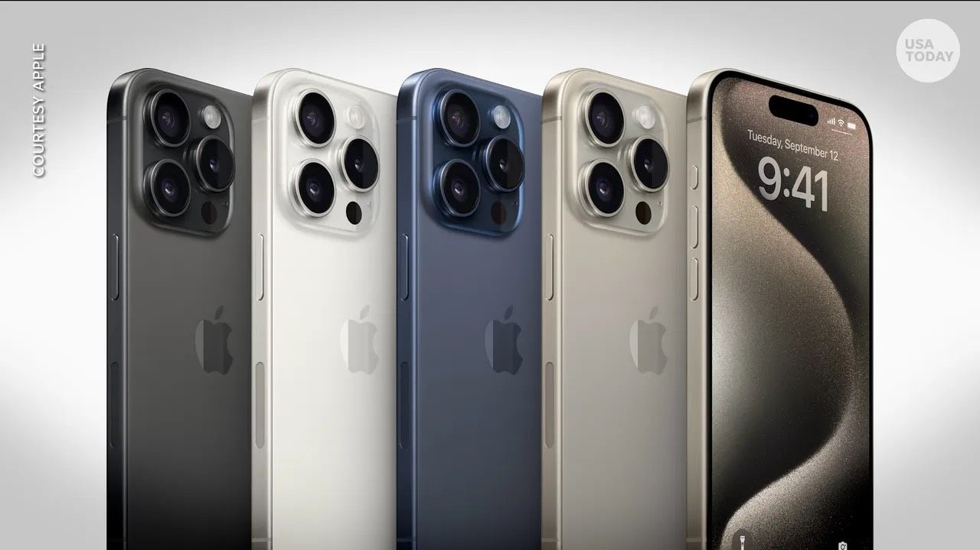

Slide 15
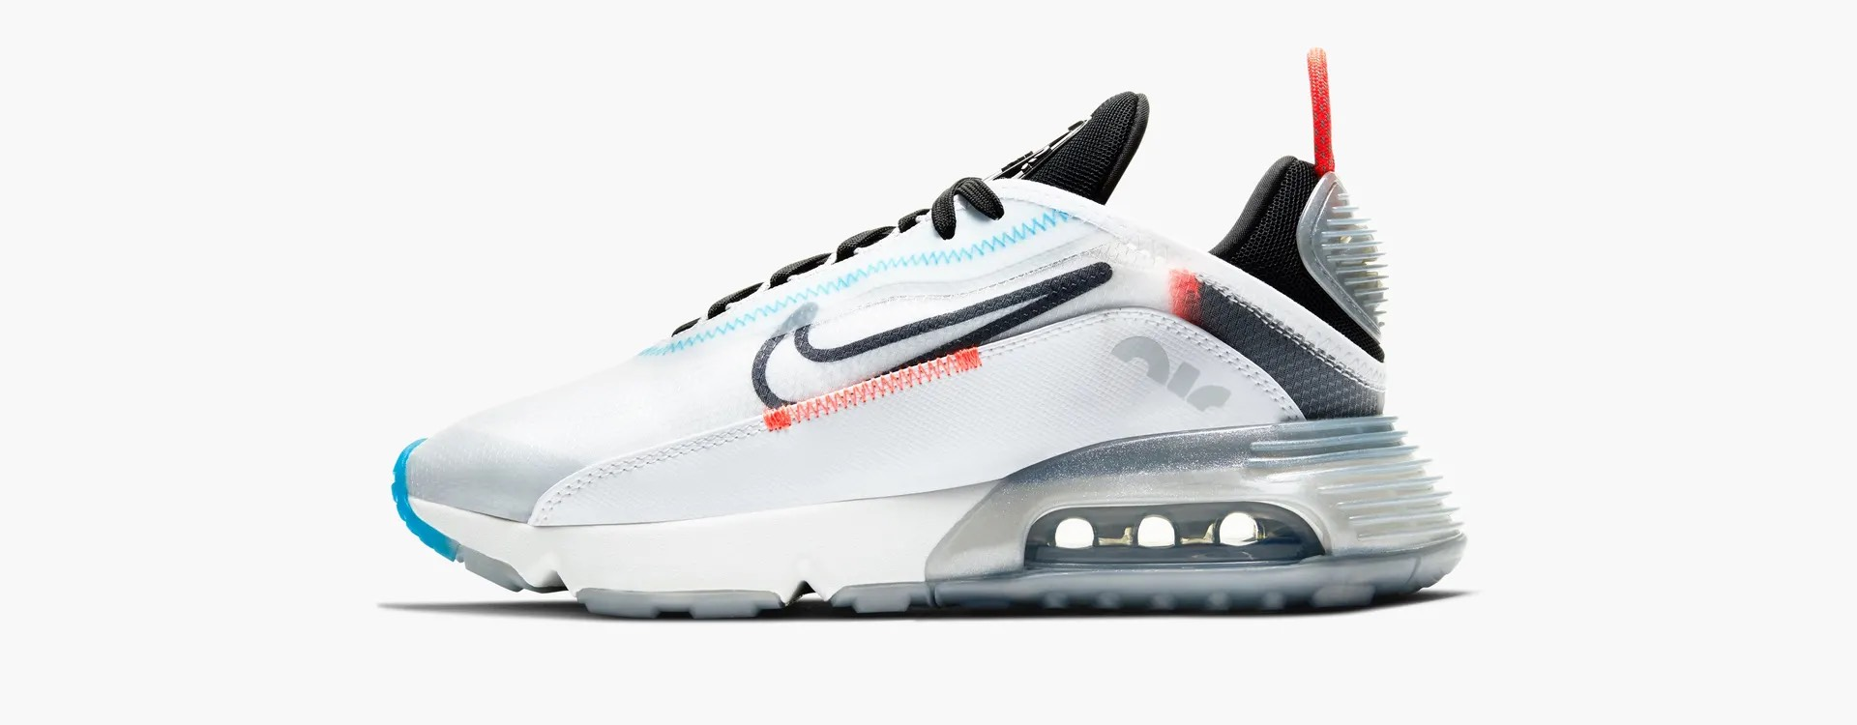

Slide 16


Slide 17
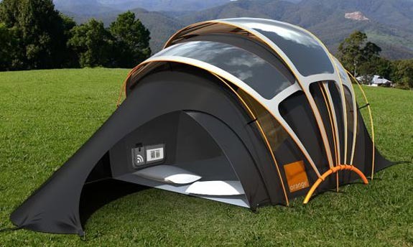

Slide 18


Slide 19
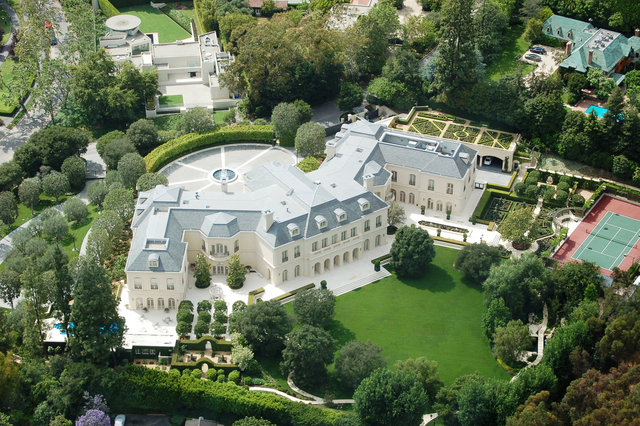

Slide 20
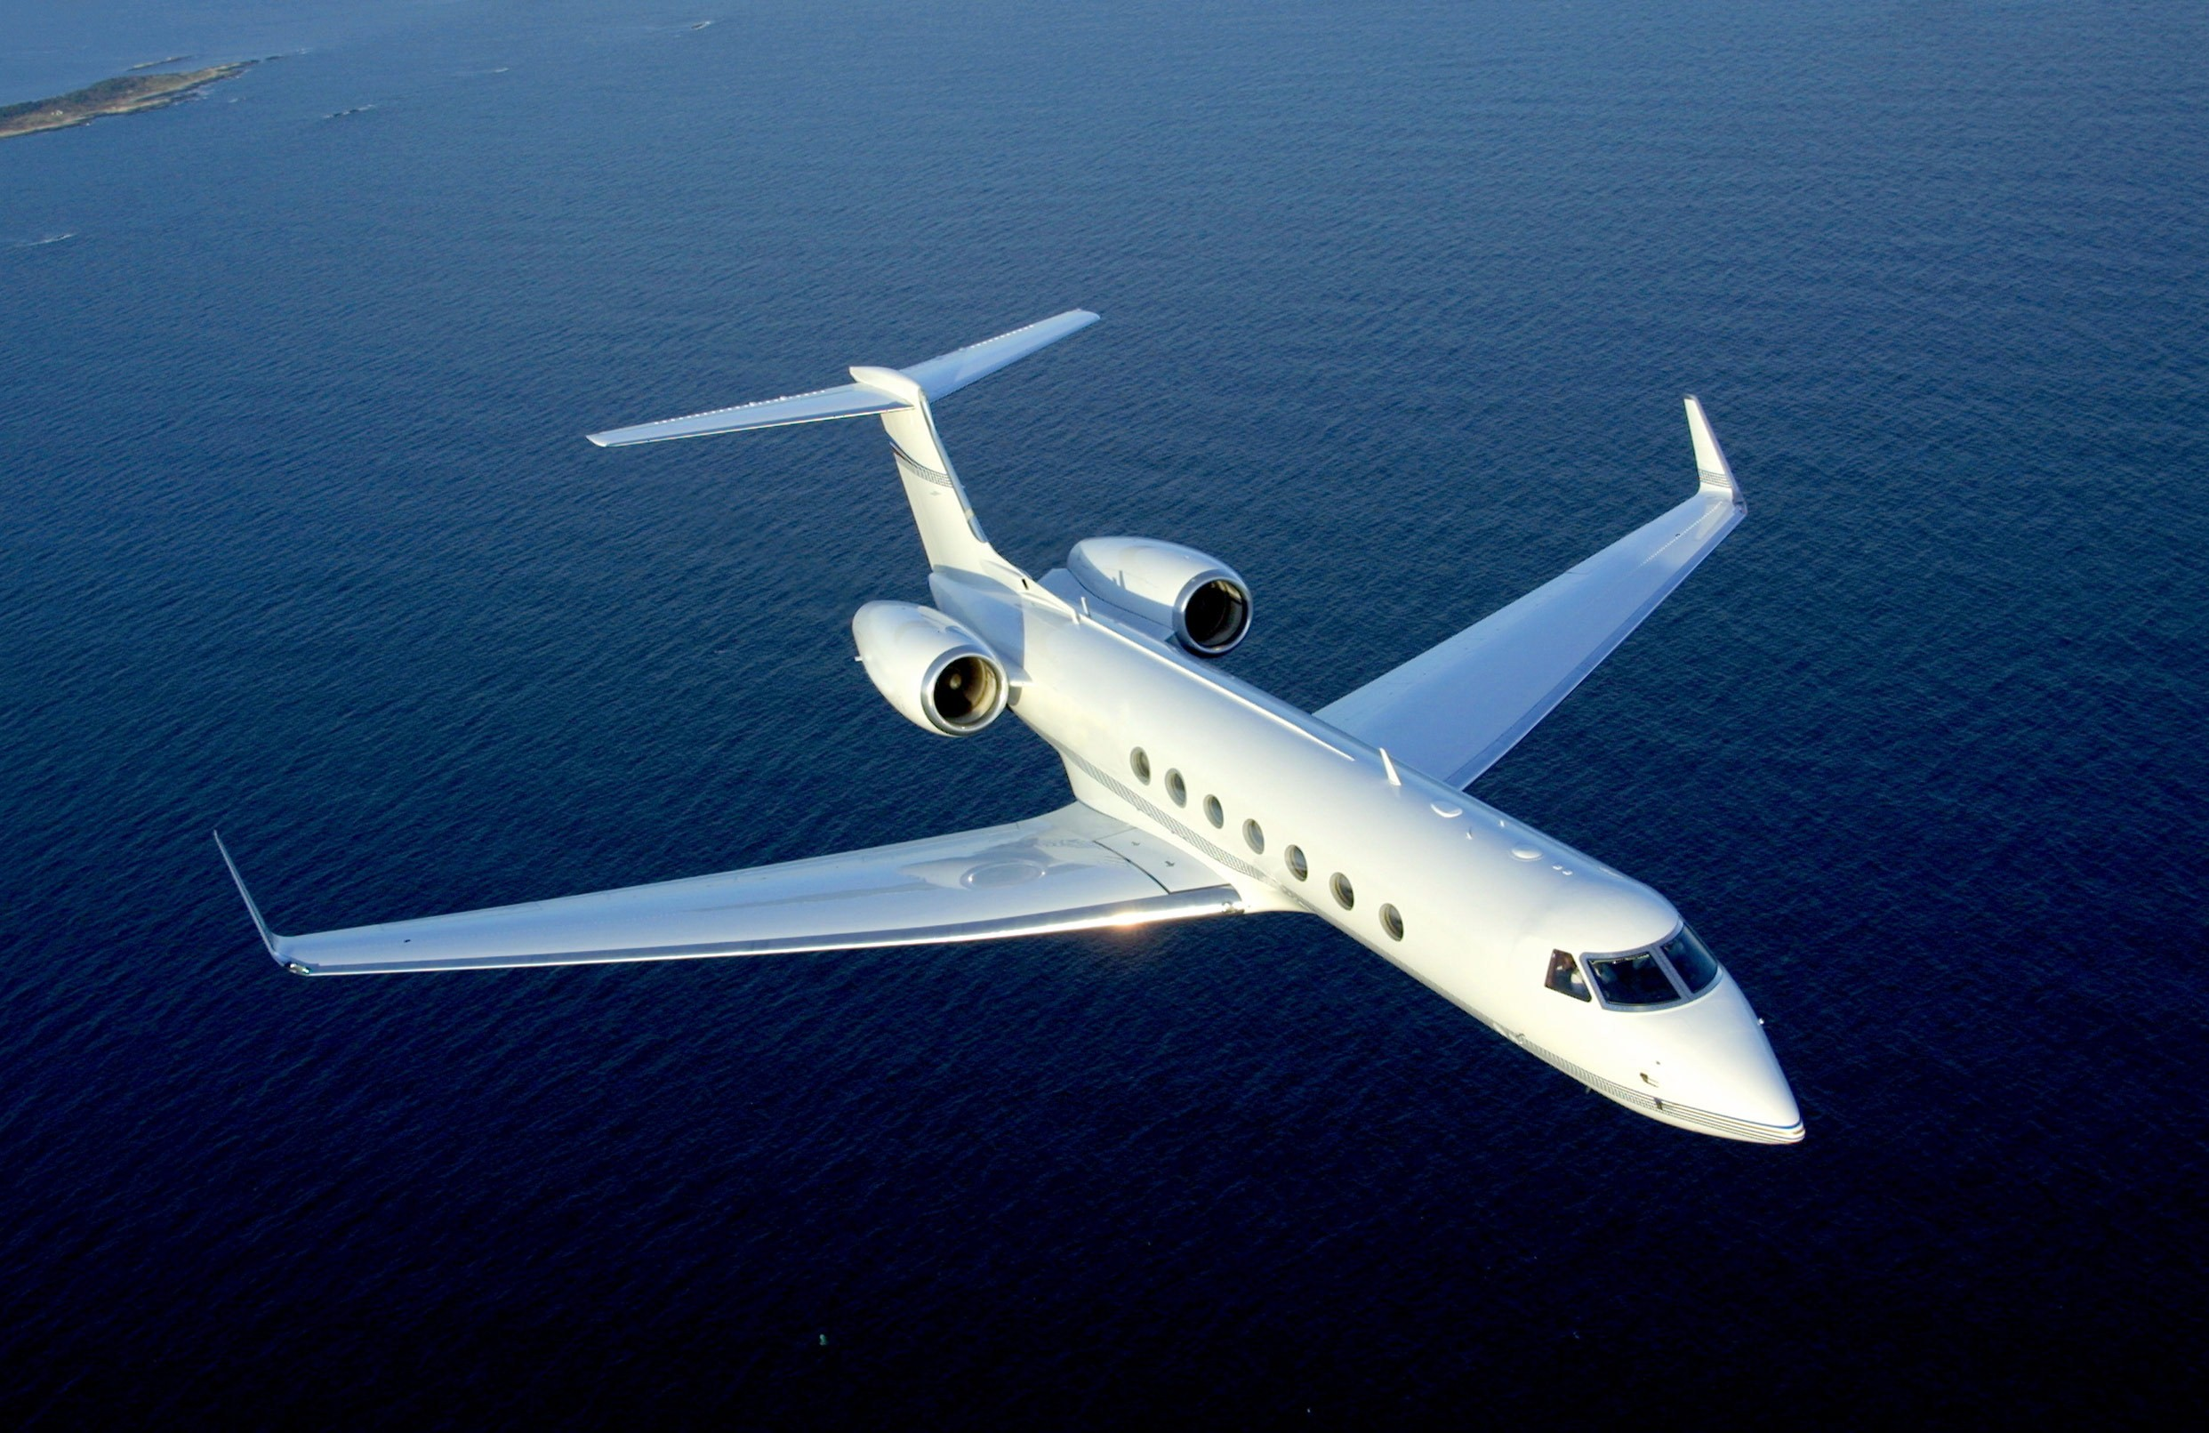

Slide 21
On your own, fill out the 3 columns on your worksheet. Then share a few items with people sitting near you.

Slide 22

9th & 10th Commandments
You shall not covet…

Slide 23
Small Catechism (pgs. 89)
What is the main difference between both commandments?
  The 9th Comm. deals with what your neighbor owns.
  The 10th Comm. deals with the people that help your neighbor: wife, servant, etc…
What does God require of us in both of these commandments?
  Be content.

Slide 24
Matthew 6:19-34
What does Jesus mean in verse 21?
Is Jesus saying we should never invest in possessions? Why or why not?
Is He saying we shouldn’t take care of ourselves?
What does Jesus say about worrying?

Slide 25
Coveting = Worrying =
Not trusting God

Slide 26
The Close of the Commandments
(Small Catechism pg. 93)

Slide 27
Next Class:
  NO CLASS & NO HOMEWORK next Sunday! (You’re welcome!) You’re invited to our combined worship at 9:30am as we celebrate our 9th grade Confirmands!
  NO CLASS on Oct. 26 for a church-wide service project.
  Our next class will be Nov. 2 (no homework!)

Slide 28

Reminders
Total of 15 Sermon Notes due May 1st
Total of 15 Service Hours due May 1st -Fill out Report & have it signed
  -Turn in to the blue box on the Usher Shelf

Slide 29
Announcements
Sunday Night FLY is TONIGHT @ 7pm
  "200th Sunday Night FLY!”
  We’re going to have a GLOW dance party!
  AND play GLOW games!
  Plus, there will be lots of snacks & fun!
  Invite your friends!

Slide 30
Closing Prayer

Slide 31
Have a wonderful week! Go in peace and serve the Lord!

