Slide 1

WELCOME!
Please check-in & sit at a table

Slide 2

Opening Prayer

Slide 3

Quiz Show!

Slide 4

1. Which of the following should be worshipped?
a. Good grades
b. Musical ability
c. Athletes
d. God
←

Slide 5
2. When God says, “I am the Lord your God…you shall have no other gods before me,” it means God wants which of the following from you?
a. Love
b. Respect
c. Trust
d. All of the above!
←

Slide 6
3. Which of the following are names that God is known by?
a. Father
b. Yahweh
c. Abba
d. All of the above
←

Slide 7
4. Know that quote! This is who said, “We are to fear and love God so that we do not use his name superstitiously, or use it to curse, swear, lie, or deceive, but call on him in prayer, praise, and thanksgiving.”
a. Jesus
b. Pastor Peter
c. Martin Luther
d. Moses
←

Slide 8
5. The sabbath was created because…
a. everyone needs a break now and then.
b. God likes to spend time with us.
c. making time to worship God is a good thing.
d. all of the above.
←

Slide 9
6. The Israelites have always worshipped only one god.
True
False
←

Slide 10
7. It’s okay to worship other gods as long as you know which god is the head honcho and deserves the most respect and praise.
True
False
←

Slide 11
Sermon Notes
The main points need to be specific.
  Why? Who? What?
How does the sermon or text apply to my life?

Slide 12
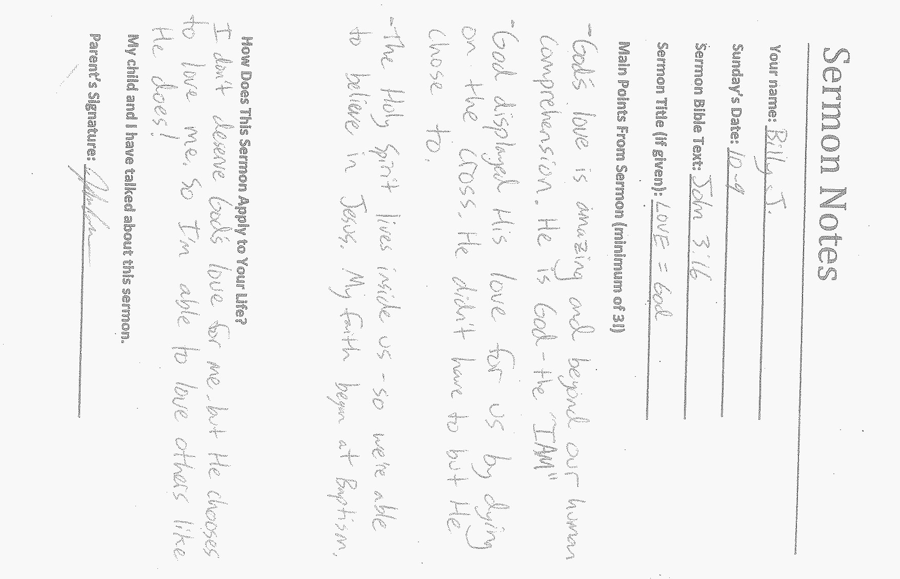

Slide 13

Memory Work
Confirmands should write down their memory work on a piece of paper and hand in to Mark.
Students should define the Key Words when Memory Work is completed.

Slide 14
Today’s Lesson
The 10 Commandments – Part 2
Key Words: Honor, Nurture, Adultery
At your table, share how you rested in God’s presence this past week.

Slide 15
Key Words
HONOR:
High respect for someone.
NURTURE:
To care for and/or provide for the needs of somebody or something.
ADULTERY:
Sexual thoughts and actions outside of marriage.

Slide 16
4th Commandment:
Honor your father and mother.

Slide 17
Small Catechism (pgs. 74-76)
Work with a partner to answer the 4 questions on your student worksheet.
Who should we honor?
  Parents and all authorities.
What does God forbid us to do?
  Despise our parents and other authorities…

Slide 18
Small Catechism (pgs. 74-76)
In Col. 3:20, should we obey our parents a few times?
  No, ALL the time!
What promise does God attach to this commandment?
  “That it may go well with you and that you may enjoy long life on the earth,” (Eph. 6:3).

Slide 19
5th Commandment:
You shall not murder.

Slide 20
Matthew 5:21-22
Is Jesus talking about murder being only a physical thing?
  No! You can murder someone with your words, too.
  At your table, brainstorm a list on your worksheets of how we murder people emotionally and spiritually.

Slide 21
6th Commandment:
You shall not commit adultery.

Slide 22
Today’s culture…
In today’s culture, we see sexual things everywhere.
On the back of your worksheet, come up with a list of where you’ve noticed sexual things in our culture.

Slide 23
Small Catechism (pgs. 81-85)
Read through the questions and answers as a class.
Do you have any other questions?

Slide 24
John 8:1-11
How does this Bible story show Jesus’ forgiveness?
If you haven’t treated your sexuality as a gift from God, there is forgiveness and grace. God has forgiven you and has created sex to be a gift within marriage.
You can always talk to Pastor Peter if you have any questions about anything. :)

Slide 25
For Next Sunday:
  Memorize: The 7th & 8th Commandments & their Meanings (SC pg. 13)

Slide 26
Announcements
Sunday Night FLY REMIX – TONIGHT @ 7pm
  YOU choose the lesson and game!
  Plus: worship, prizes, games & more in our FLY Room!
  Open to ALL youth & their friends!
  2nd & 4th Sundays through June!
Jr. FLY Fall Retreat – Oct. 3-5, 2025
  Camp Stella Maris Wegman House!
  Outdoor games, Bible sessions, food & more!
  Register online at: https://faithpenfield.org/resources-forms/
  $160 deposit & registration due by Sunday, Sept. 28!
  Financial assistance is available upon request

Slide 27


Slide 28
Closing Prayer

Slide 29
Have a wonderful week! Go in peace and serve the Lord!

