Slide 1

May 4, 2025
May the Fourth be with you!

Slide 2
Welcome
&
Opening Prayer

Slide 3
QUIZ
(on Chapter 28)

Slide 4
1. Who authored the Book of Acts?
Paul
Acts
Luke
John

Slide 5
2. Jesus ascended to Heaven ___ days after his resurrection.
3
7
40
50

Slide 6
3. 50 days after Passover, the disciples celebrated the Jewish festival of:
Hannukah
Pentecost
Booths
None of the above

Slide 7
4. Who arrived on Pentecost?
God the Father
God the Son
God the Holy Spirit
Saul

Slide 8
5. The early church devoted themselves to:
Apostles’ teaching
Fellowship
Breaking of Bread
All of the above

Slide 9
6. Who was the first follower of Jesus to be stoned to death?
James
Peter
John
Stephen

Slide 10
7. Jesus appeared to _____ on the road to Damascus.
Saul
Cornelius
Peter
Stephen

Slide 11
8. Who converted Saul?
Jesus
Ananias
Peter
Cornelius

Slide 12
9. This man was the first Gentile convert to Christianity.
Saul
Cornelius
Peter
Stephen

Slide 13
This Week’s
Memory Work:
Romans 6:23

Slide 14
Romans 6:23 Image
YOU
GOD
wages
gift
sin
God
death
eternal life

Slide 15
Chapter 29

Slide 16


Slide 17
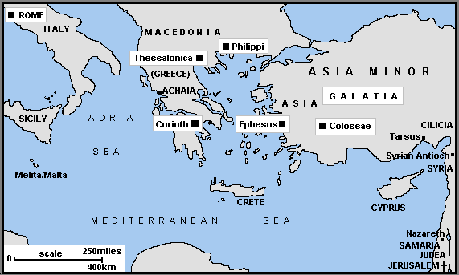

Slide 18
Paul’s Letters:
Romans
1 & 2 Corinthians
Galatians
Ephesians
Philippians
Colossians
1 & 2 Thessalonians
1 & 2 Timothy
Titus
Philemon

Slide 19
In your group…
Grab a Study Bible packet.
Pastor Peter will assign your group one of Paul’s letters.
Read background information about it in the packet.
Answer questions on your Chapter 29 worksheet.
When you’re done and waiting for other classmates to finish, you can work on your test study guide.
Then each person will present info about their letter to the class.

Slide 20
Group Presentations

Slide 21
Chapter 30

Slide 22
Chapter 30 Discussion Questions

Slide 23
How was Paul able to endure the pain and trials that he suffered for his beliefs?

Slide 24
What can you learn from Paul’s life about how to face difficult circumstances?

Slide 25
Why was Paul willing to walk into the face of danger?

Slide 26
How would you sum up Paul’s message?

Slide 27

Thank you to everyone who helped with our Cinnamon Roll Sale last Sunday!

Slide 28
15 Sermon Notes & 15 Service Hours
were DUE by May 1st!

Slide 29
Upcoming Confirmation Classes
-May 11 - Read Chapter 31 & Memorize Eph. 2:8-9
  *Kahoot Review Game
-May 18 - Final Test
-May 25-June 1 - Jr./Sr. FLY Class in the FLY Room

Slide 30
Speaking of the test…
The Study Guide is available! Use it!
The test will be on Sun, May 18.
The test will include material from Lessons 1-31.
The test will have:
    -Matching
    -True/False
    -Multiple Choice
    -Fill in the blank
    -Short Answer
    -3 paragraph essay

Slide 31
Closing Prayers

