Slide 1

Welcome
Jr. FLY Confirmands!
Apr. 13, 2025

Slide 2
Welcome
&
Opening Prayer

Slide 3
QUIZ
(on Chapter 26)

Slide 4
1. What Jewish holiday were the disciples and Jesus celebrating during the “Last Supper?”
Hanukkah
Passover
Festival of Booths
Communion

Slide 5
2. What happened next? During the Last Supper, Jesus wrapped a towel around his waist and…
Broke bread
Told Judas he’d betray him
Told Peter he’d betray him
Washed his disciples feet

Slide 6
3. In Communion, bread and wine _______ the body and blood of Jesus.
Is
Represents
Symbolizes
Isn’t

Slide 7
4. True/False: The disciples fell asleep while Jesus was praying.
TRUE
FALSE

Slide 8
5. The chief priests and elders handed Jesus over to _________.
Judas
Peter
Pilate
Cyrus

Slide 9
6. Jesus’ last words before dying were:
“Father, forgive them.”
“My God, my God, why have you forsaken me?”
“You will be with me today in paradise.”
“It is finished.”

Slide 10
Who can recite this week’s Memory Work?
Matthew 28:19-20

Slide 11
Matthew 28:19-20 Notes
Jesus is speaking to his disciples before ascending into Heaven.
The Great Commission
  Christ gives us a mission to “go and make disciples of all nations!”
  How are we going to do that?
  “Baptizing & teaching”
  So we baptize and teach others about Christ!
  “I am with you always”
    Christ’s promise to you and me!

Slide 12


Slide 13
See the Story
Draw a simple image or symbol that best represents Ch. 27.

Slide 14
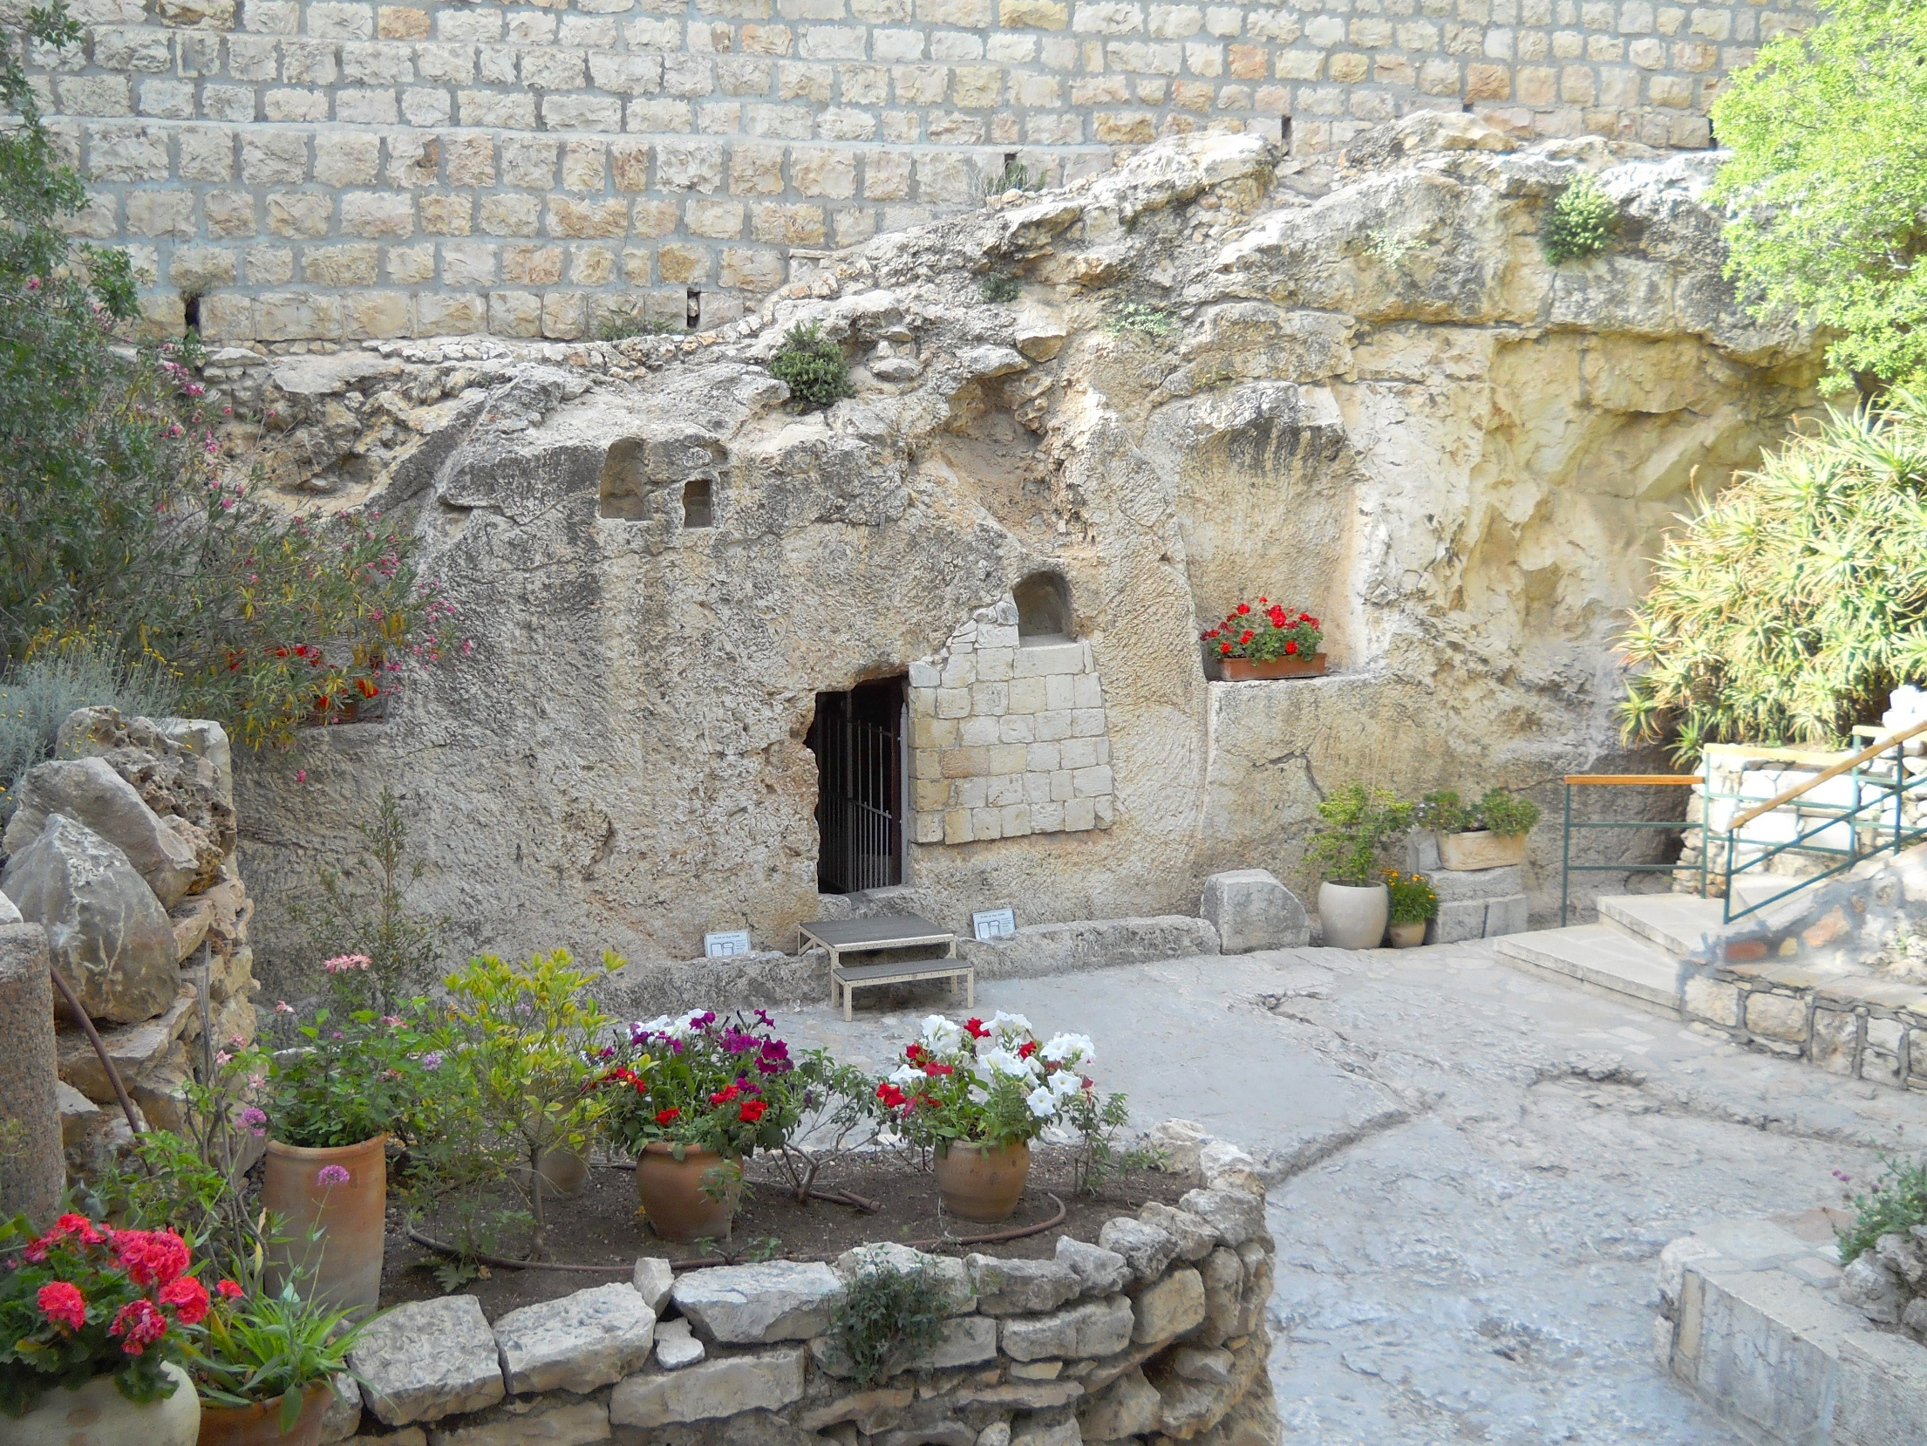

Slide 15
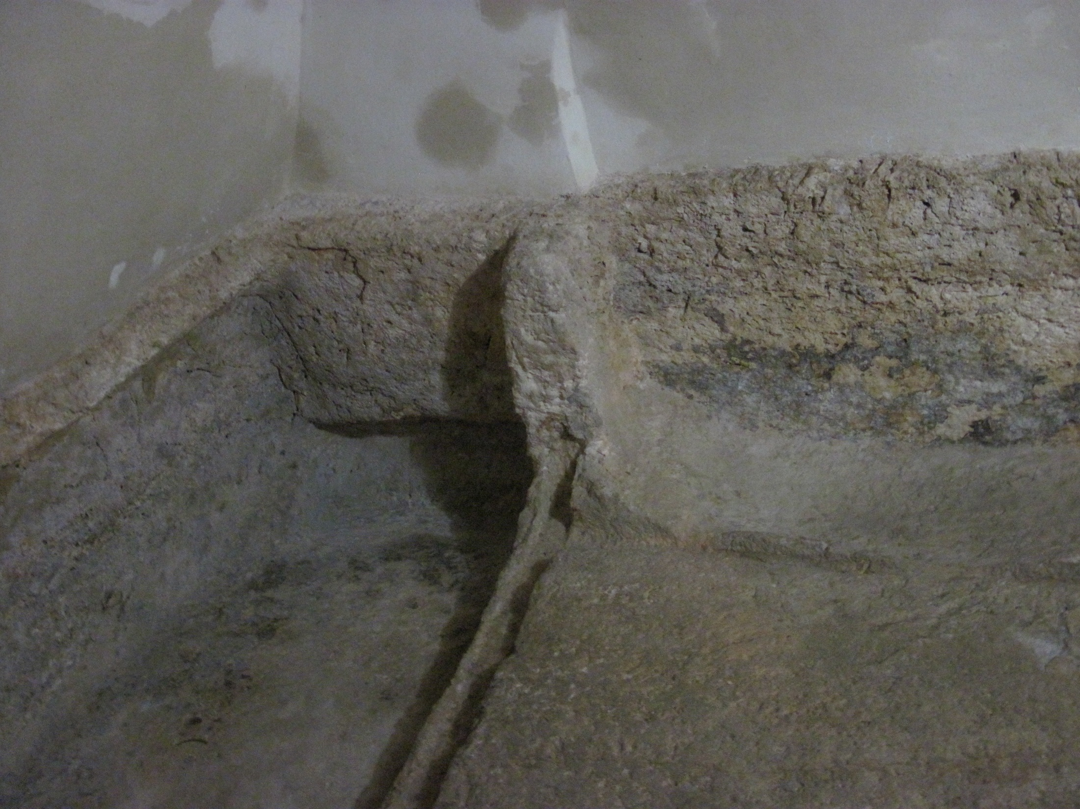

Slide 16
Significant Names & Events from Chapter 27
Joseph of Arimathea
Securing Jesus’ tomb
Women went to tomb first
Jesus appeared to Mary
Peter and John ran to tomb
On the road to Emmaus
Appearances to disciples
“Feed my sheep”
Ascension to Heaven

Slide 17
Chapter 27 Notes
Road to Emmaus
  2 disciples un-knowingly meet Jesus
  They tell him of the events from Jerusalem
  “And beginning with Moses and all the Prophets, he explained to them what was said in all the Scriptures concerning himself,” (pg. 385).
    Jesus shared the Upper Story to these disciples!
  Jesus had Communion with them and then disappeared!

Slide 18
Chapter 27 Notes
Jesus appeared to his disciples
  They touched his hands and side
  Doubting Thomas
  “Blessed are those who have not seen and yet have believed,” (pg. 386). That’s us!!
  Cooked fish and ate bread with his disciples along the shore in Galilee
    Jesus has a physical resurrected body
  Told Peter to feed his sheep and follow him
  Great Commission

Slide 19
The Story is for YOU!
“But these are written that you may believe that Jesus is the Messiah, the Son of God, and that by believing you may have life in his name,” John 20:31.

Slide 20


Slide 21
See the Story
Draw a simple image or symbol that best represents Ch. 28.

Slide 22
Chapter 28 Notes
Book of Acts
  Dr. Luke’s sequel to his Gospel of Luke
  Follows the growth of the early church & adventures of the first missionaries
“You will be my witnesses in Jerusalem, and in all Judea and Samaria, and to the ends of the earth.”
  The Gospel is spreading geographically
Jesus’ ascension – 40 days after his resurrection
  Promised to come back the same way he ascended.
  We wait for Christ’s return!
  He also promised the Holy Spirit.

Slide 23
Chapter 28 Notes
Pentecost
  A Jewish festival celebrated 50 days after Passover.
  Jesus’ disciples were celebrating this festival in Jerusalem together.
  Thousands of Jews from other countries also celebrated in Jerusalem.
  Read pgs. 390-391
  The disciples were filled with the Holy Spirit!
  Spread the news of Jesus in foreign languages.
    Why is this so important?
  Peter gave the first sermon after Jesus
    “Everyone who calls on the name of the Lord will be saved!”
    3,000 people were saved that day!

Slide 24
Chapter 28 Notes
The early church devoted themselves to:
  Apostles’ teaching
  Fellowship
  Breaking of bread
  Prayer
Apostles performed miracles in Jesus’ name
Christians sold possessions and gave to the poor
Peter & John were arrested for healing in Jesus’ name and were released after telling others to follow Jesus.
The apostles were jailed but an angel opened the doors!

Slide 25
Chapter 28 Notes
Stephen
  Full of the Holy Spirit
  Debated Jewish leaders & they couldn’t win
  Members of the Sanhedrin stoned him to death as Stephen said, “Lord, don’t hold this sin against them.”
Saul
  Pharisee & Roman citizen
  Well educated man & knowledgable
  Also a tent-maker
  Persecuted Christians
    Also known as “The Way”

Slide 26
Chapter 28 Notes
Saul to Paul
  Traveling to Damascus to persecute more Christians
  Jesus appears to him on the road!
  Was blinded for 3 days
  Ananias baptized him and Saul began to preach the Gospel of Jesus Christ!
Cornelius the Centurion
  He was a Roman and wasn’t Jewish (aka Gentile)
  He and his family followed Jesus
  Peter baptized them
  The first time Gentiles were welcomed into God’s family!

Slide 27
Chapter 28 Notes
Peter’s arrest
  Herod Agrippa I arrested him after James was killed
  An angel led Peter out of the prison unharmed
  Herod later was struck down by an angel because “Herod did not give praise to God.”
  The church continued to grow.
Saul & his mentor Barnabas started to minister to people in Antioch – where the believers were first called “Christians.”
Saul’s name changed to Paul during this time.

Slide 28
Under “Join the Story…” on the Chapter 28 worksheet
Answer: What’s happened in your life that caused you to view God in a brand-new way?
Answer: How did this story challenge or inspire you to live differently?

Slide 29
Is the Holy Spirit still at work in the world today?
How have you experienced it or seen it at work?

Slide 30
How would you describe this first “church” of Jesus followers?

Slide 31
Why do you think the message of Jesus Christ spread quickly?

Slide 32
Why do you think the religious leaders disliked the early Christians?

Slide 33
Questions?

Slide 34
Upcoming Confirmation Classes
-Apr. 20 - EASTER! (no class)
-Apr. 27 - Church-wide Service Project (no class)
-May 4 - Read Chapters 29 & 30 and Memorize Romans 6:23
-May 11 - Read Chapter 31 & Memorize Eph. 2:8-9
  *Kahoot Review Game
-May 18 - Final Test
-May 25-June 1 - Jr./Sr. FLY Class in the FLY Room

Slide 35
Speaking of the test…
The Study Guide is available! Use it!
The test will be on Sun, May 18.
The test will include material from Lessons 1-31.
The test will have:
    -Matching
    -True/False
    -Multiple Choice
    -Fill in the blank
    -Short Answer
    -3 paragraph essay

Slide 36

Sign-up to help with our Cinnamon Roll FUNdraiser on Sunday, Apr. 27!
15 Sermon Notes & 15 Service Hours
are DUE by May 1st!

Slide 37


Slide 38
Closing Prayers

