Slide 1

Welcome
Jr. FLY Confirmands!
Apr. 6, 2025

Slide 2
Welcome
&
Opening Prayer

Slide 3
QUIZ
(on Chapter 25)

Slide 4
1. Jesus’ transfiguration:
Was similar to God revealing himself to Moses.
Revealed his true identity to his disciples.
Teaches us that the God of Sinai is visibly present in Jesus Christ.
All of the above.

Slide 5
2. The Jews expected the coming Messiah to:
Battle their Roman occupiers.
Be their new earthly king.
Begin a time of everlasting peace.
All of the above.

Slide 6
3. Jesus _____ when he heard ________ had died.
Wept, John
Celebrated, Joseph
Wept, Lazarus
Slept, John

Slide 7
4. Jesus travelled to _______ to celebrate _______.
Jerusalem, Passover
Bethlehem, Lord’s Supper
Nazareth, Passover
Bethany, Christmas

Slide 8
5. “Hosanna” means:
Amen
Save
Emmanuel
None of the above

Slide 9
6. Why did Jesus clear out the Temple courts?
To sacrifice a lamb
To celebrate Passover
People were robbing others
People were worshiping a golden calf

Slide 10
This Week’s
Memory Work:
John 14:6

Slide 11
John 14:6 Notes
Jesus is speaking to his disciples
“I am”
  Another “I am” statement of identity from Jesus
“The Way”
  The way to God.
  Jesus is not one of many ways to God. There is only ONE WAY = Jesus Christ!
  In the early Church, Christianity was sometimes called “The Way”
“The Truth”
  Not worldly lies, but heavenly Truth
“The Life”
  Eternal life is a gift through Jesus!

Slide 12


Slide 13
On your worksheet…
Under “See the Story,” create a simple image or symbol that you think best represents
Chapter 26.

Slide 14
Chapter 26 Notes
Passover meal
  Jesus washed his disciples feet. Why?
  “Wash one another’s feet. I have set you an example.”
    Serve & love your neighbors!
  Judas leaves the table (is about to betray Jesus)
  Jesus institutes a New Covenant
    Bread = Christ’s body
    Wine = Christ’s blood
    Broken & shed for us for the forgiveness of our sins!
  Promises to prepare rooms in heaven
  Promises to send the Holy Spirit
  Predicts betrayals

Slide 15
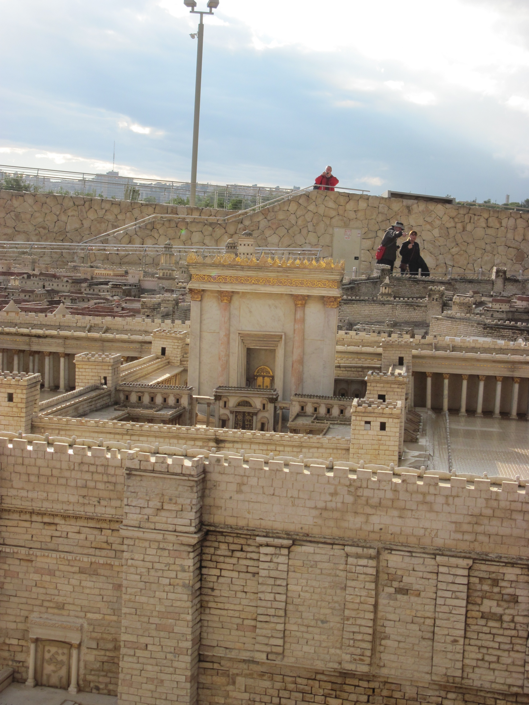

Slide 16
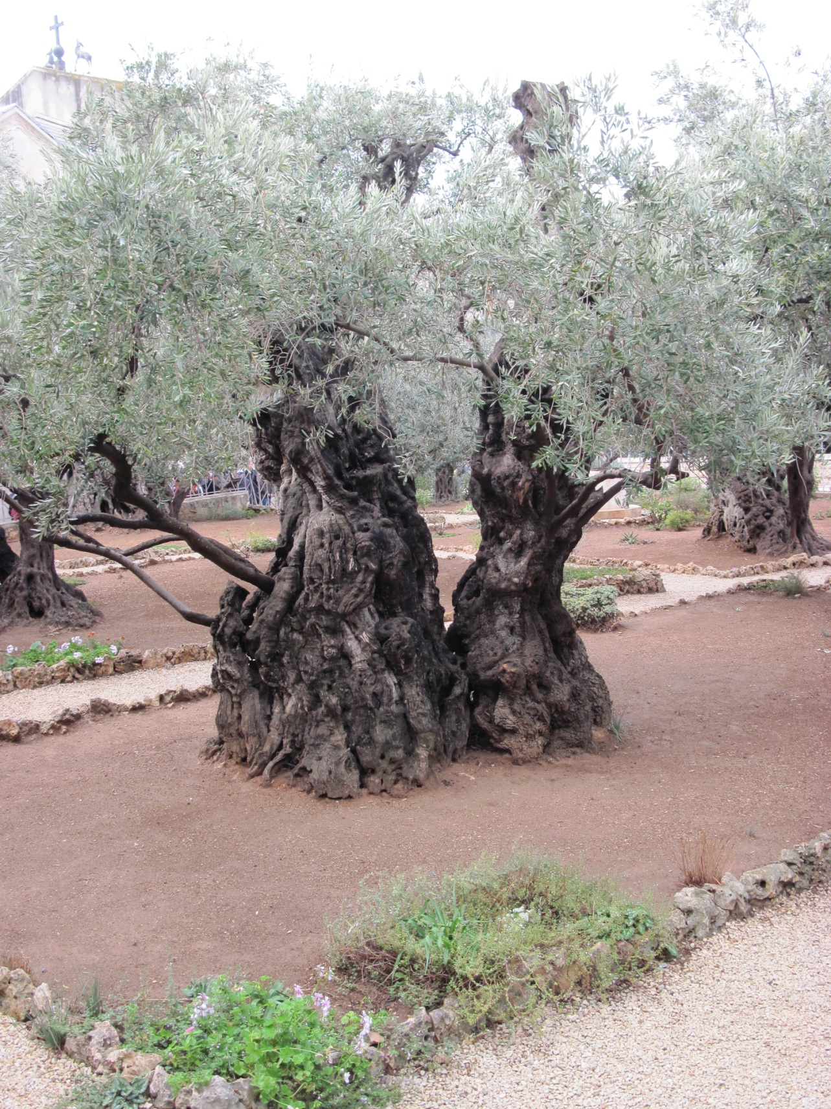

Slide 17
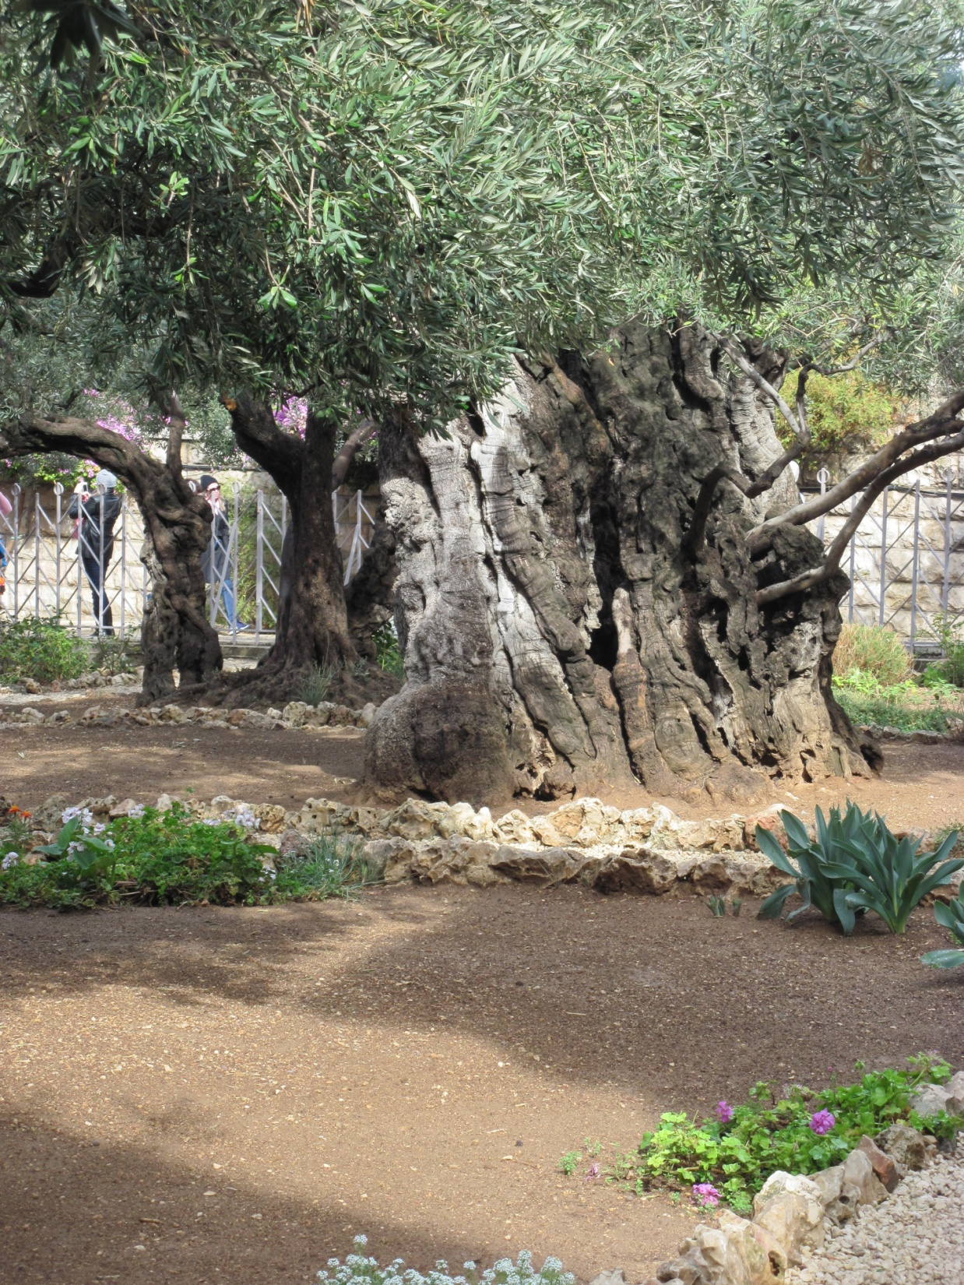


Slide 18
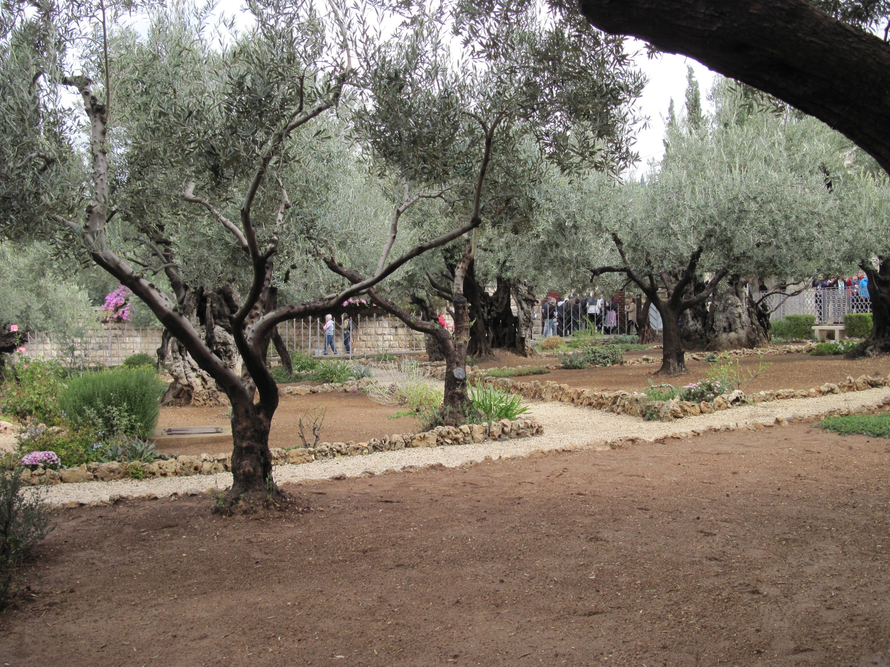

Slide 19
Chapter 26 Notes
Mount of Olives/Garden of Gethsemane
  Jesus’ prayer to his Father (pgs. 372-373)
    Cup = a symbol of deep sorrow and suffering
    Refers to his Father’s face being turned away from him when “he who had no sin was made sin” for all people.
  Disciples kept falling asleep
  Judas and armed men show up and arrest Jesus
  Peter cuts off the right ear of a high priests’ servant
    Jesus heals his ear.

Slide 20
Chapter 26 Notes
Jesus taken to Caiaphas the high priest
  Sanhedrin = Jewish chief priests, elders, and teachers
  71 members
  Under Roman jurisdiction, but couldn’t sentence people to death
Peter denied Jesus 3 times before the rooster crowed.
  How have you denied Jesus?
  We deny him every time we sin.
  Christ forgave Peter and forgives us.

Slide 21
Chapter 26 Notes
Judas felt guilty and remorseful
  Returned the 30 silver coins to the chief priests
  Hanged himself
Pontius Pilate
  Prefect of the Roman province of Judea (26-36 AD)
  If he refused to condemn Jesus, Jewish accusers would portray him as no friend of Caesar
  If he sentenced Jesus to death, he’d be going against his judicial views and cave in to the people he despise.
  He questioned Jesus himself
  “My kingdom is not of this world.”
  Sentenced Jesus to be crucified.
    Or did we??

Slide 22
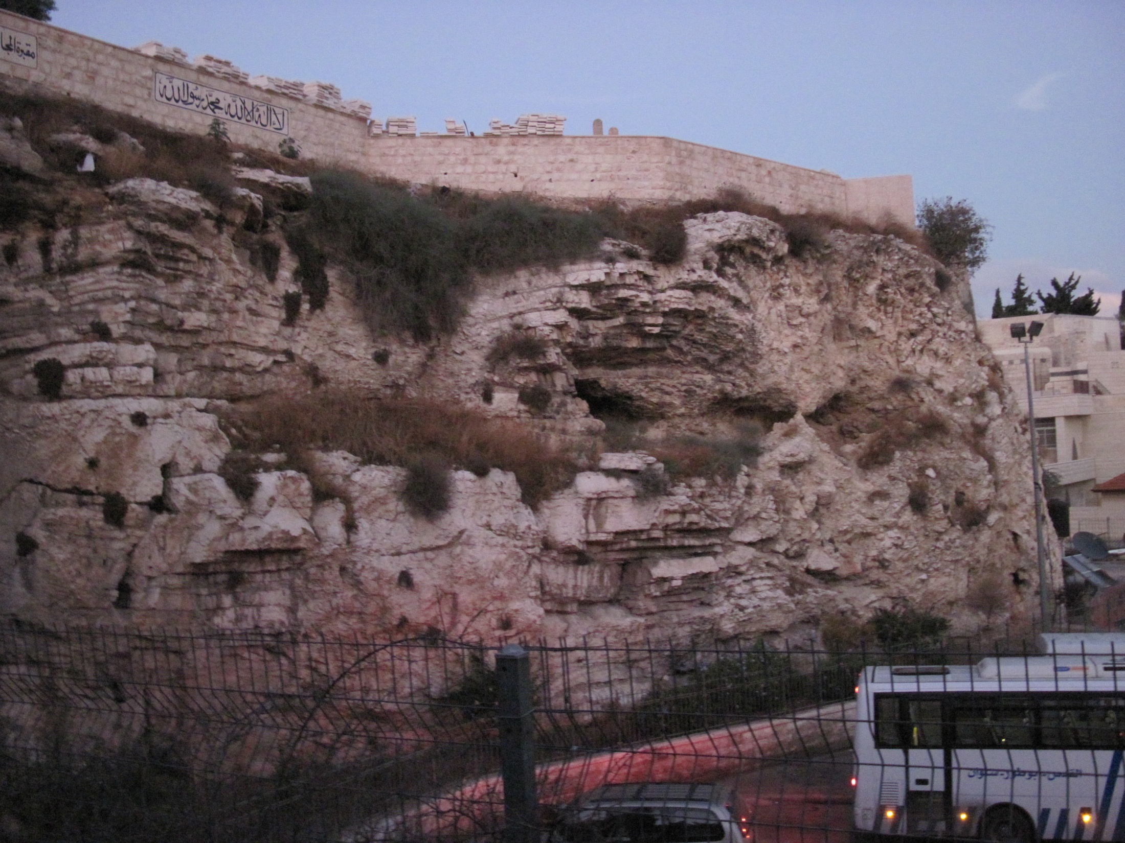

Slide 23
Chapter 26 Notes
On the cross…
  What did Jesus say while on the cross? (pg. 378)
  “Father, forgive them, for they do not know what they are doing.”
  He’s talking about the soldiers... And all people, including you and me!
  Crucified with two other criminials
  Read pgs. 379-380
What happened when Jesus died?
  Temple curtain tore in half – top to bottom!
  60’ tall x 30’ wide x 4” thick
  Symbolized Christ’s opening the way directly to God!

Slide 24
Join the Story…
Answer: “How is Jesus’ sacrifice meaningful to you?”

Slide 25
Discussion Questions

Slide 26
Why do you think the crowds turned against Jesus so quickly, when only a few days before they were praising him as he entered
Jerusalem?

Slide 27
How did Jesus’ followers respond to the tragic events? How do you think you would’ve responded?

Slide 28
What implications does Jesus’ death on the cross have for your life?

Slide 29
What do you learn about God’s love through these events?

Slide 30

Upcoming Confirmation Classes:
-Read Chs. 27 & 28 and Memorize Matt. 28:19-20 for Apr. 13
-NO CLASS on Easter Sunday (4/20)

Slide 31
Sign-up to help with our Cinnamon Roll FUNdraiser on Sunday, Apr. 27!
15 Sermon Notes & 15 Service Hours
are DUE by May 1st!

Slide 32


Slide 33
Closing Prayers

