Slide 1

Welcome
Jr. FLY Confirmands!
Mar. 30, 2025

Slide 2
Welcome
&
Opening Prayer

Slide 3
QUIZ
(on Chapter 24)

Slide 4
1. Jesus’ parables point out:
A central truth about God’s Kingdom
Jesus is the Bread of Life
John the Baptist was the last prophet
None of the above

Slide 5
2. Jesus’ Sermon on the Mount begins with:
A calling to be the salt of the world
9 Beatitudes
A calling to be the light of the world
Jesus offering his life for all people

Slide 6
3. What demon possessed animals rushed down a cliff to their deaths?
Cows
Roosters
Pigs
Donkeys

Slide 7
4. Which disciple tried to walk on water with Jesus?
Andrew
James
John
Peter

Slide 8
5. What did Jesus use to feed 5,000 men + women & children?
5 loaves of bread
2 fish
20 loaves
Both A & B

Slide 9
6. Jesus told his followers they must eat his flesh and…
Walk on water
Drink his blood
Fish in Galilee
Walk to Jerusalem

Slide 10
Memory Work:
John 11:25-26

Slide 11
This week’s video:
Jesus, the Son of God
How many Bible stories can you spot in the film?

Slide 12


Slide 13
On your worksheet…
Under “See the Story,” create a simple image or symbol that you think best represents
Chapter 25.

Slide 14
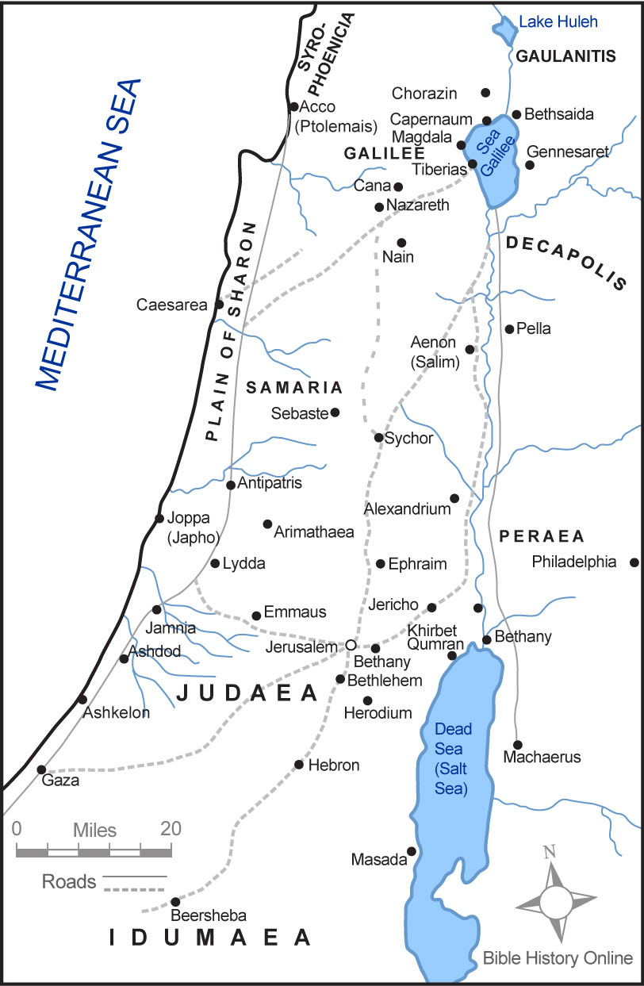

Slide 15
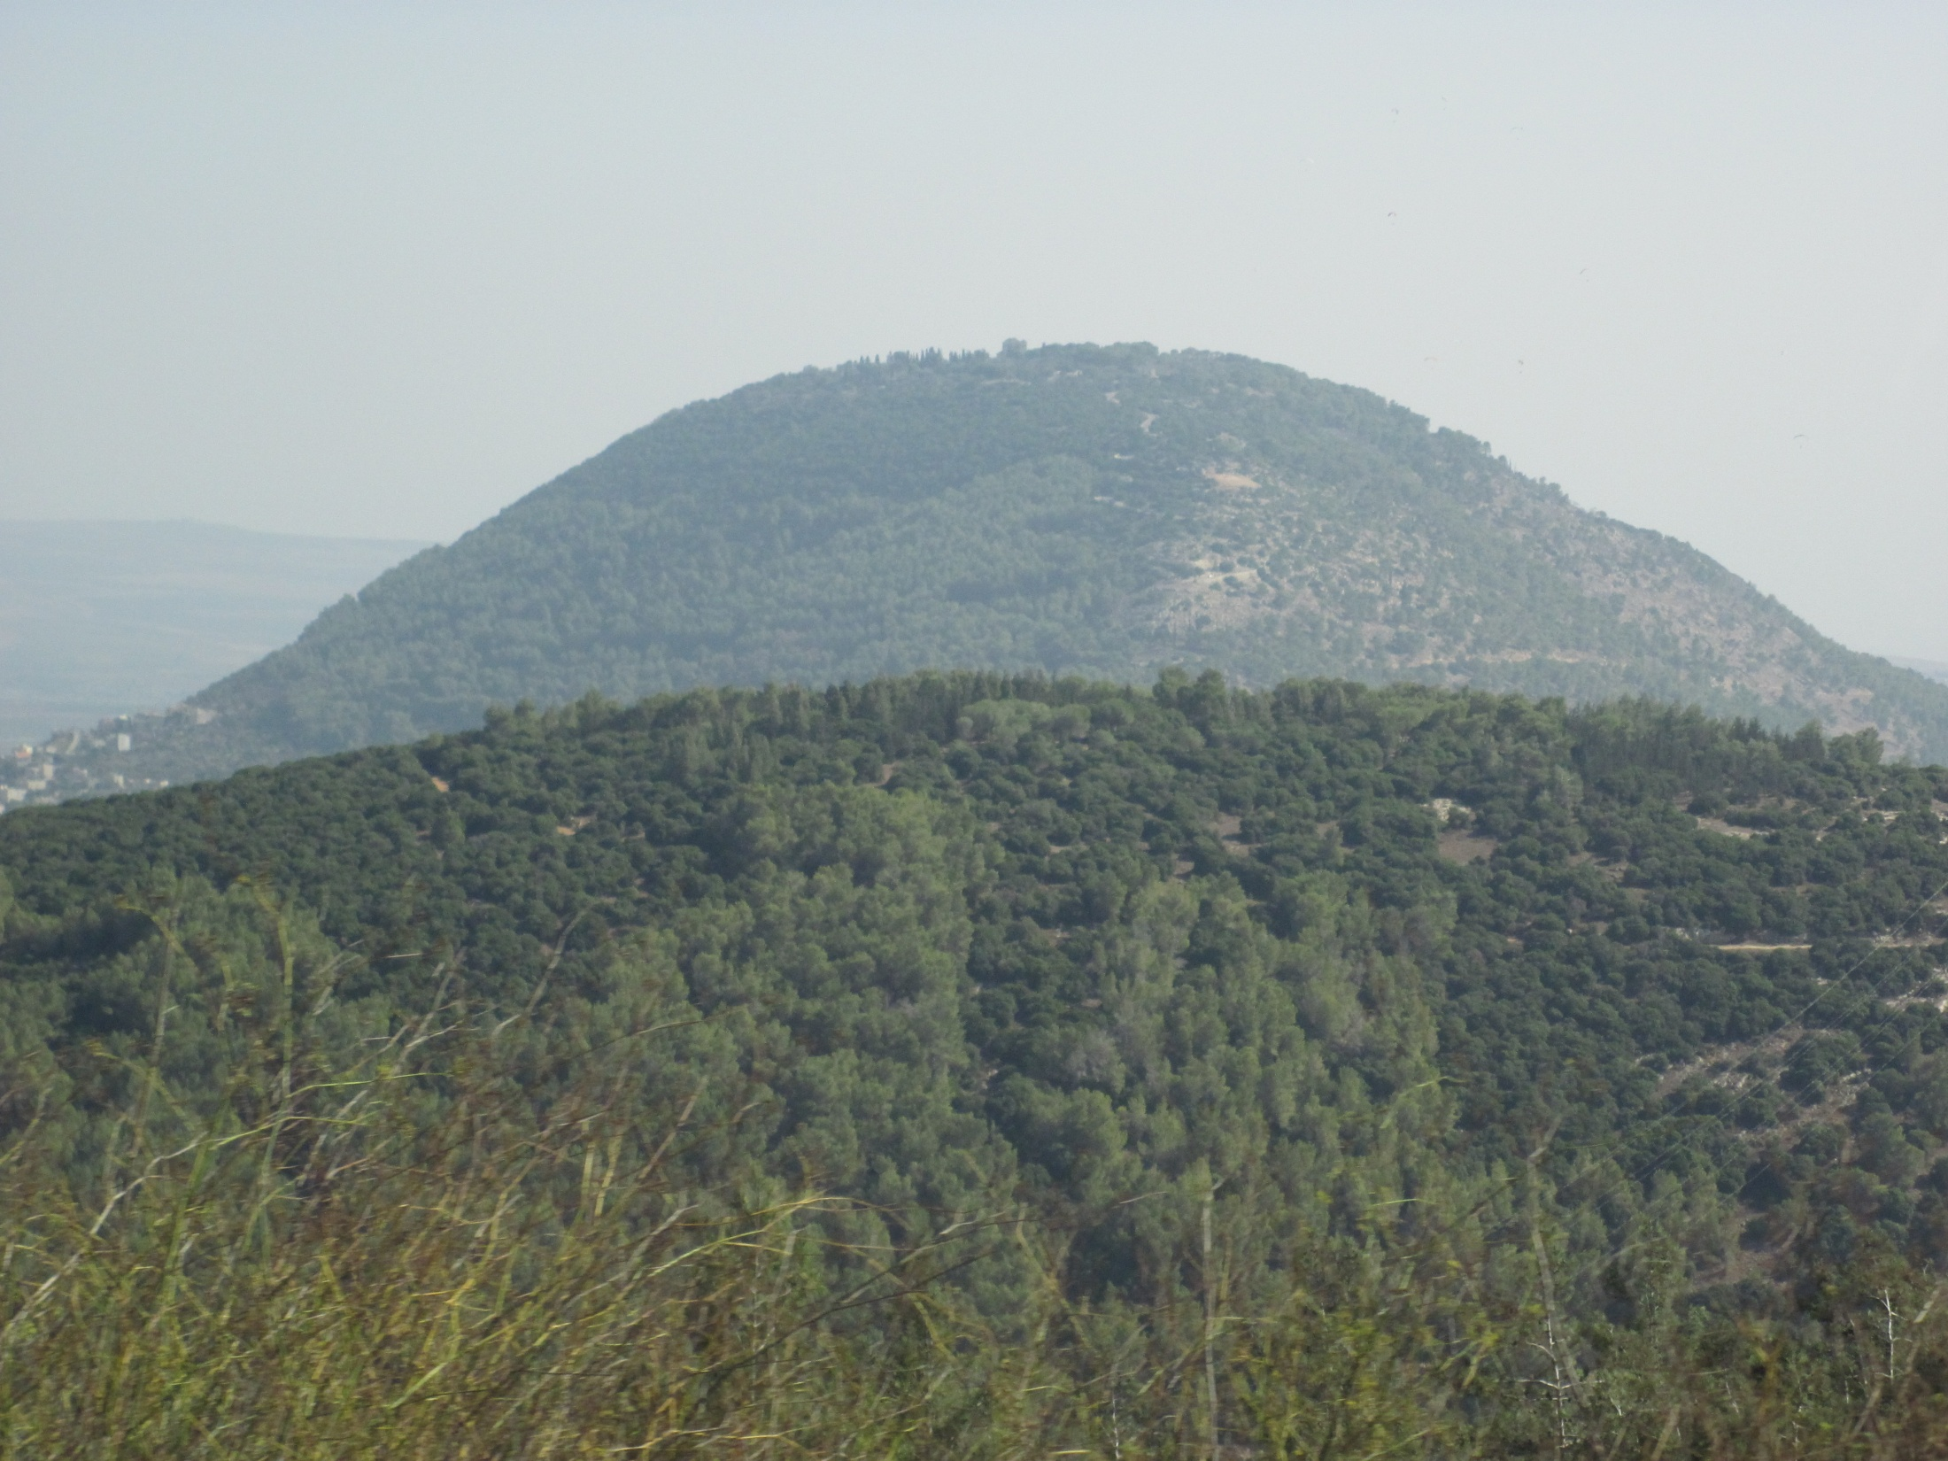
Mt. Tabor
Elevation: 1,886 ft.
Jesus’ Transfiguration

Slide 16
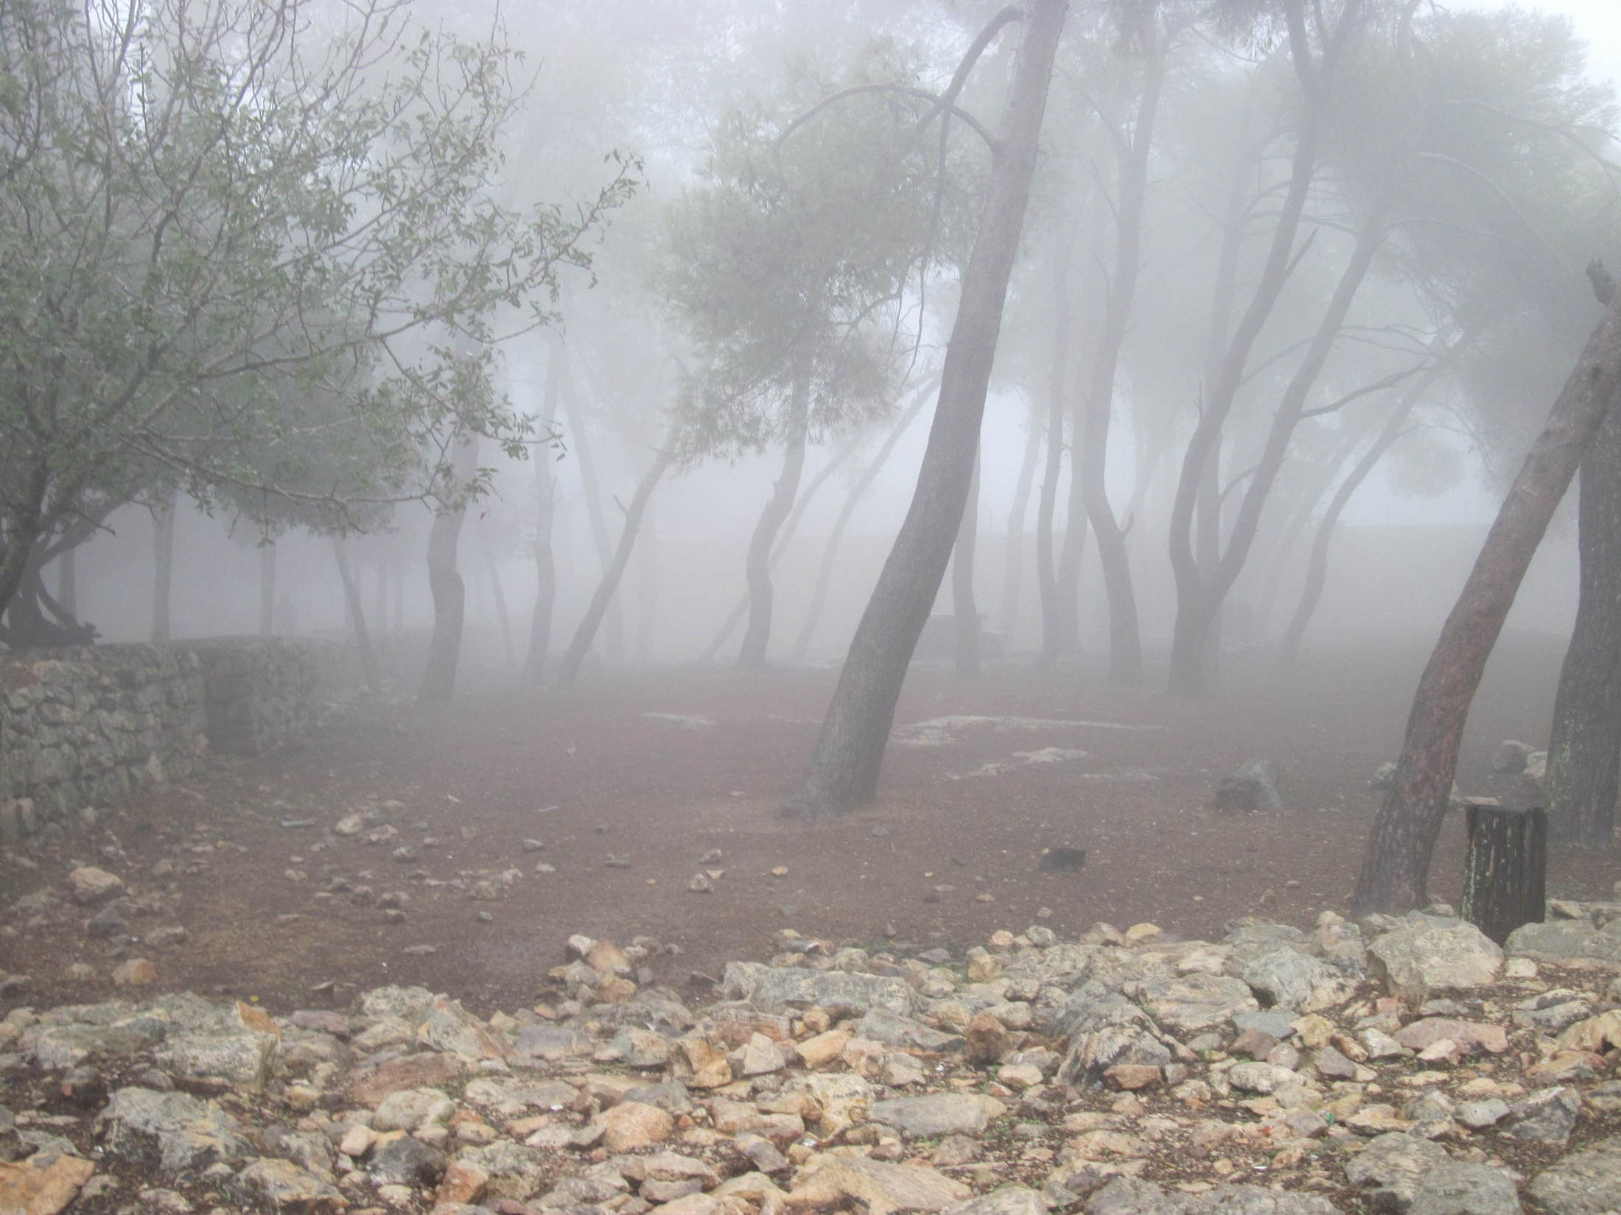
“while he was speaking, a bright cloud covered them…”

Slide 17
Chapter 25 Notes
Jesus’ Transfiguration
  Connection back to God revealing Himself to Moses at Mt. Sinai in the Old Testament
  Jesus reveals His true identity to the disciples on Mt. Tabor.
  Upper Story Connection: the God of Sinai is visibly present among His people in the person of Jesus!
  God the Father repeats His kingly coronation.
Jesus predicts His death & resurrection
  Multiple times throughout the Gospels
  Yet, the disciples didn’t understand until after His resurrection

Slide 18
Chapter 25 Notes
Jews expected the coming Messiah to:
  Battle their Roman occupiers as a warrior
  Be their new earthly king
  Start a time of everlasting and universal peace
When Jesus didn’t meet their expectations, Pharisees and other Jewish leaders considered him a dangerous and misleading teacher.
Jesus’ many claims of identity – some examples:
  From above
  Existed before Abraham
  Believers will never die

Slide 19
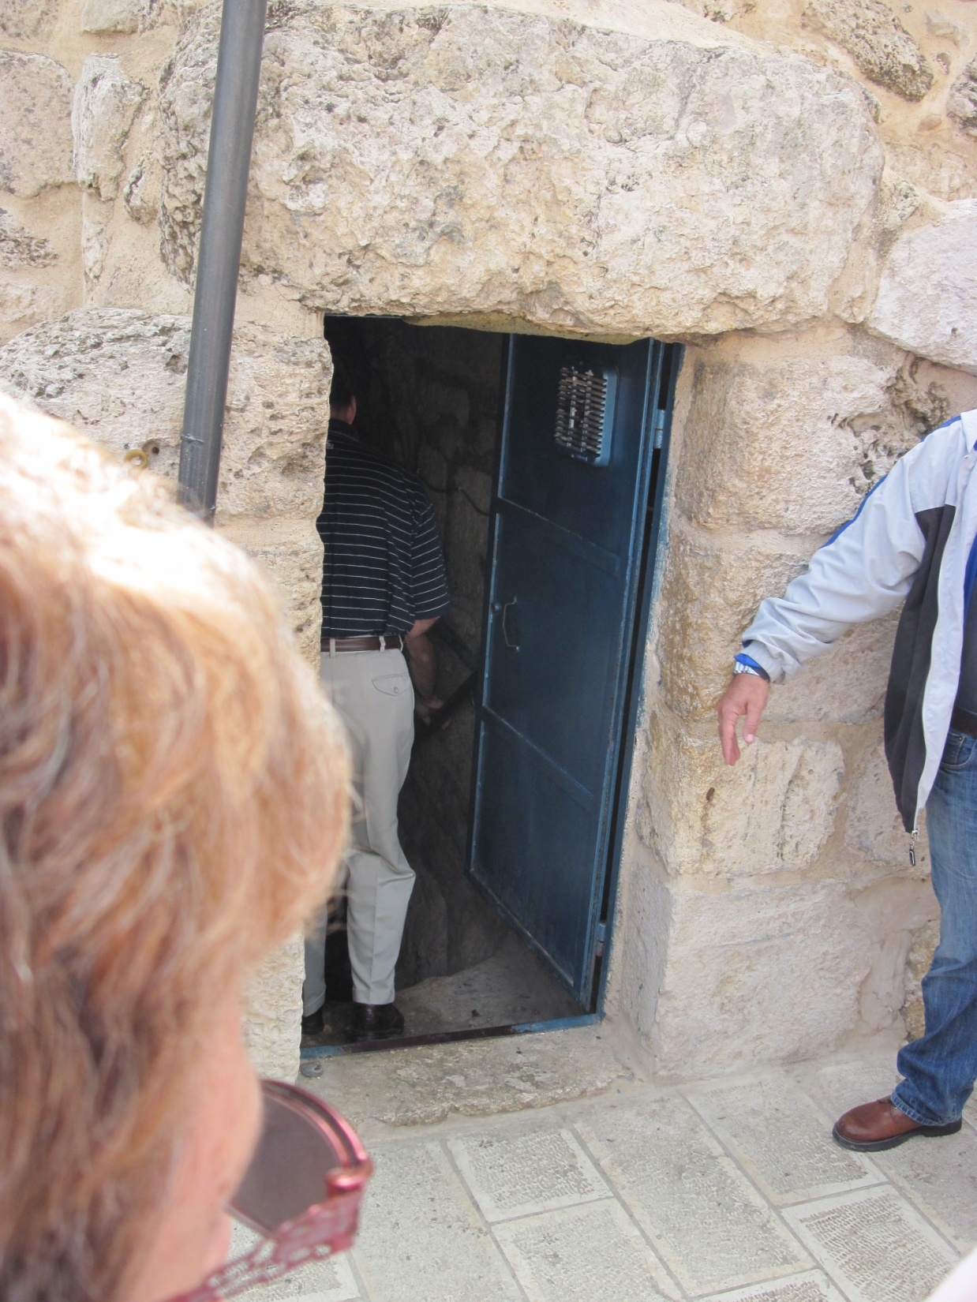
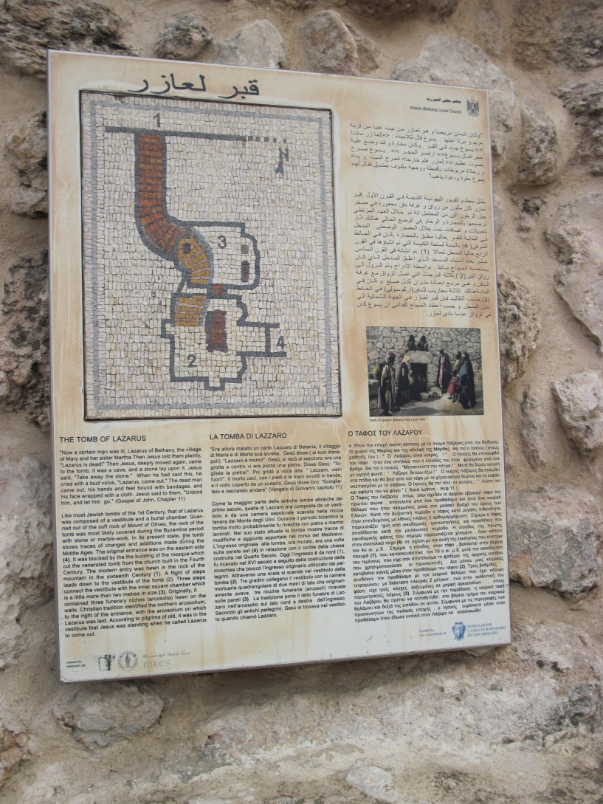
Lazarus’ Tomb

Slide 20
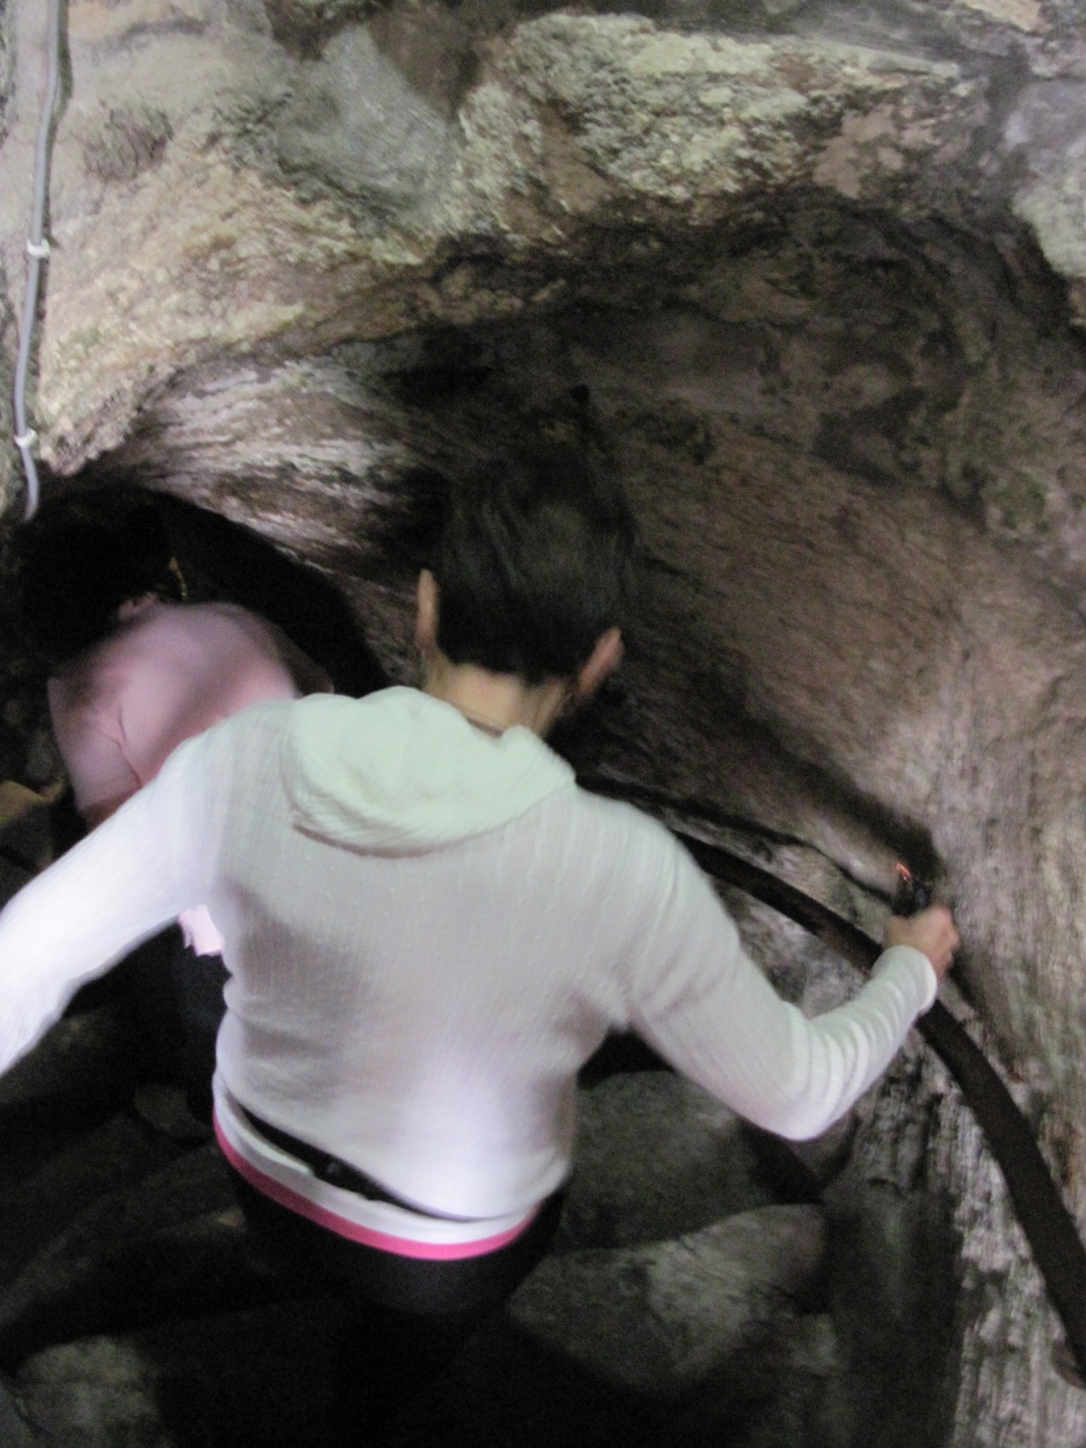

Slide 21
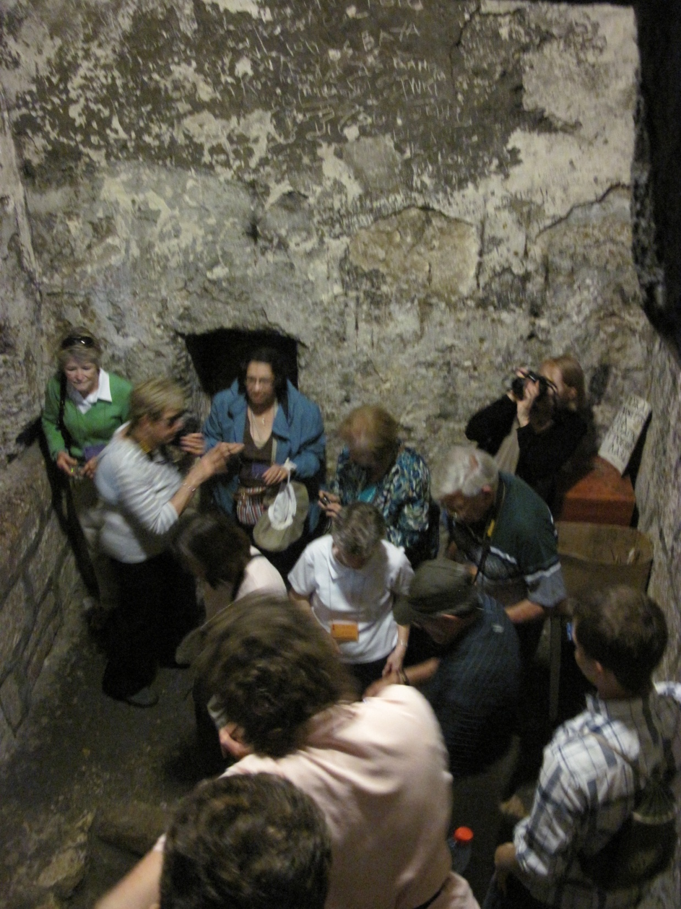

Slide 22
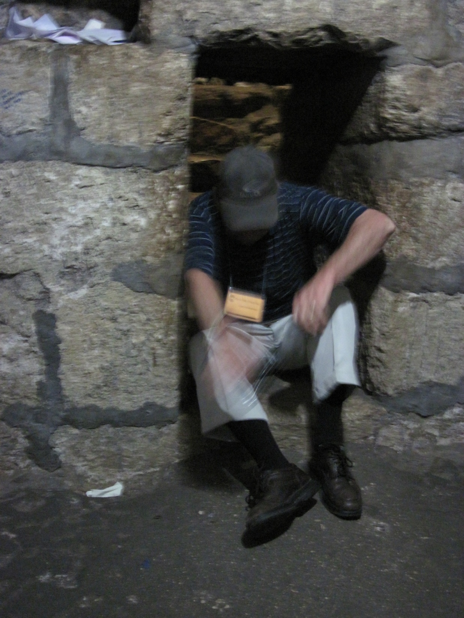

Slide 23
Chapter 25 Notes
Jesus is on His way to celebrate the Passover in Jerusalem. The village of Bethany is 2 miles from Jerusalem.

Slide 24
Chapter 25 Notes
Connections from Lazarus to us today:
  Jesus wept.
    Why would Jesus cry?
    Does Jesus cry with you?
      YES!! He knows your pain and comforts you!
  Jesus spent time with his friends.
    Does Jesus call you a friend?
      YES!! He is with you forever – as your friend!
  Jesus offers life.
    His life is your life!

Slide 25
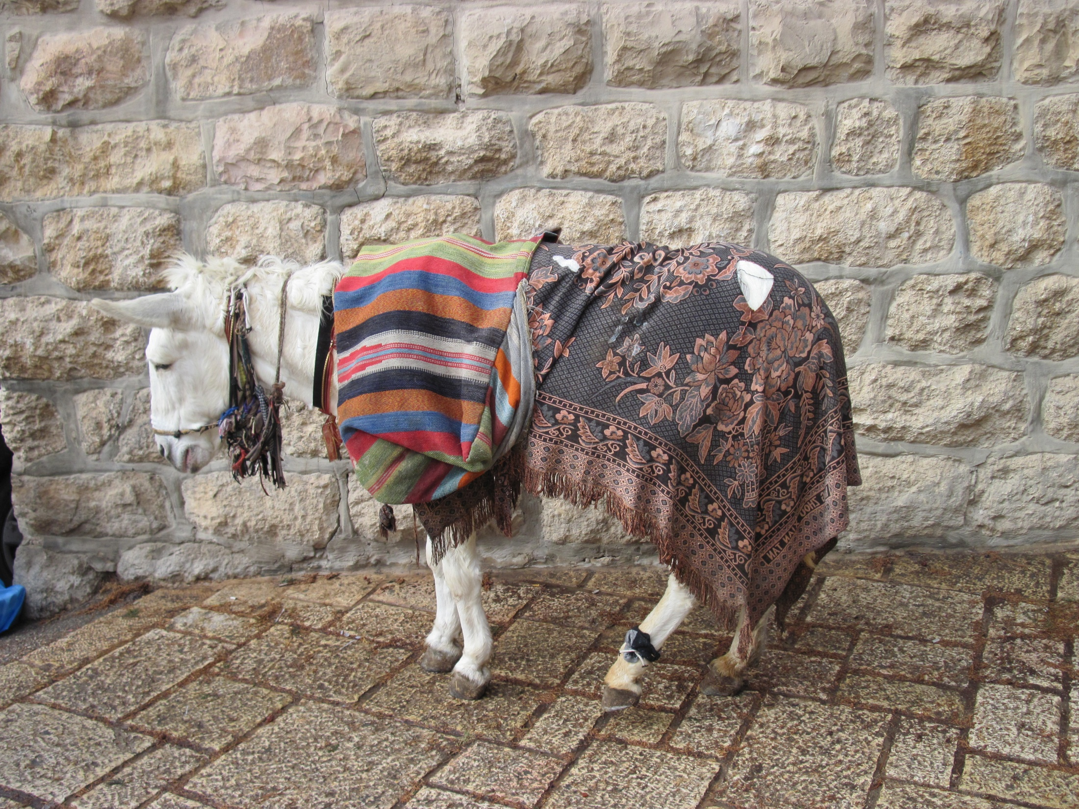
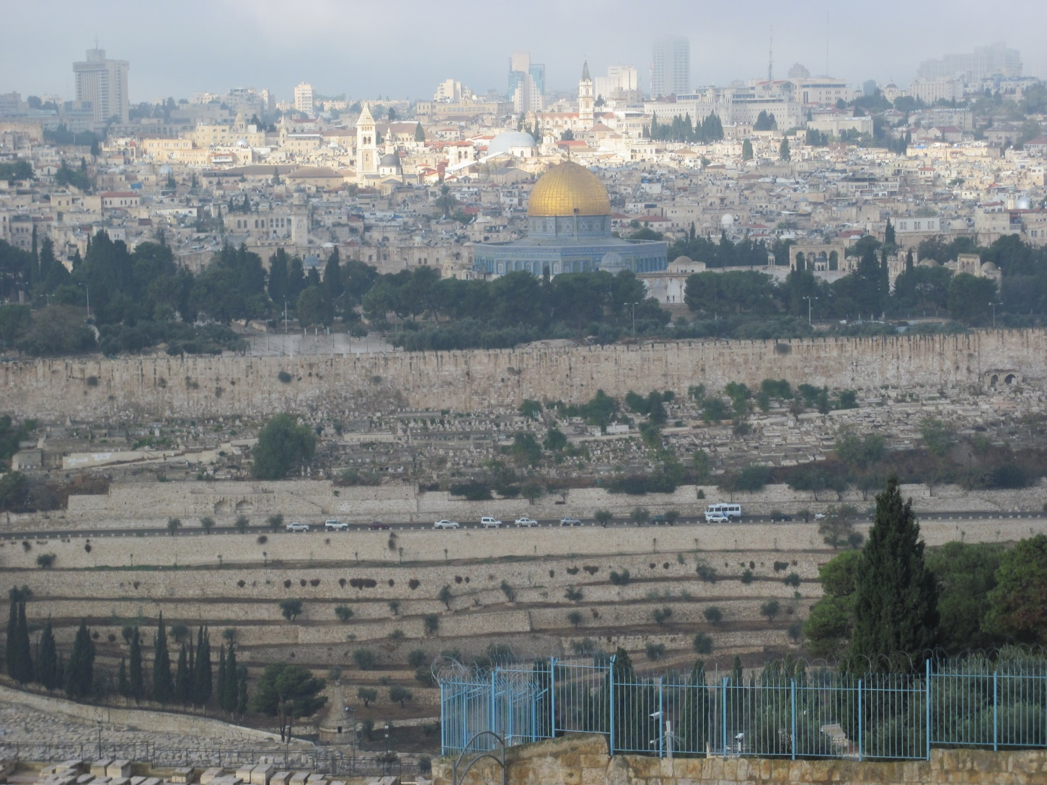
“Go to the village ahead of you,
and just as you enter it,
you will find a colt tied there…”

Slide 26


Slide 27
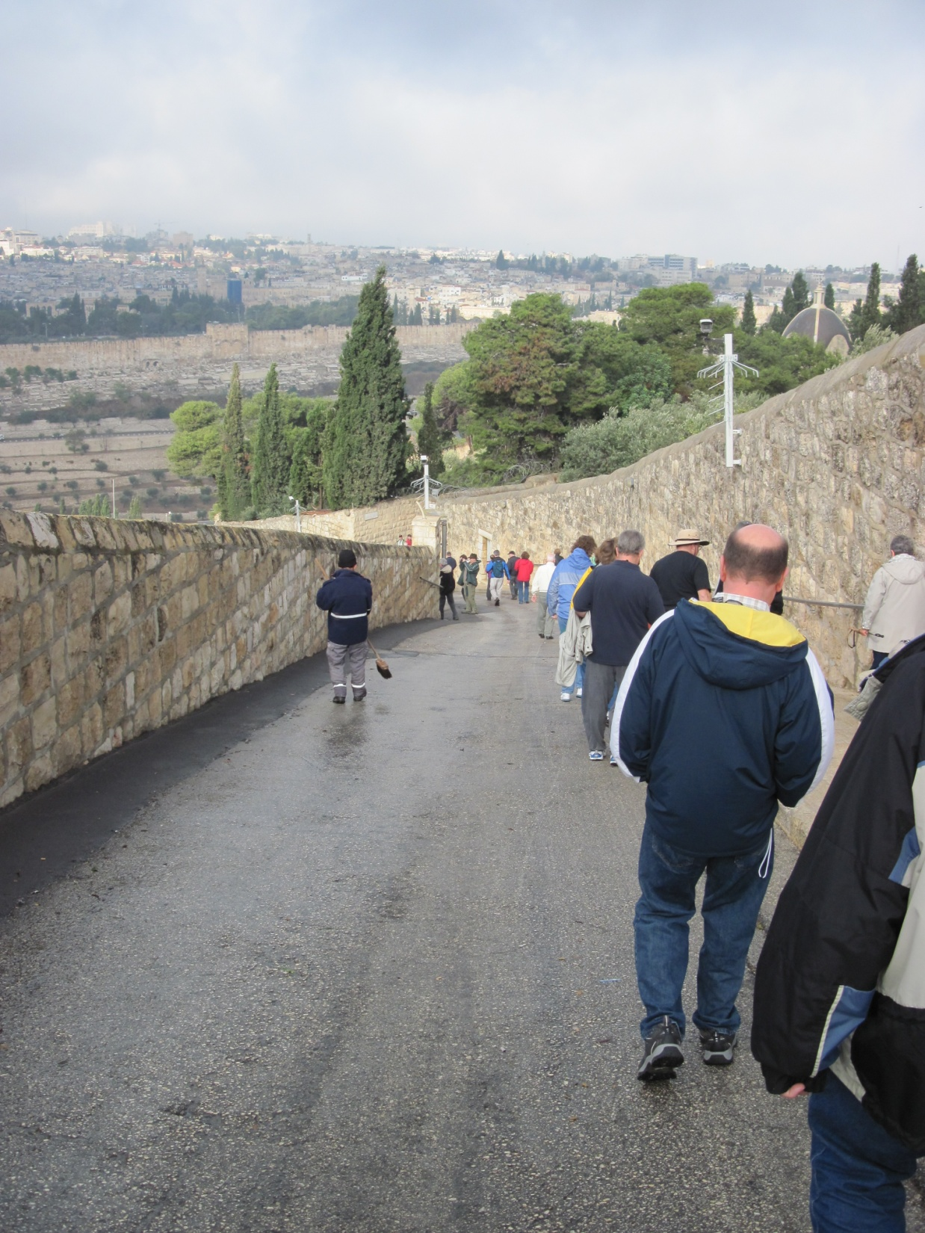
“Hosanna! Blessed is he who
comes in the name of the Lord!”

Slide 28
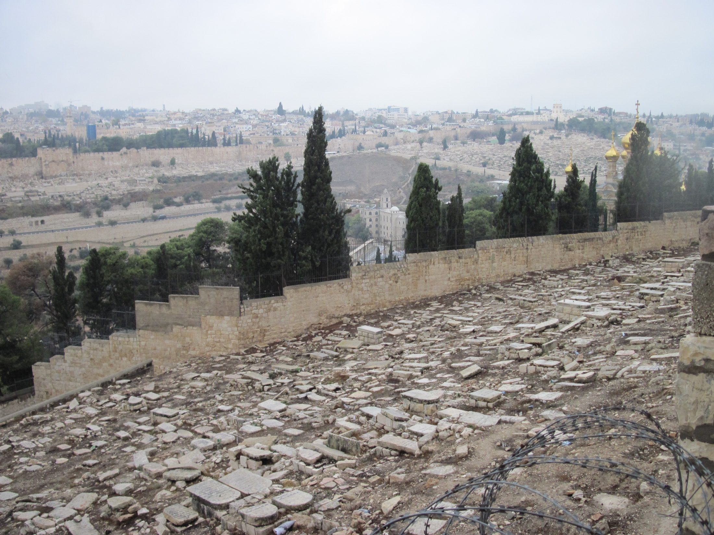
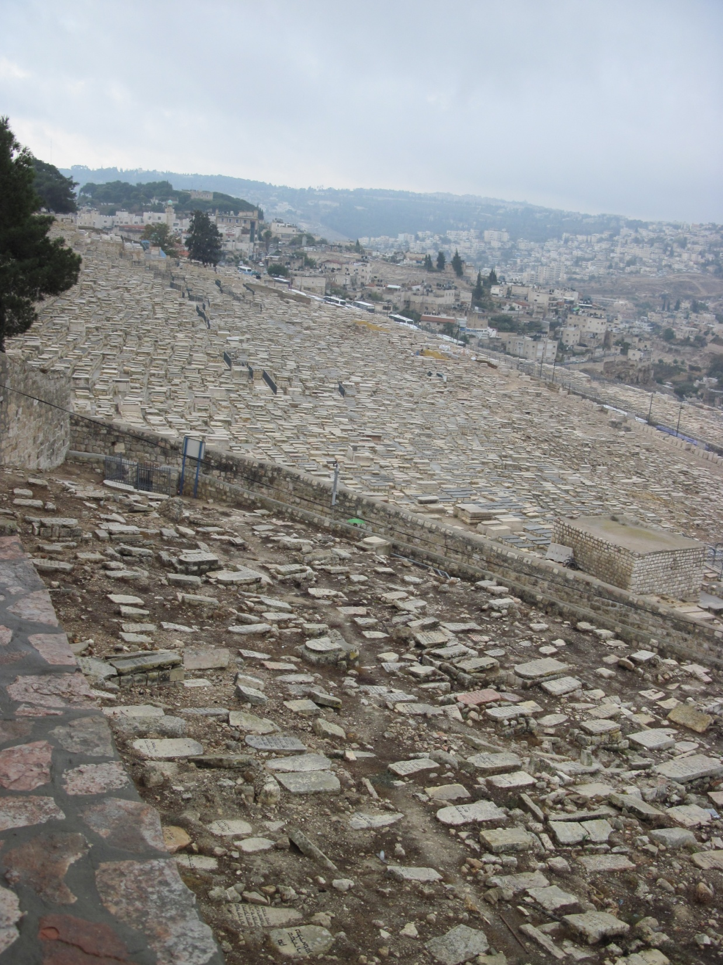

Slide 30
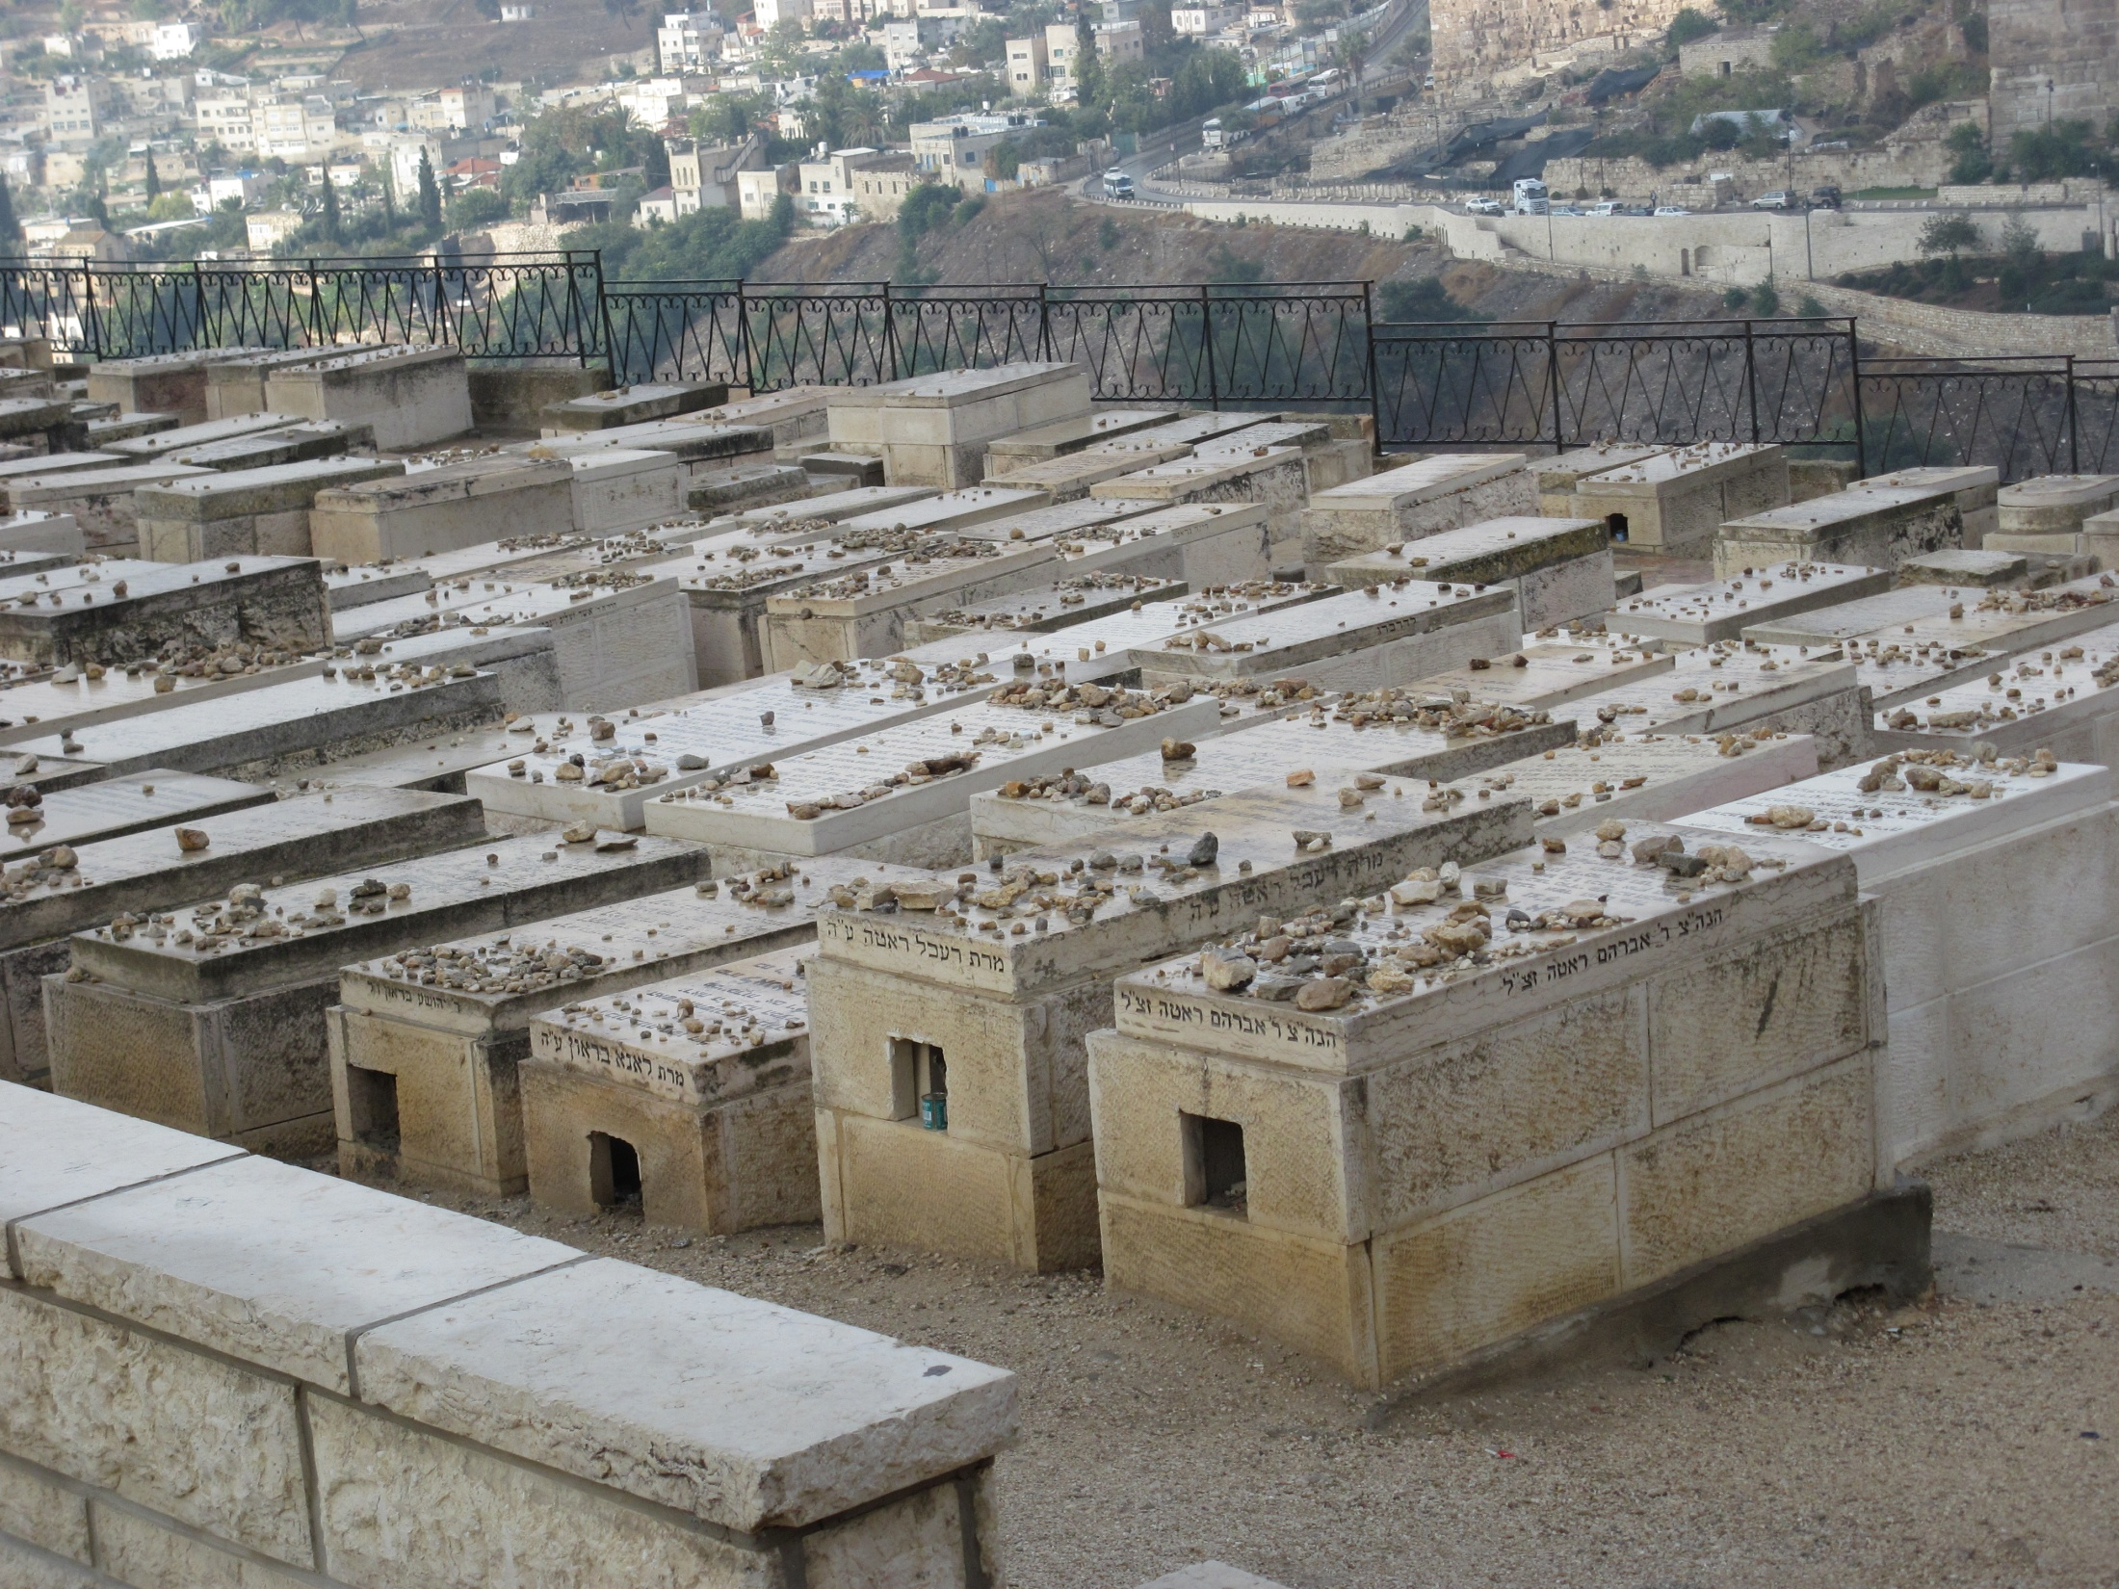

Slide 31
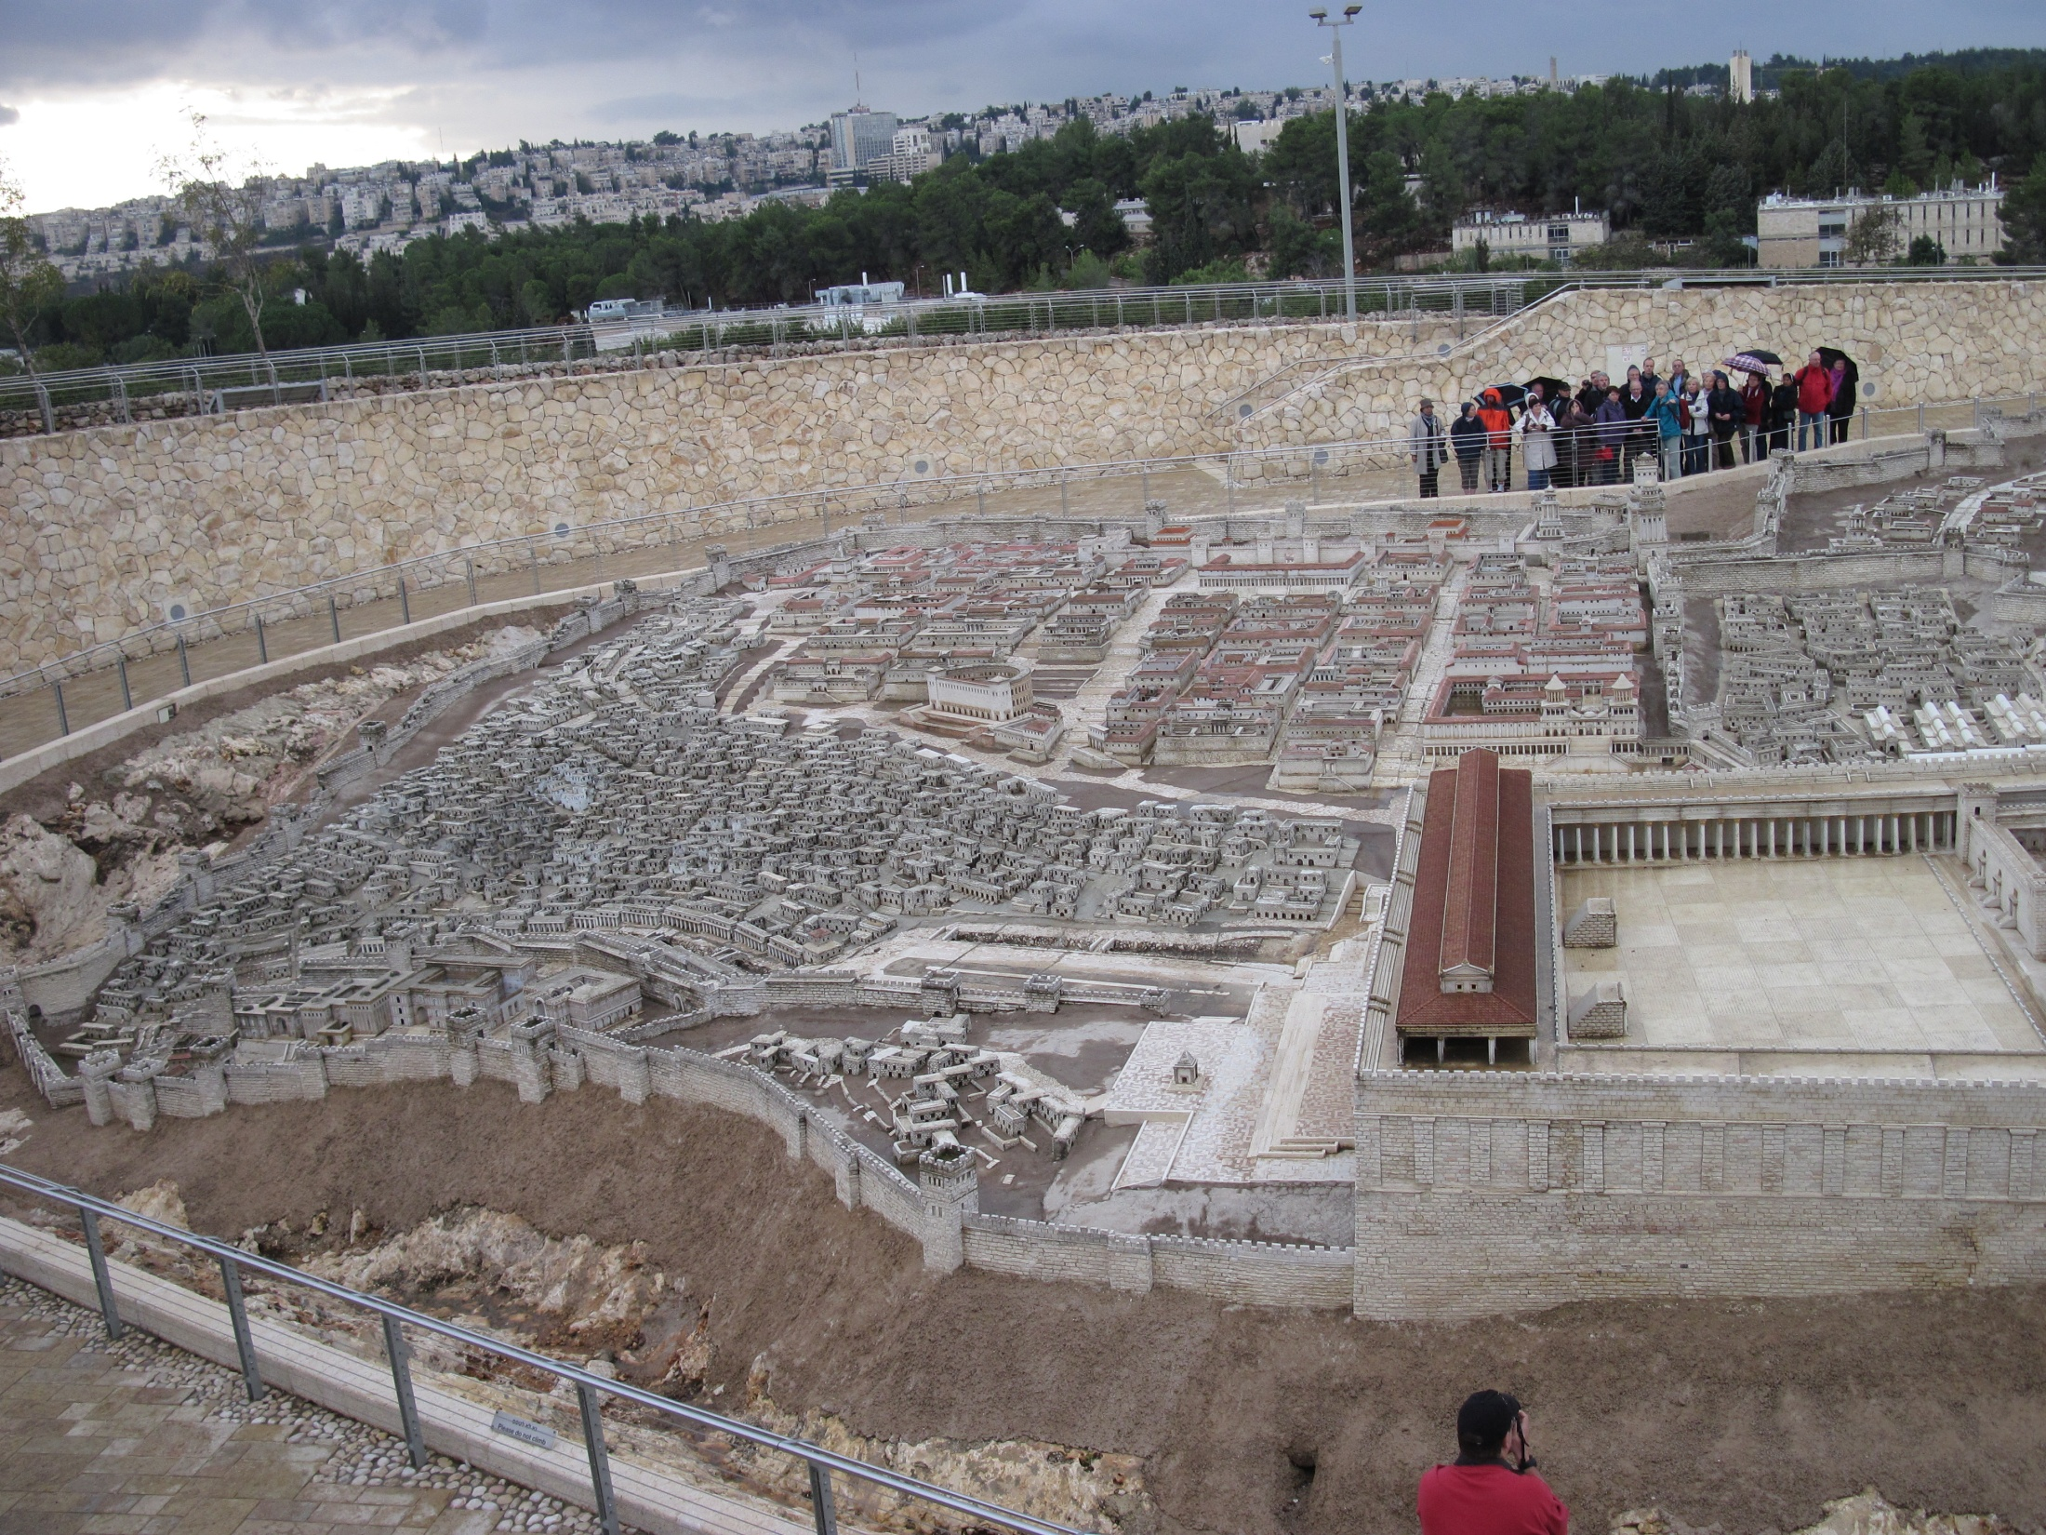

Slide 32
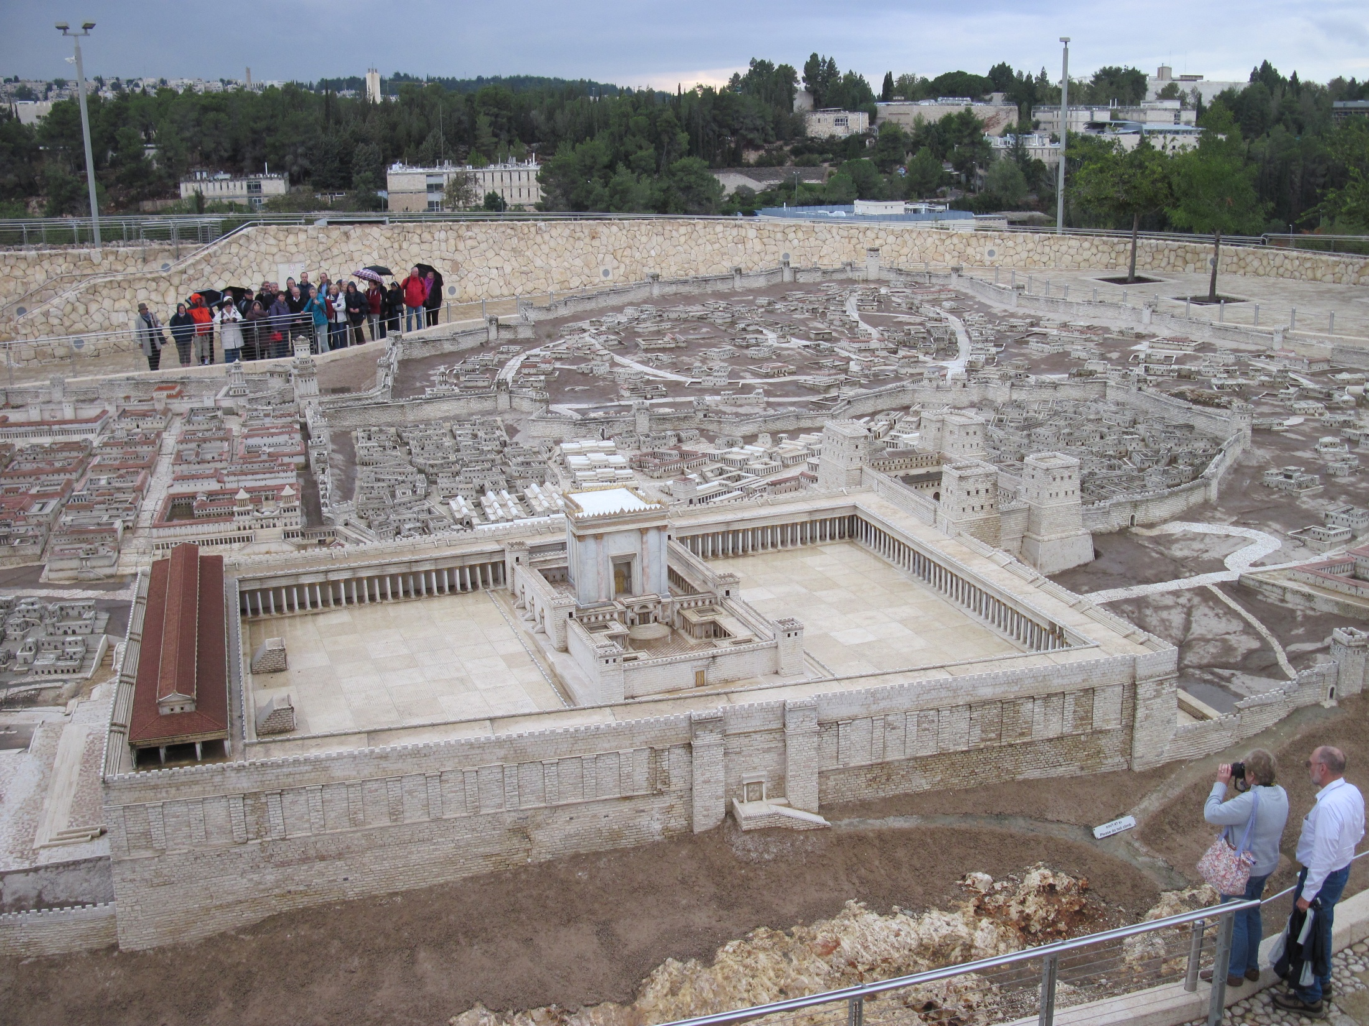
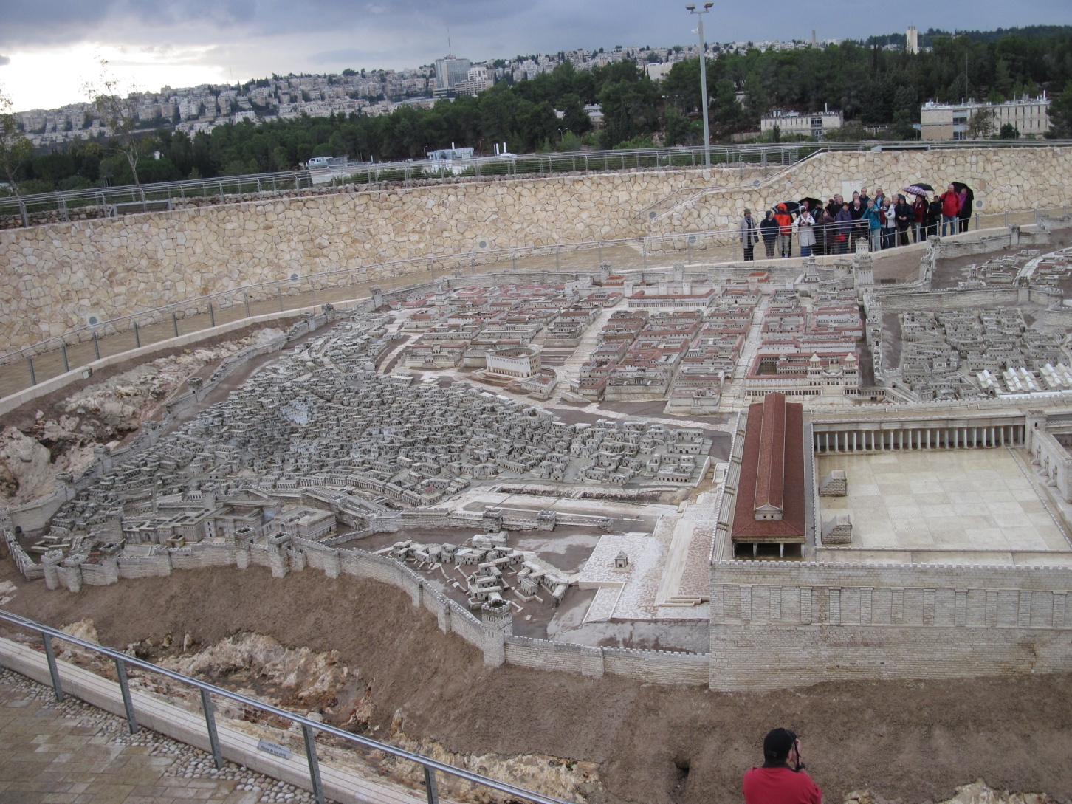

Slide 33
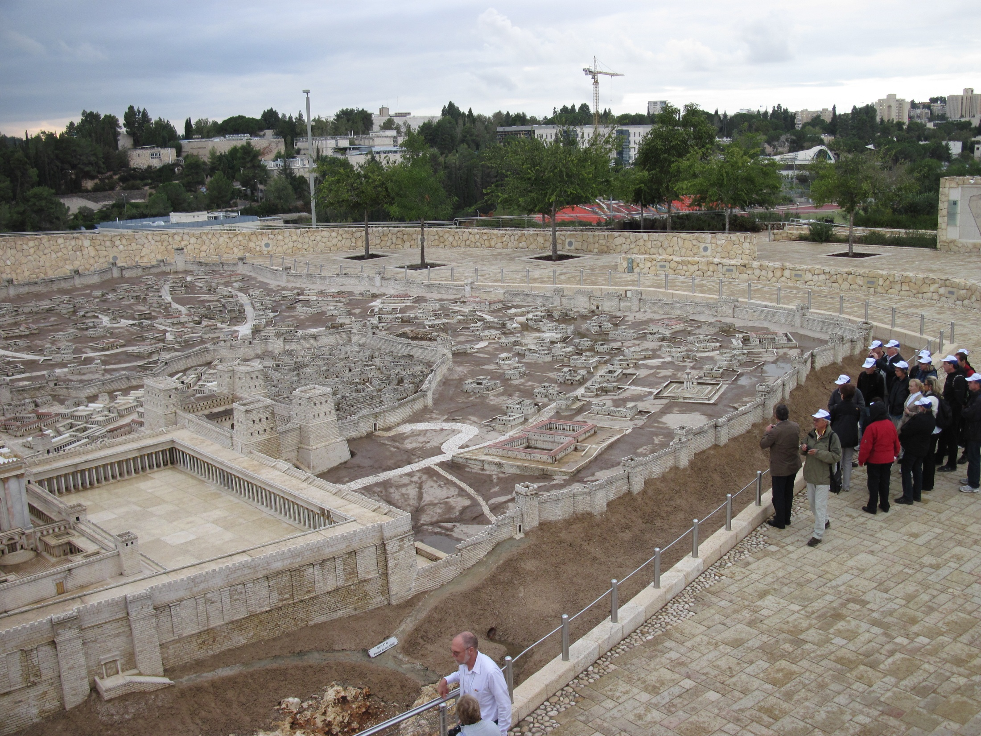

Slide 34
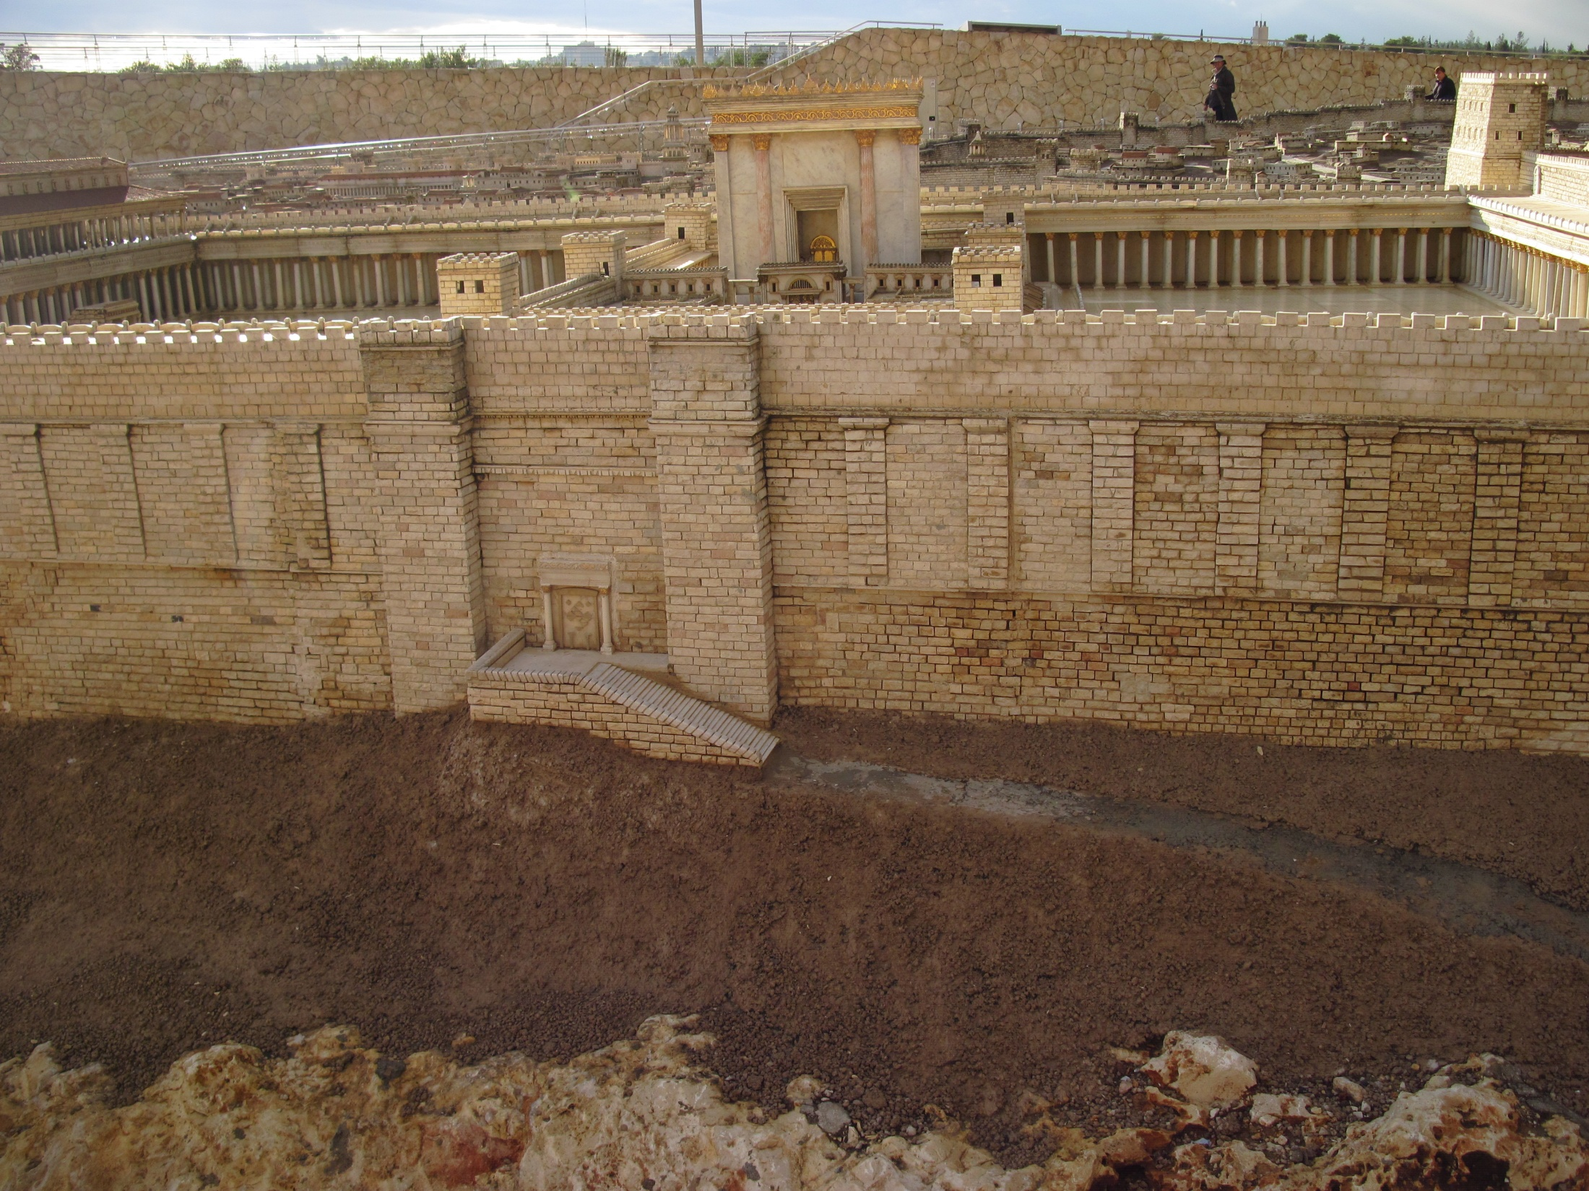

Slide 35
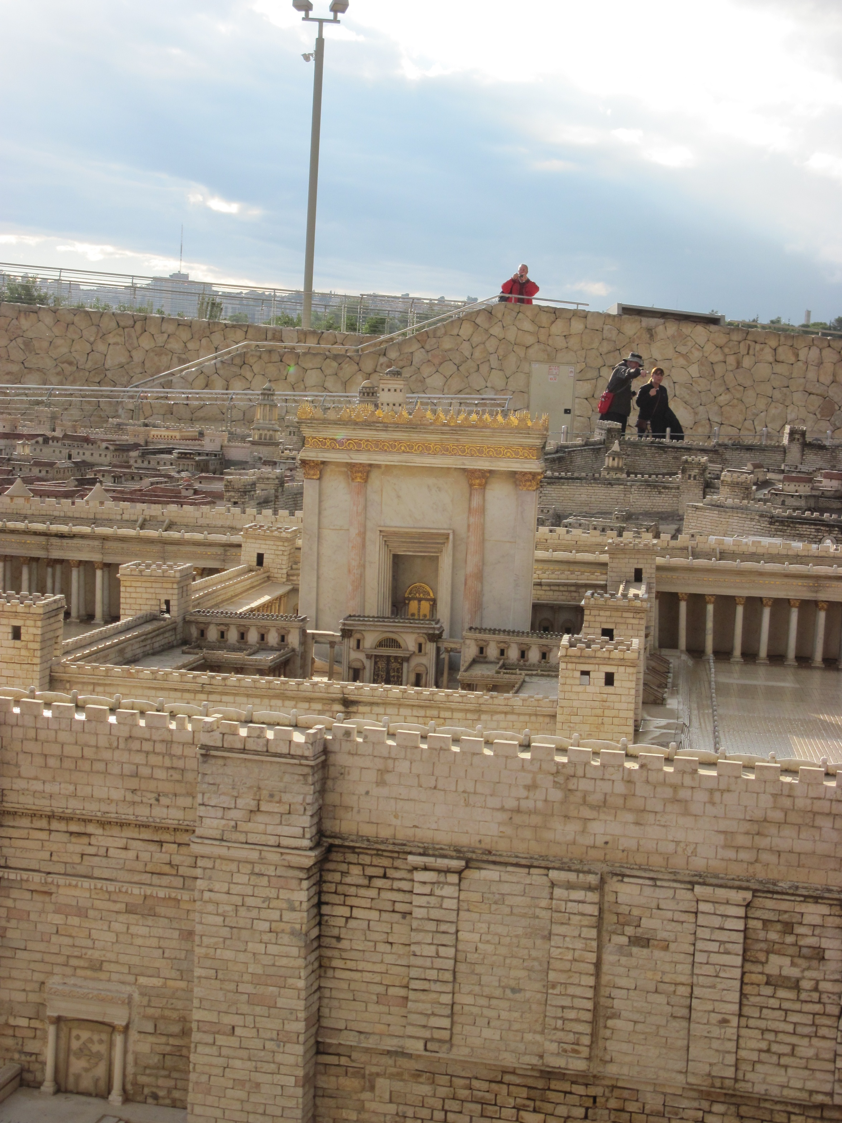

Slide 36
Chapter 25 Notes
The time has come… Jesus knew what was coming this week of Passover.
He no longer told people to be quiet about His identity. He allowed the crowds to rejoice on that first Palm Sunday.
“Hosanna” means “Save!”
Back then, a king rode a donkey when seeking peace; and a horse when advancing to war.
Jesus cleared out the Temple courts.
  Why?
  People were robbing others in God’s house.

Slide 37
Hear The Story
-Write down main events from Chapter 25.

Slide 38
Discussion Questions

Slide 39
What would you say was Jesus’ primary mission during his life?

Slide 40
What words would you use to describe Jesus?

Slide 41
How would you respond to the question, “How do you know that Jesus is God?”

Slide 42

For Next Sunday:
Read Ch. 26
Memorize John 14:6

Slide 43

Thanks for packing cookies for college students last Sunday!

Slide 44
Closing Prayers

