Slide 1

Welcome
Jr. FLY Confirmands!
Mar. 23, 2025

Slide 2
Welcome
&
Opening Prayer

Slide 3
QUIZ
(on Chapter 23)

Slide 4
1. John the Baptist’s main message was:
God is with us!
Repent, for the kingdom of heaven has come near!
Follow me.
None of the above

Slide 5
2. “This is my Son, whom I love” was:
Psalm 2:7
Spoken by God the Father
Used in coronating King David’s descendants
All of the above

Slide 6
3. What was Jesus’ defense against Satan’s temptations?
A sword
The sword of the Spirit
Bread
Angels

Slide 7
4. Jesus told Nicodemus to be:
Born of water and Spirit
A disciple
A Roman citizen
None of the above

Slide 8
5. Jesus told the Samaritan woman at the well that He is:
The Bread of Life
The Light of the World
The Good Shepherd
Living water

Slide 9
6. Jesus’ first miracle was:
Curing a paralyzed man
Healing the blind man
Driving out demons
Turning water into wine

Slide 10
7. Jesus said, “I have not come to call the righteous but ________.”
Sinners
Tax collectors
Kings
Fishermen

Slide 11
This Week’s
Memory Work:
John 6:35

Slide 12
John 6:35 Notes
“I am”
  Sound familiar?
  Refers back to God calling Himself “I am” in the burning bush to Moses (Ex. 3:14)
  The first of 7 “I am” statements in the Gospel of John
“Bread of life”
  We all need food to live, but yet we still die
  Jesus offers eternal bread
“Never be thirsty”
  We thirst in this life
  Jesus offers eternal water

Slide 13


Slide 14
On your worksheet…
Under “See the Story,” create a simple image or symbol that you think best represents
Chapter 24.

Slide 15
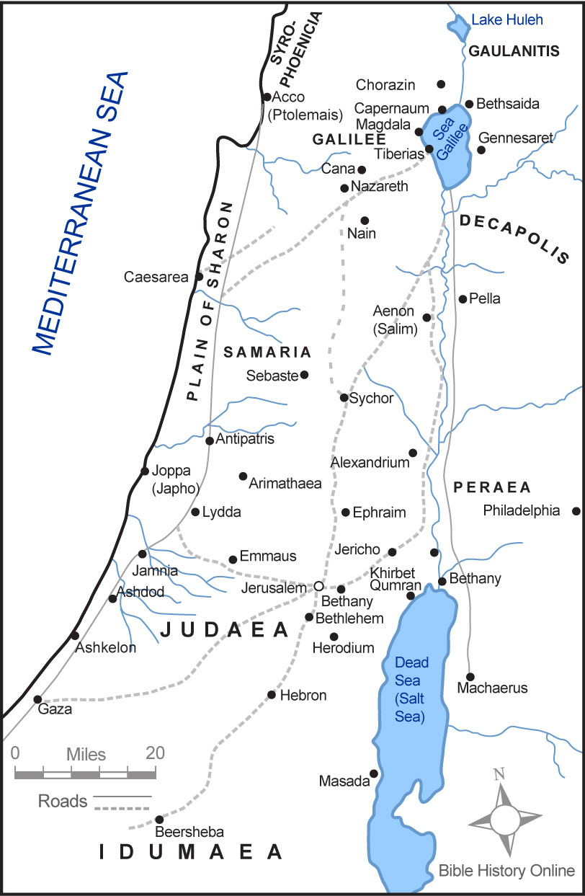

Slide 17
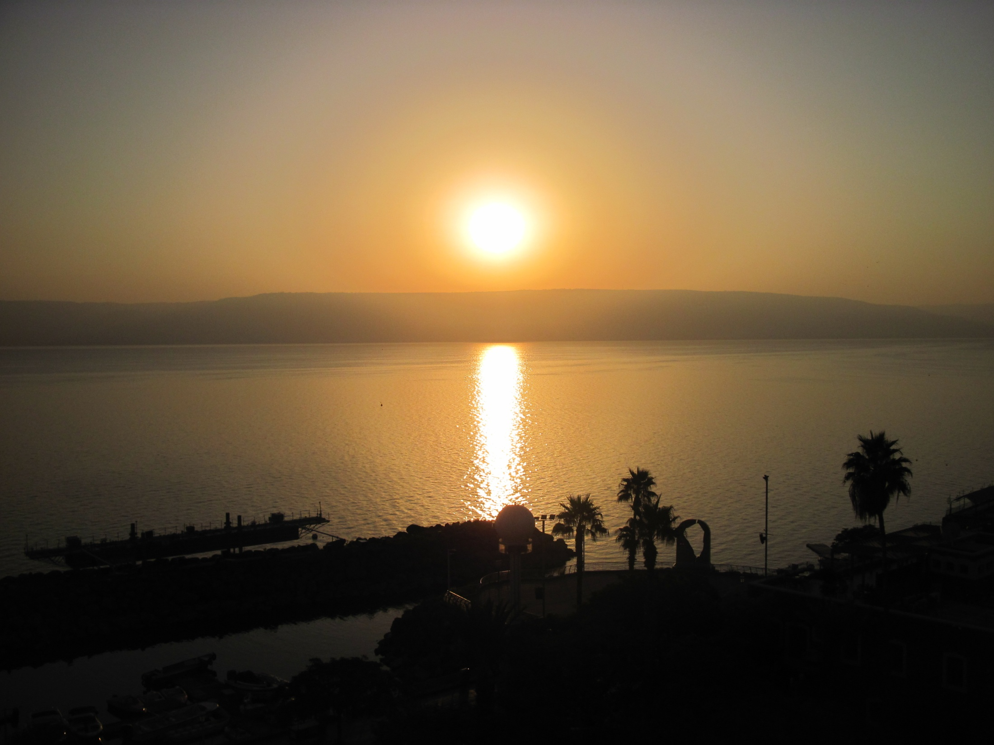
Sea of Galilee

Slide 18
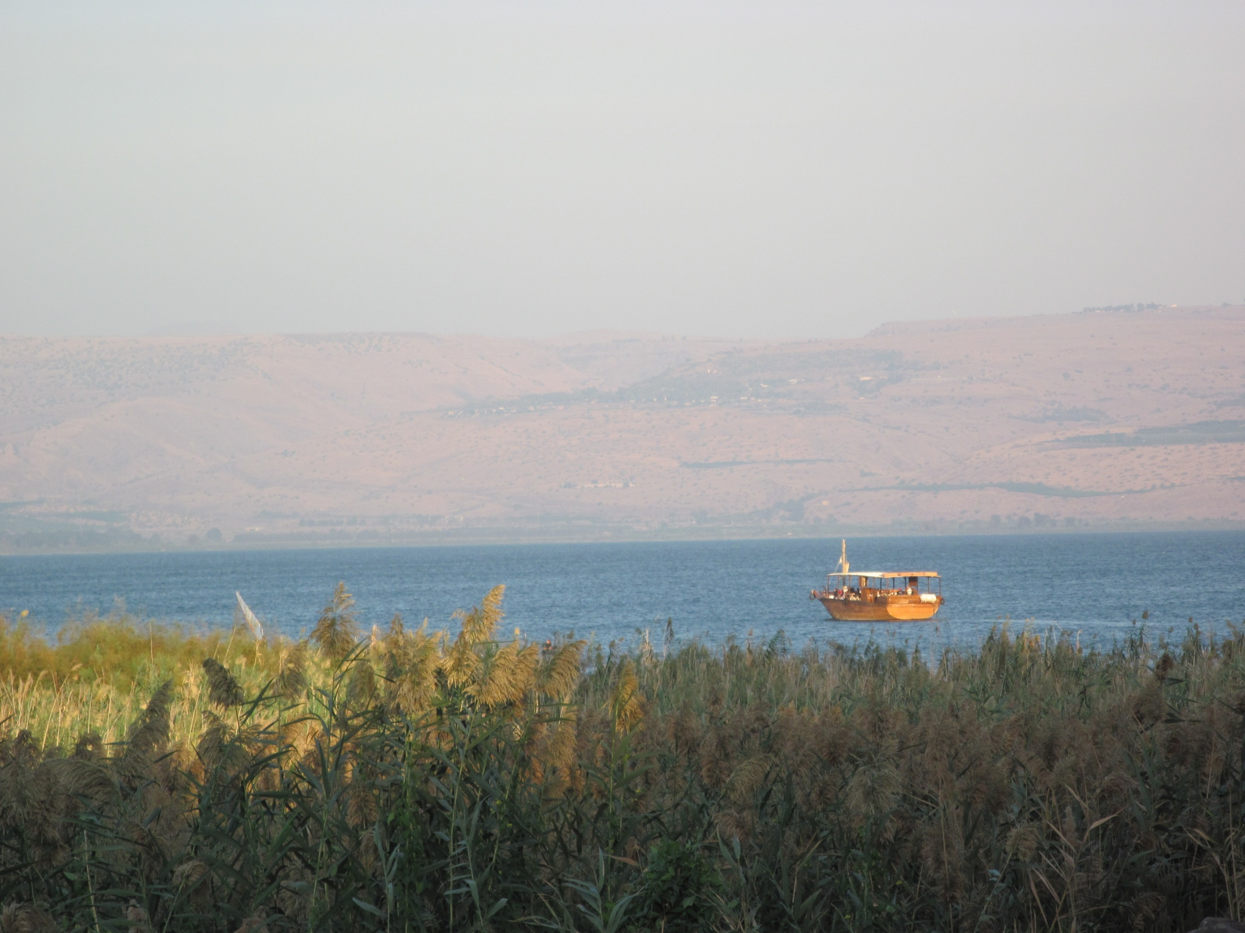
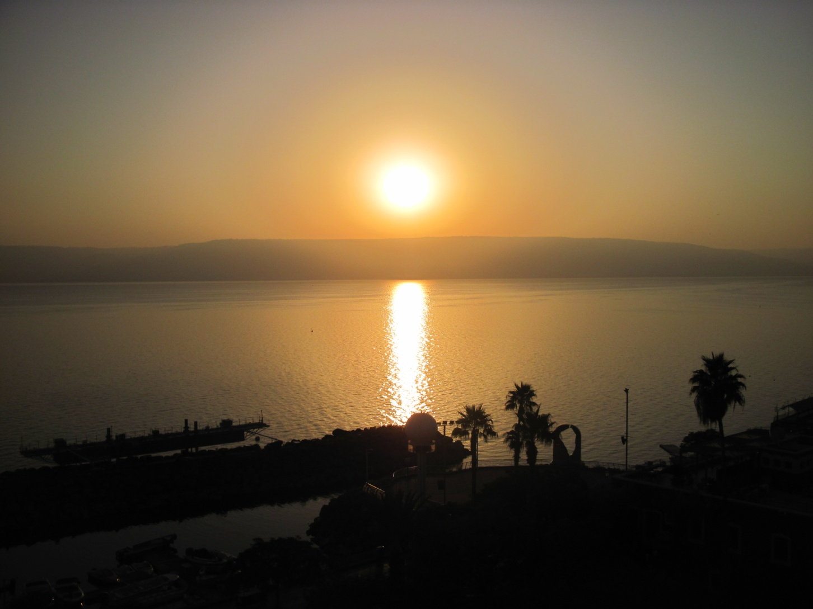
Sea of Galilee

Slide 19
Chapter 24 Notes
Jesus’ parables
  Stories drawn from nature or everyday life
  Point out a central truth about God’s Kingdom
  Require a response from the listener/reader
Read the prodigal son parable (pg. 338-339)
  Who do you relate to in this parable?
  What is Jesus teaching us in this parable?
  What’s your response?

Slide 20
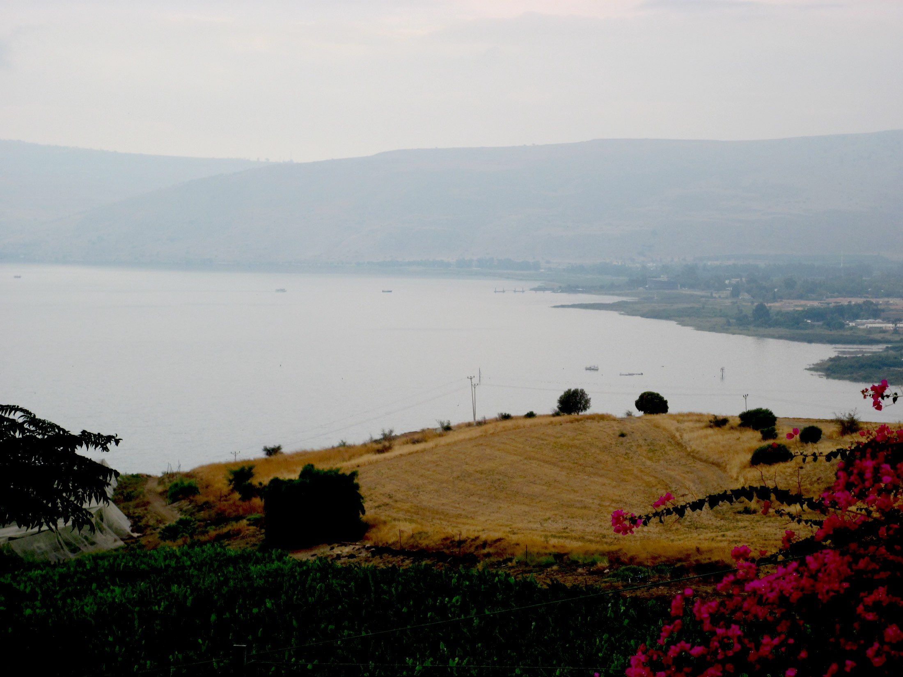
“Now when he saw the crowds, he went up on a
mountainside and sat down. His disciples came to him,
and he began to teach them…” – Matthew 5:1-2

Slide 21
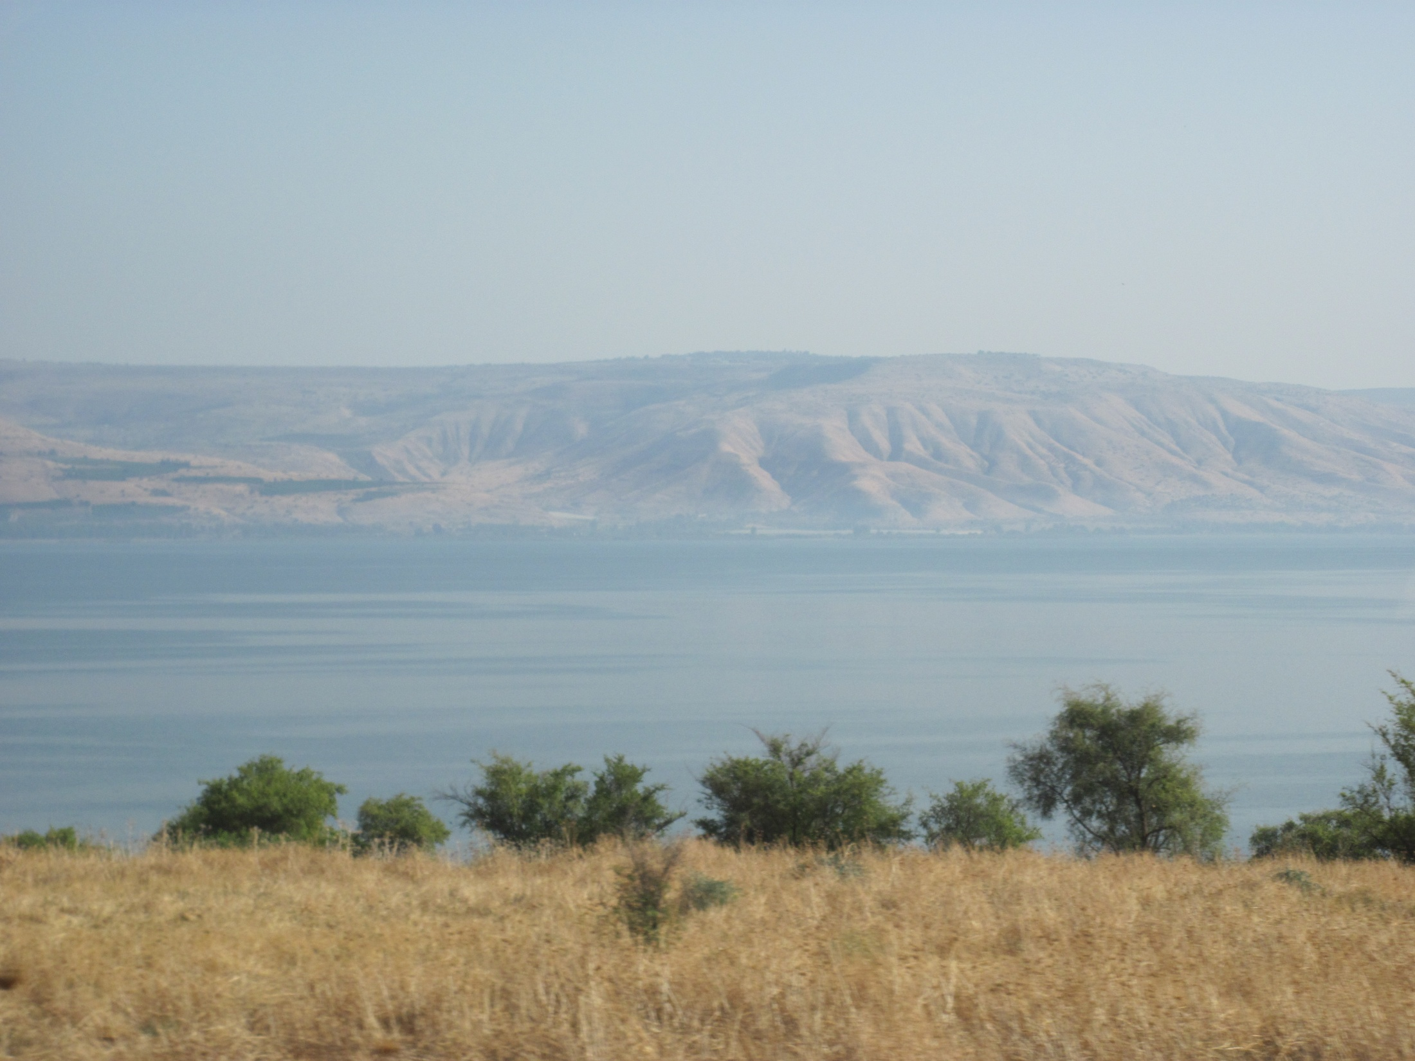
“A city on a hill cannot be hidden.” – Matthew 5:14

Slide 22
Chapter 24 Notes
Jesus’ Sermon on the Mount
  Teaching his disciples
  3 parts:
    Beatitudes (aka Blessings)
    Calling to be the salt & light of the world
    Implications of Christ’s calling

Slide 23
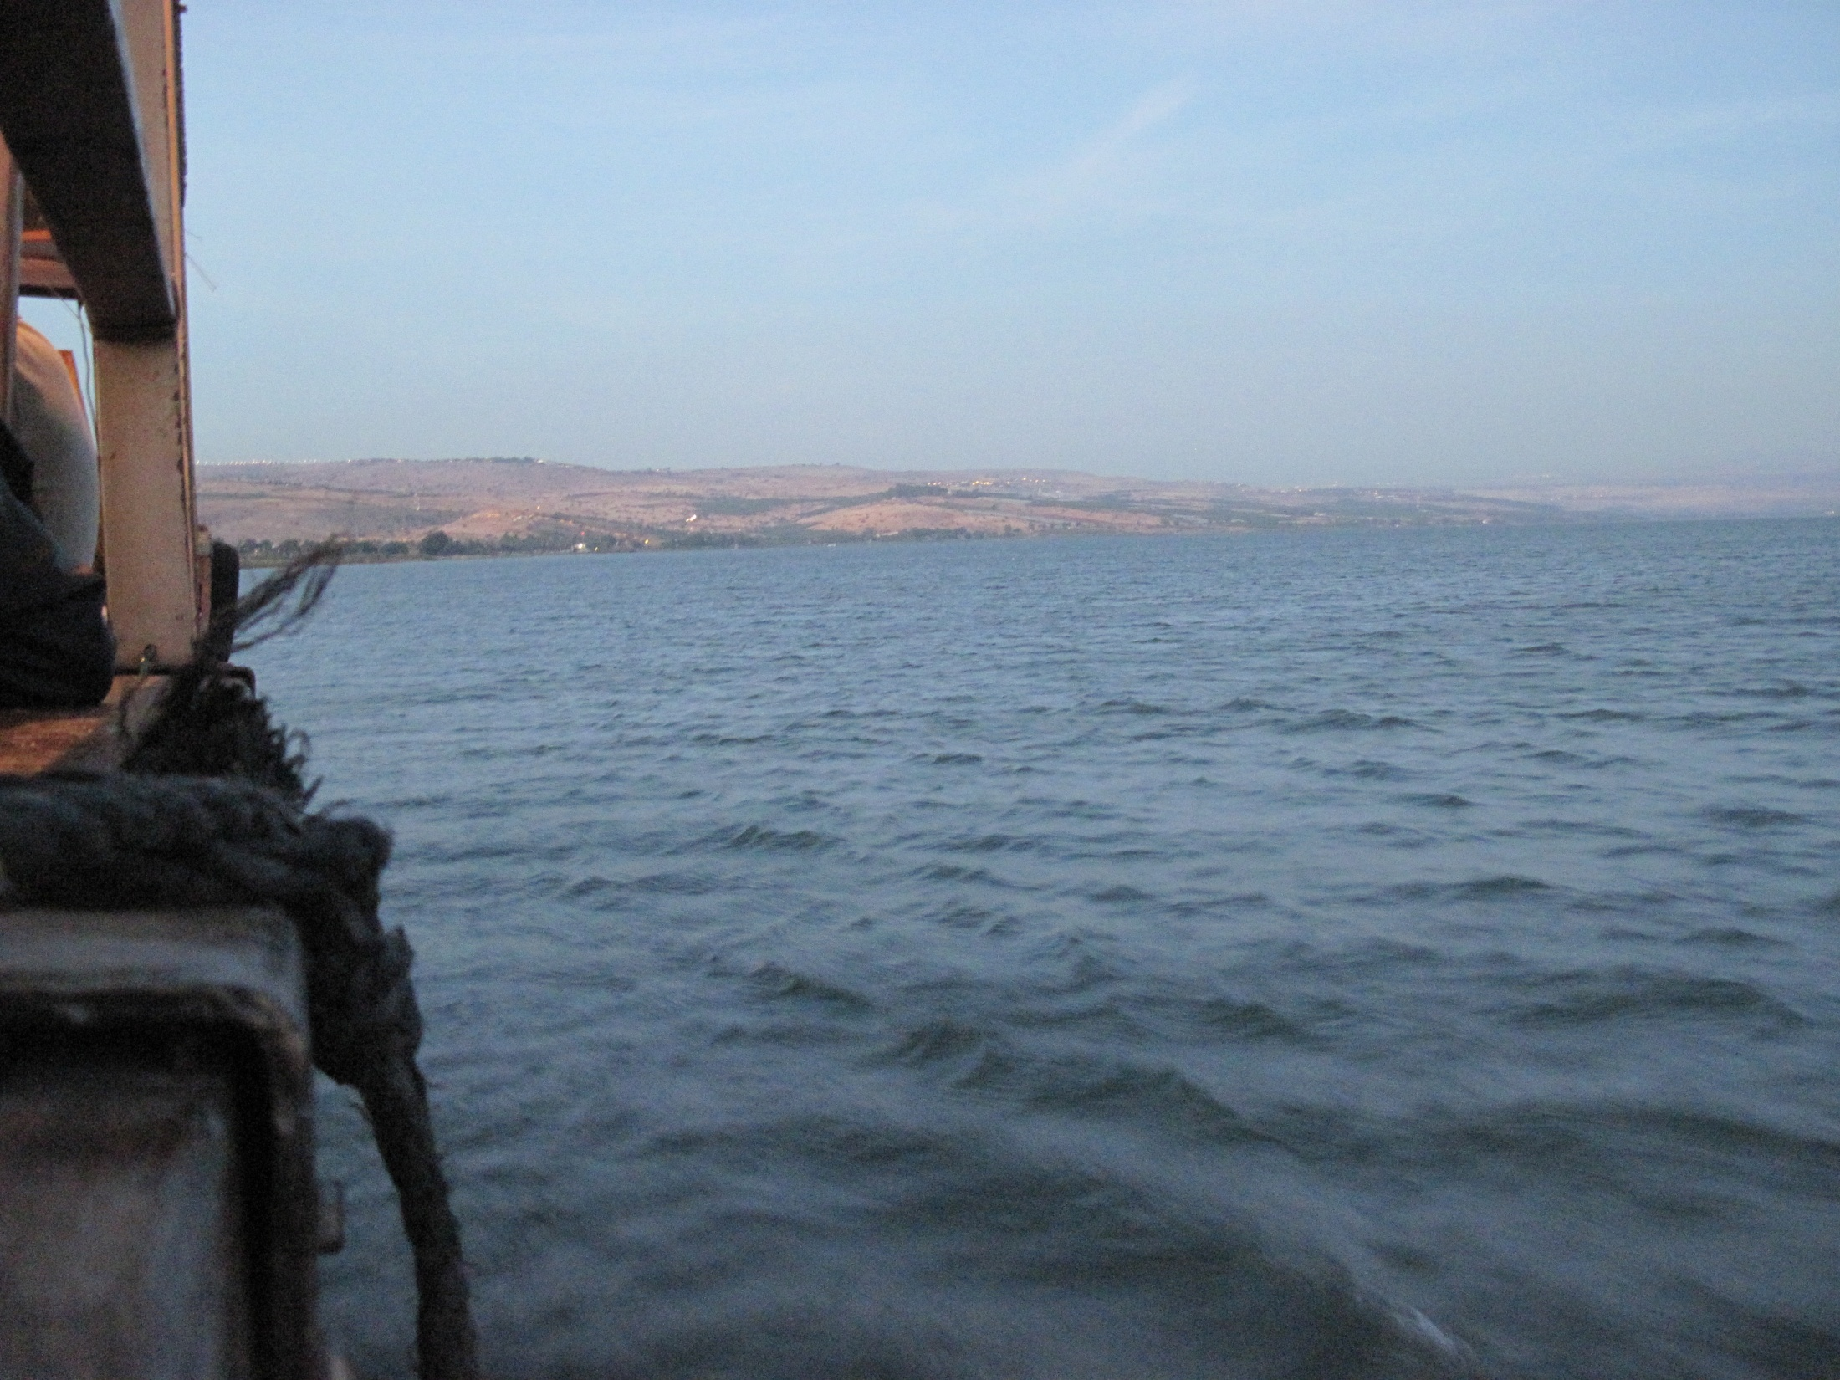
“Then he got up and calmed the winds and the
waves.” – Matthew 8:26

Slide 24
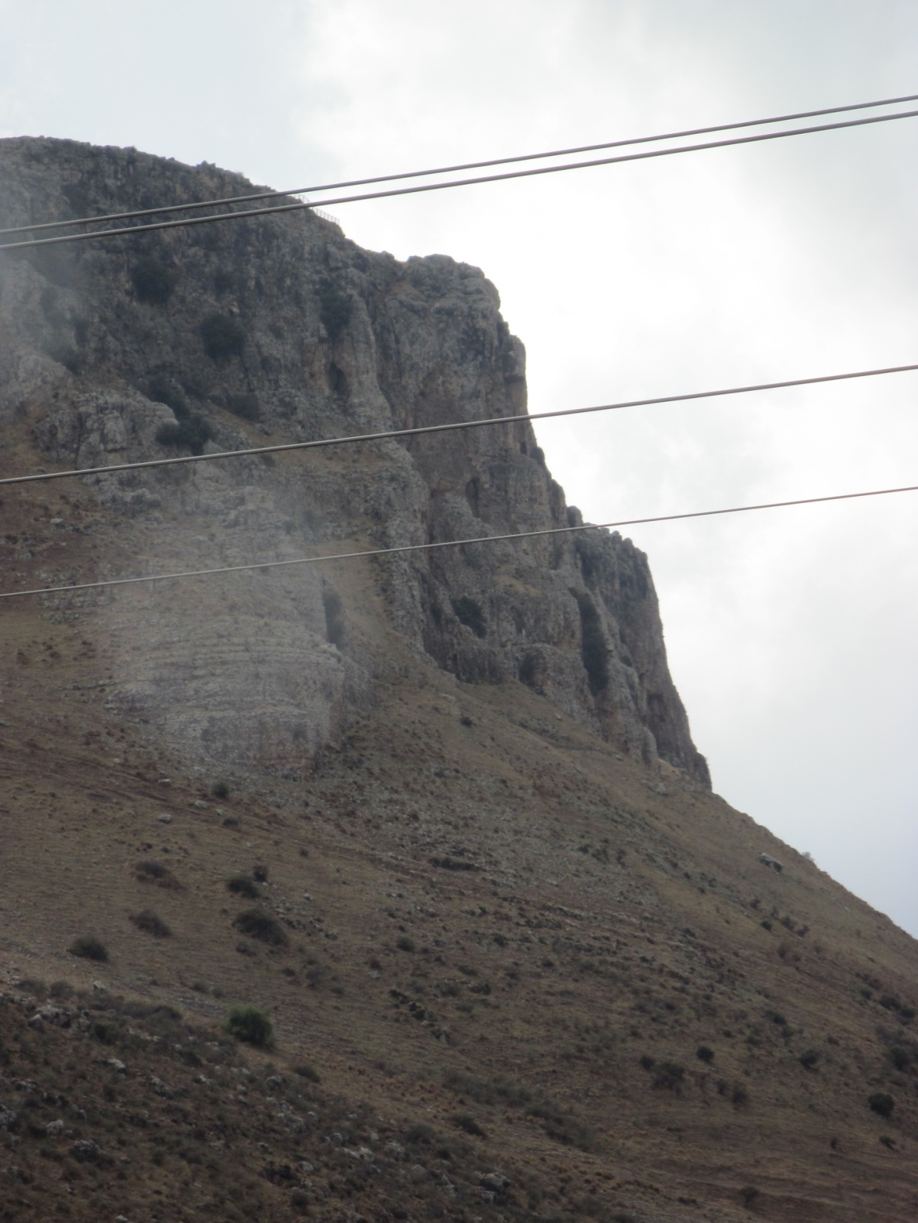
“and the whole herd
of pigs rushed
down
the
cliff
and
died…”
-Mt. 8:32

Slide 25
Chapter 24 Notes
Jesus was no ordinary man
  More healings took place
    Demonic man is healed
    Bleeding woman healed
    Jairus’ daughter raised from the dead
    Blind men see!
    Mute man is healed
  More miracles took place
    Calming the storm
    Walking on water
    Feeding the 5,000 men + women & children
Why did he tell people to be quiet?
  He had to fulfill every prophecy before dying being on the cross.
  He didn’t want to speed up God’s plans for him.

Slide 26
Chapter 24 Notes
“Eat my flesh… drink my blood.” – Jesus
  What’s He talking about?
  Holy Communion!
    Bread is His body given for us
    Wine is His blood shed for us!
  Through Christ, we are forgiven all of our sins and are freely given eternal life!
Simon Peter’s declaration of faith (pg. 351)
  We declare these words, too!
  We declare this faith, too!

Slide 27
Questions?

Slide 28
The Beatitudes
Matthew 5:3-8

Slide 29
On the back of your worksheet…
Choose a Beatitude and draw it. You can’t use words in the drawing. Be as detailed as possible.
*We’ll try to guess which Beatitude you drew!

Slide 30

For next Sunday:
Read Ch. 25
Memorize John 11:25-26

Slide 31
15 Service Hours
& 15 Sermon Notes
are DUE by May 1st!

Slide 32


Slide 33
Closing Prayers

