Slide 1

Welcome
Jr. FLY Confirmands!
Mar. 16, 2025

Slide 2
Welcome
&
Opening Prayer

Slide 3
QUIZ
(on Chapter 22)

Slide 4
1. John begins his Gospel with:
In the beginning was the Word…
In the beginning God created...
In the beginning Adam named the animals...
None of the above.

Slide 5
2. The Law points us to:
Moses
Our sins
Jesus
Abraham

Slide 6
3. The Gospel points us to:
Moses
Our sins
Jesus
Abraham

Slide 7
4. Gabriel appeared to:
Daniel
Zechariah
Mary
All of the above

Slide 8
5. Immanuel means:
God keeps promises.
Jesus rose
God saves
God with us

Slide 9
6. After Jesus was born, who were the first to be told?
Magi
King Herod
Shepherds
Gabriel

Slide 10
7. True or False: The Magi reported back to King Herod after visiting Jesus.
TRUE
FALSE

Slide 11
8. The Bible is silent about Jesus’ childhood until he’s 12 years old.
TRUE
FALSE

Slide 12
This Week’s
Memory Work:
John 3:16-17
Who wants to recite it?

Slide 13
John 3:16-17 Notes
“God so loved the world” – The great Truth that motivated God’s plan of salvation.
“the world” – All people! All of creation! Not just Israel!
“shall not perish” – Not perish eternally in hell
“but have eternal life” – Eternal life with Jesus in the new creation!
“Condemn” – Sentence someone to a punishment
Christ doesn’t condemn us! He saved us through his death & resurrection!

Slide 14


Slide 15
On your worksheet…
Under “See the Story,” create a simple image or symbol that you think best represents
Chapter 23.

Slide 16
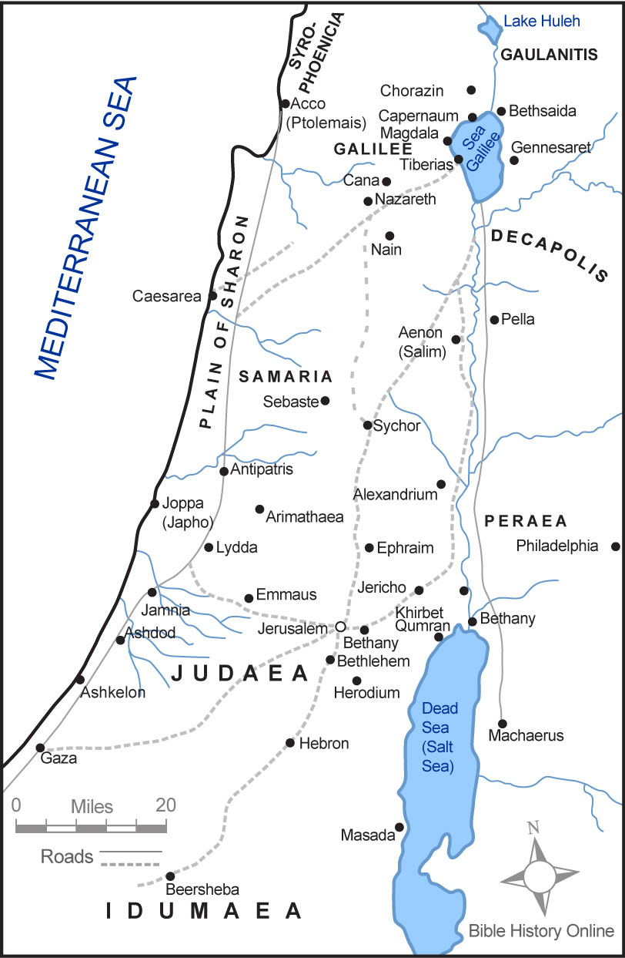

Slide 18
Some photos from Pastor Peter’s trip to Israel in 2012…

Slide 19
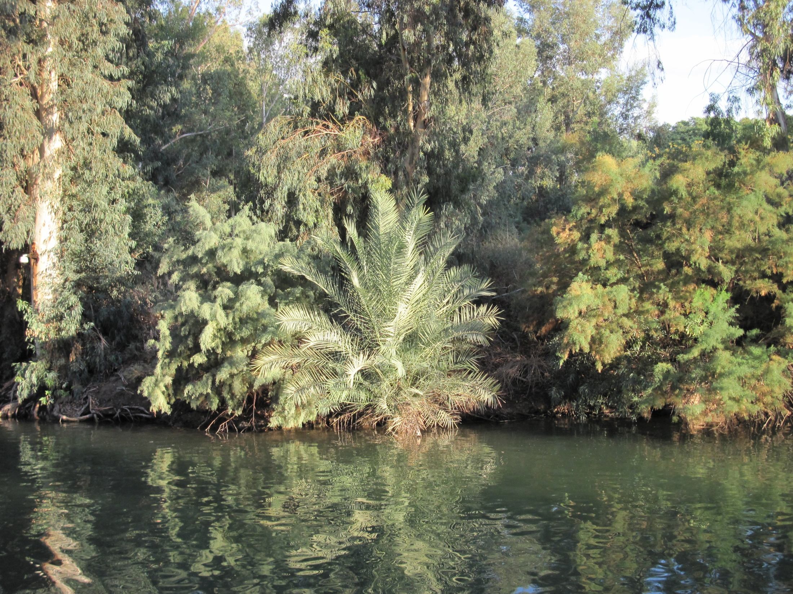
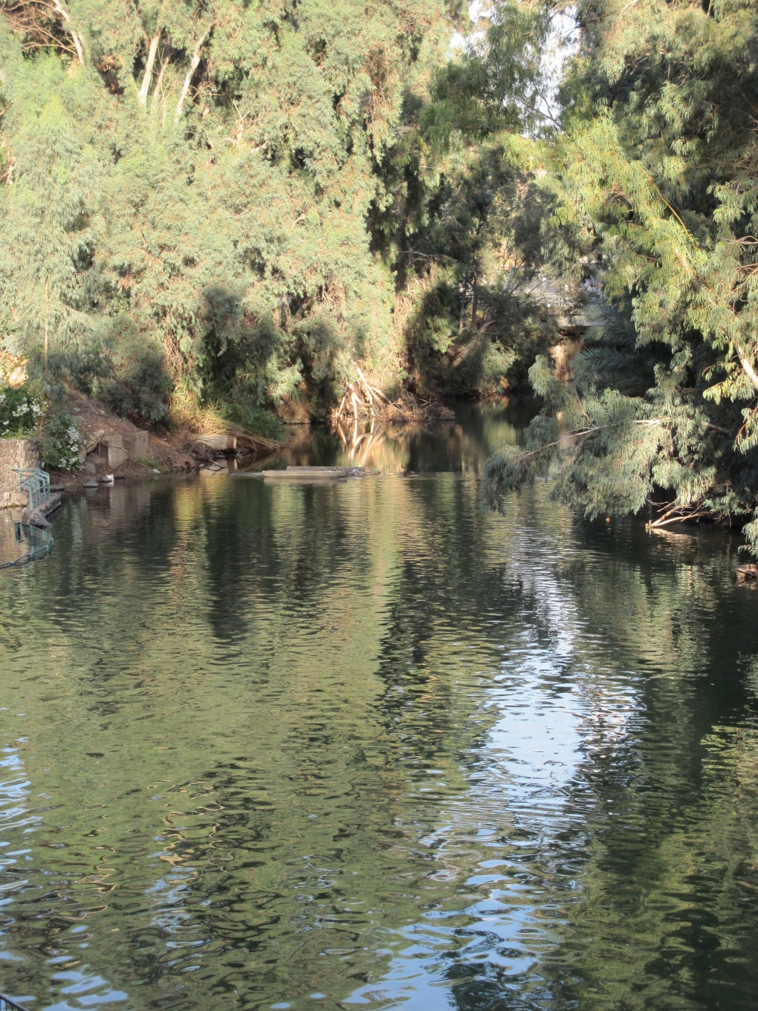
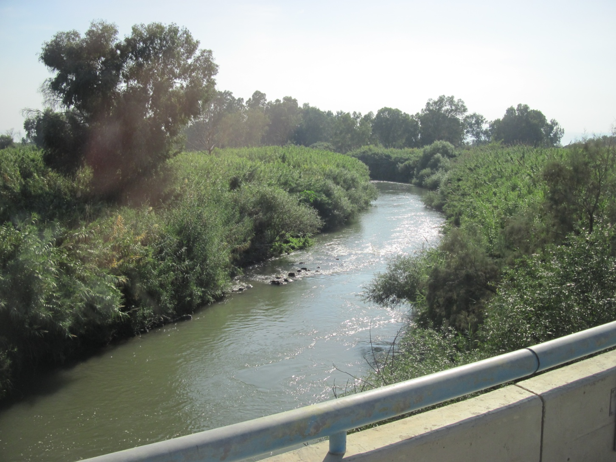
Jordan River

Slide 20
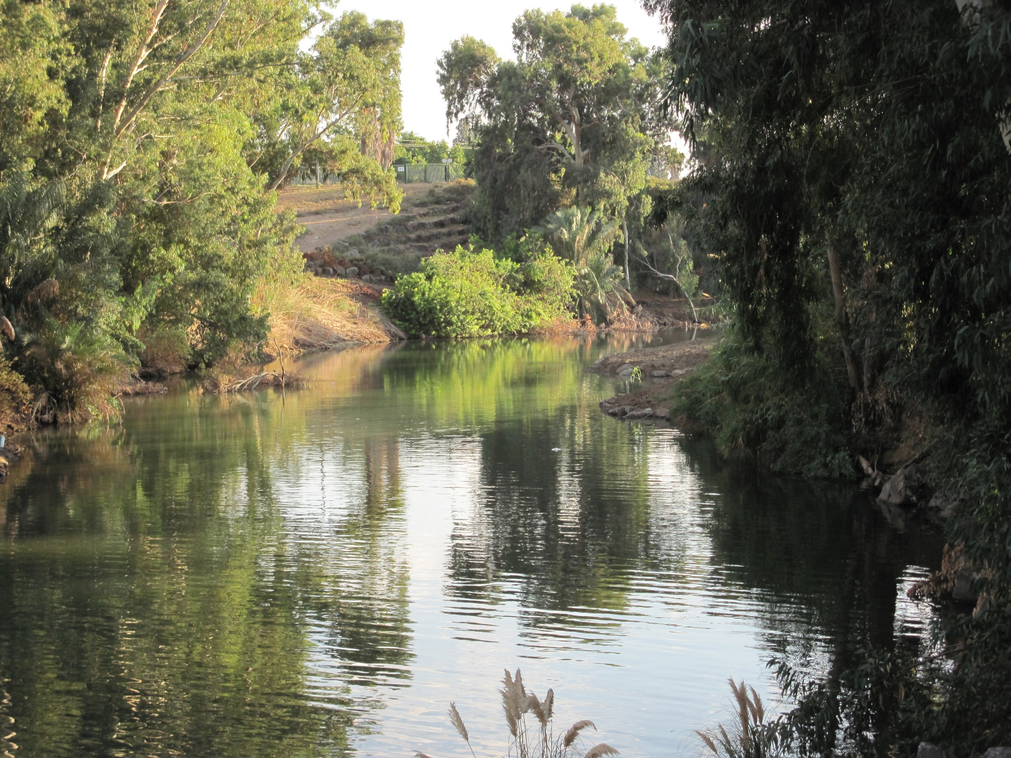
Jordan River

Slide 21
Jordan River

Slide 22

Jordan River

Slide 23
Chapter 23 Notes
John the Baptist
  The last prophet
  “In the spirit and power of Elijah” – just like the prophets foretold
  Wore camel’s hair & ate locusts & honey
  Main message: “Repent, for the kingdom of heaven has come near!”
  He summoned Jews to be baptized – this was a change in tradition! Usually, only Gentiles (non-Jews) were to be baptized when they converted to Judaism.
  John baptized in the Jordan River
  People had to re-enter Israel and walk across the Jordan – echoing Israel’s first entry into the Promised Land

Slide 24
Chapter 23 Notes
Jesus’ baptism
  Does the Trinity show up?
    Jesus = Son
    Dove = Holy Spirit
    Voice from Heaven = Heavenly Father
  “This is my Son, whom I love” – Psalm 2:7
    Used in coronation ceremonies when descendants of King David were anointed into office as King
  “with Him I am well pleased” – Is. 42
    The first of Isaiah’s Servant Songs
    Jesus is the ultimate Servant-King

Slide 25
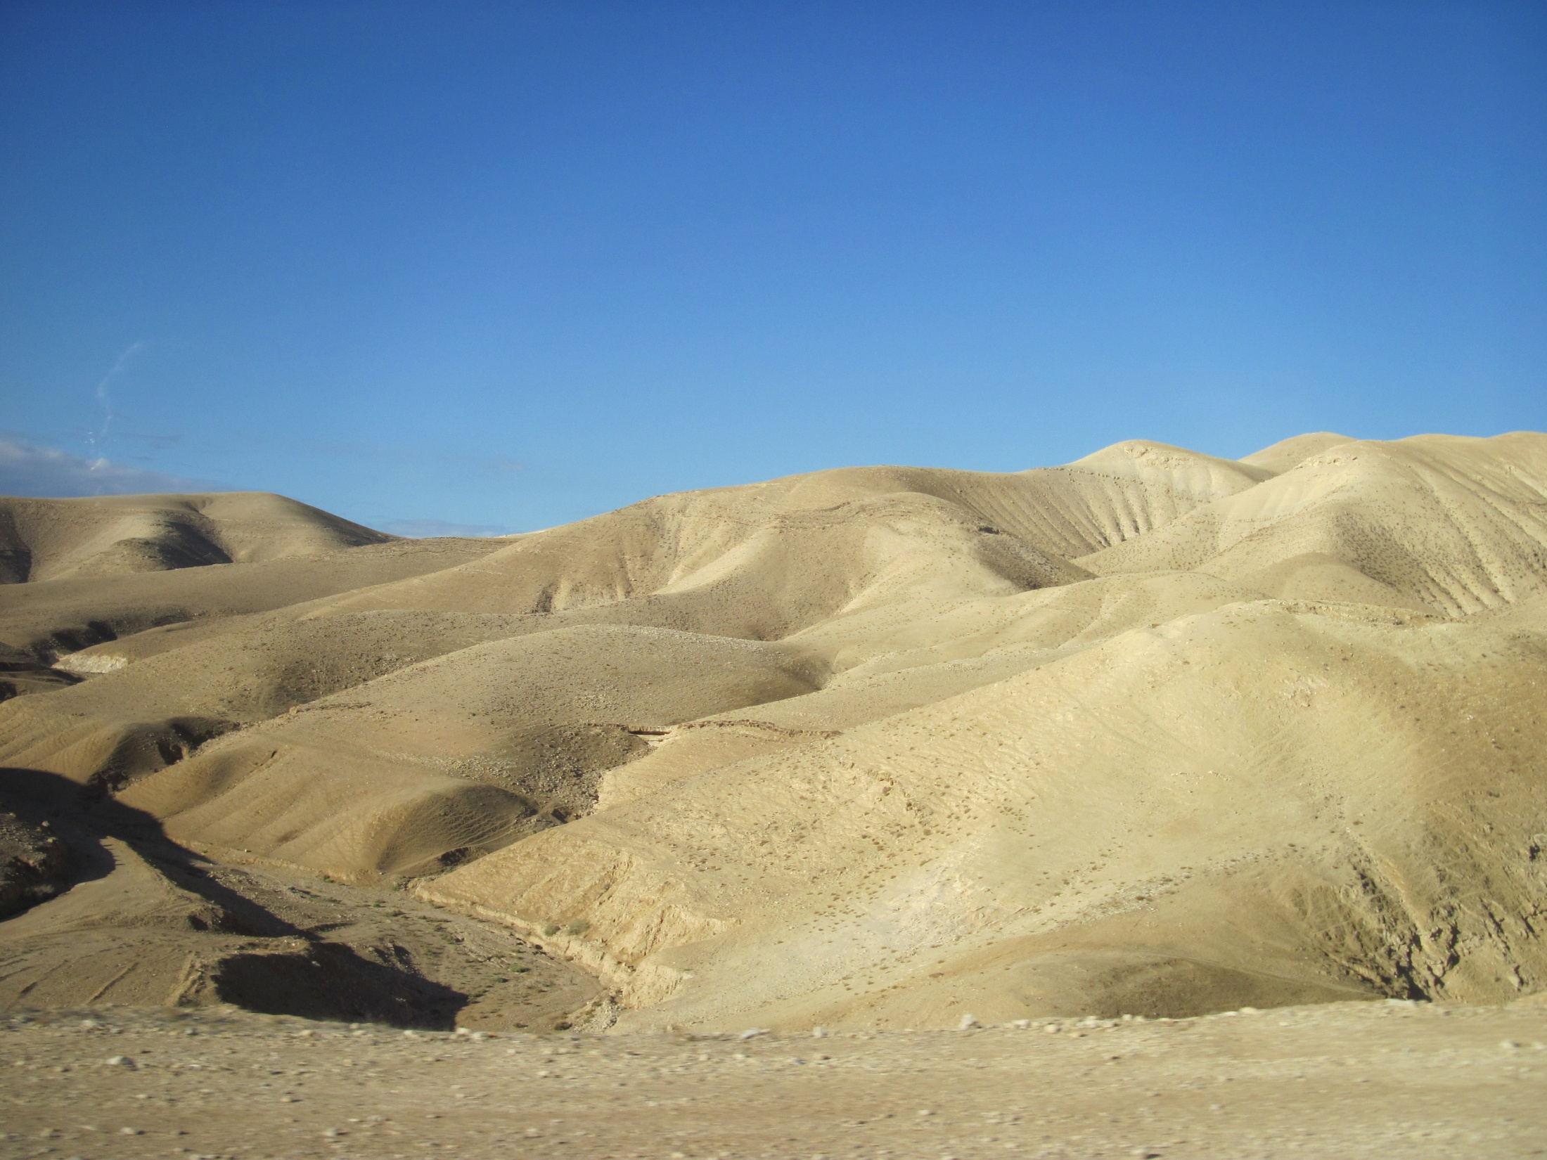
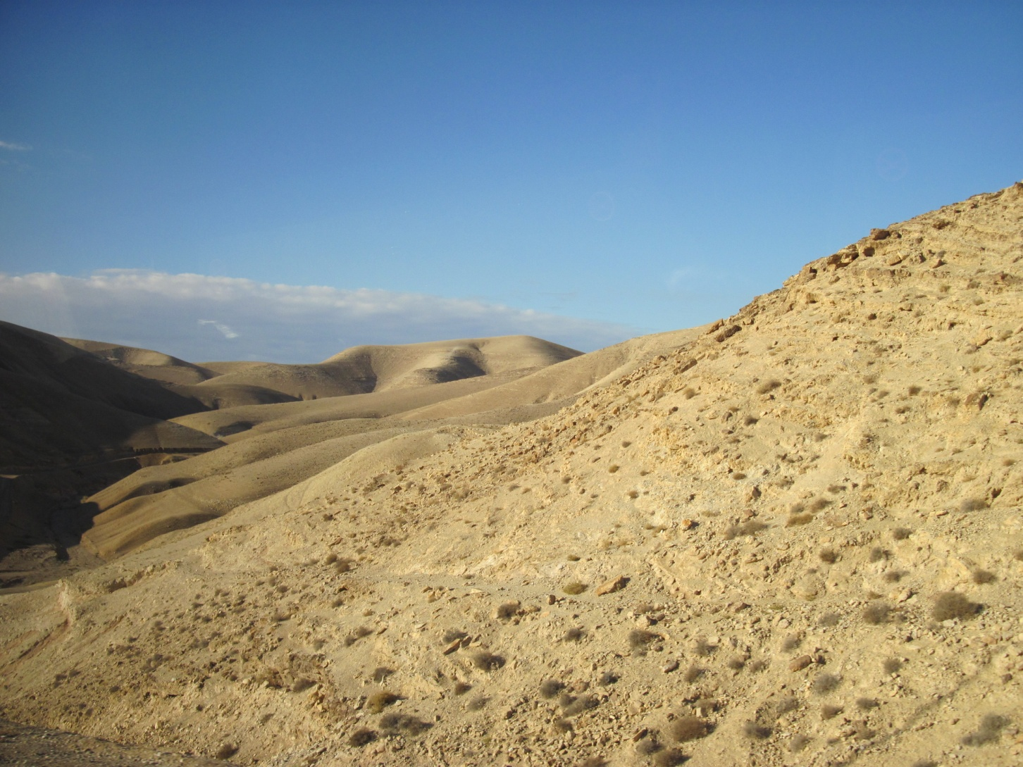
“The wilderness”

Slide 26


Slide 27
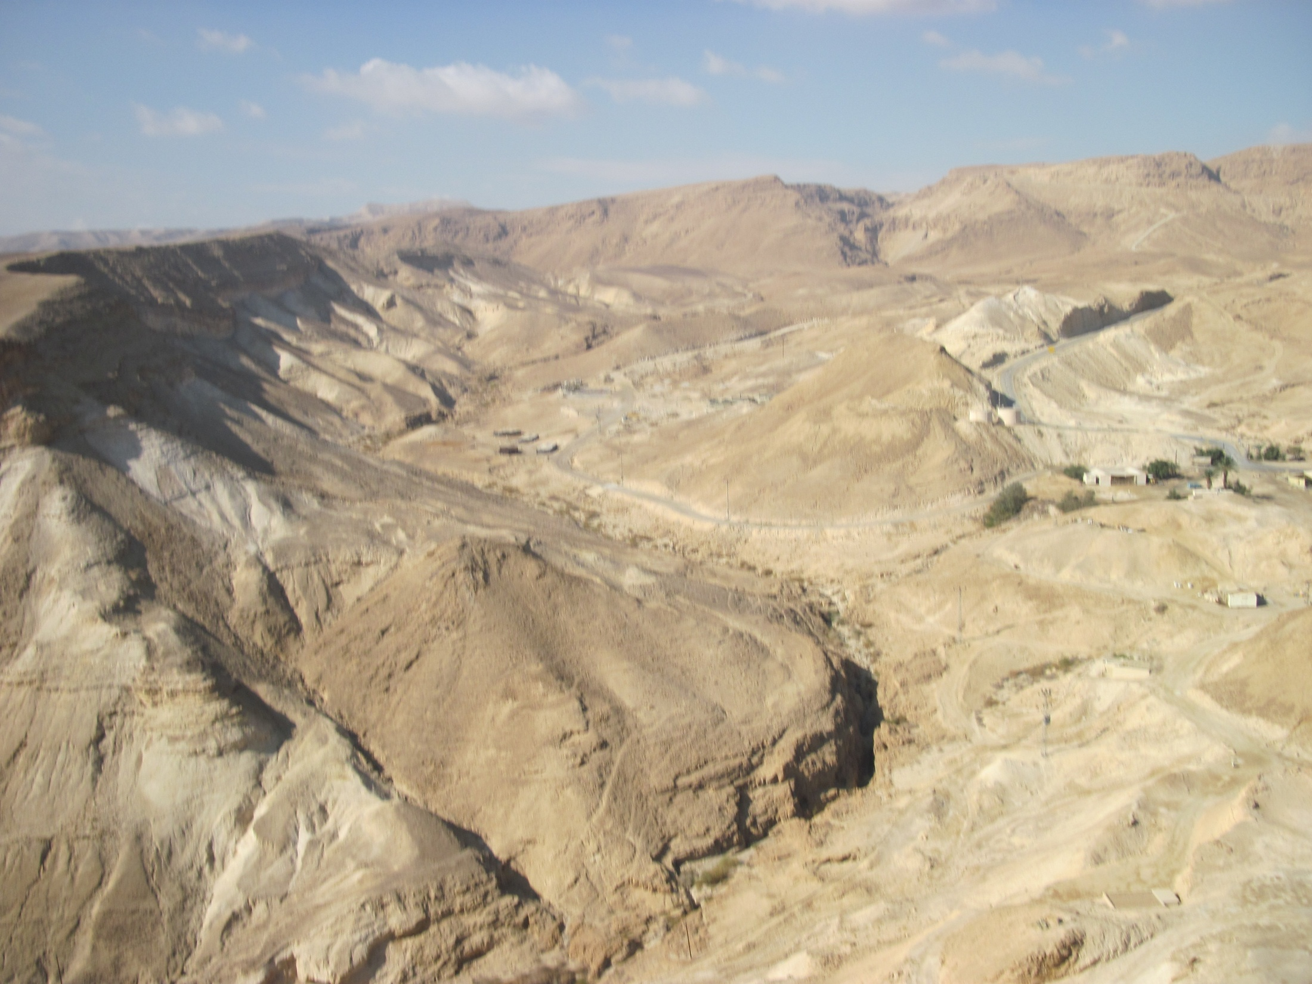

Slide 28
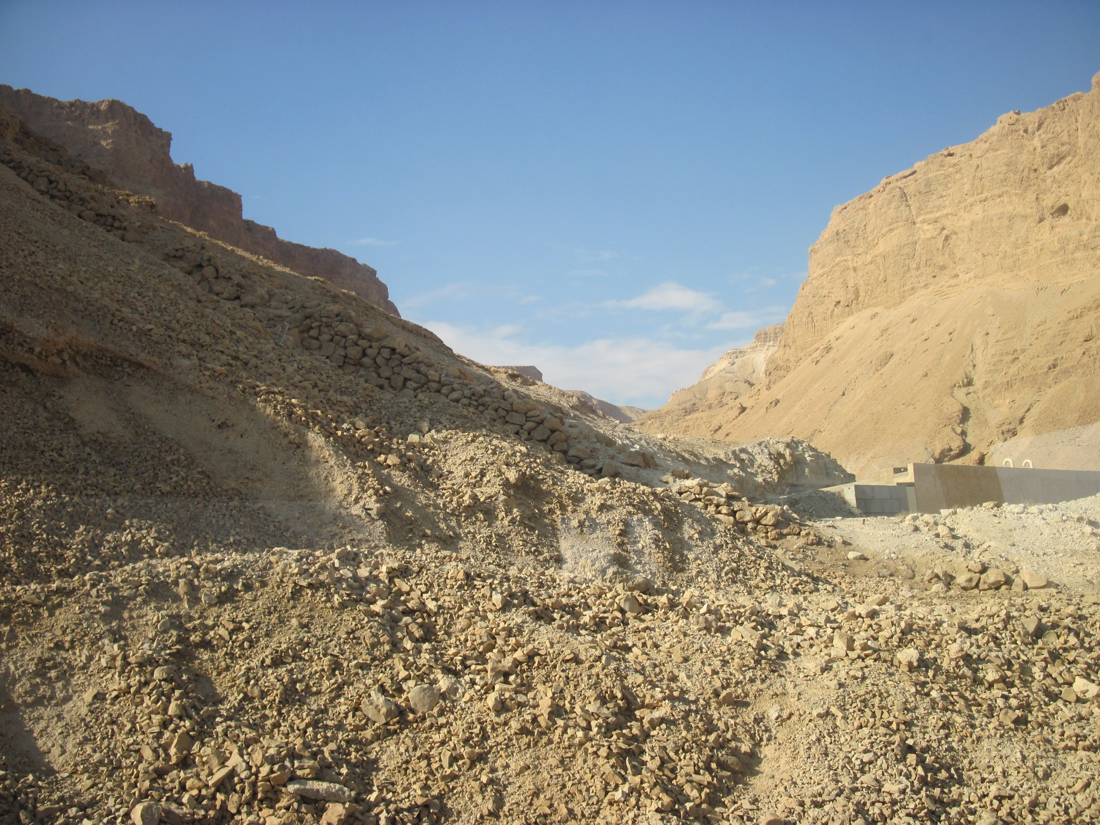

Slide 29
Chapter 23 Notes
Jesus’ temptation
  Jesus was led by the Spirit into the wilderness
  Fasted for 40 days & nights
  Satan tempted him three times (read pg. 322)
  What was Jesus’ defense?
    God’s Word! The sword of the Spirit – Eph. 6:17
  1st temptation: use your supernatural powers for your own needs
  2nd temptation: Use your powers to win a large following.
  3rd temptation: Compromise with Satan
  Satan knows Scripture!
    He abused it against Jesus.

Slide 30
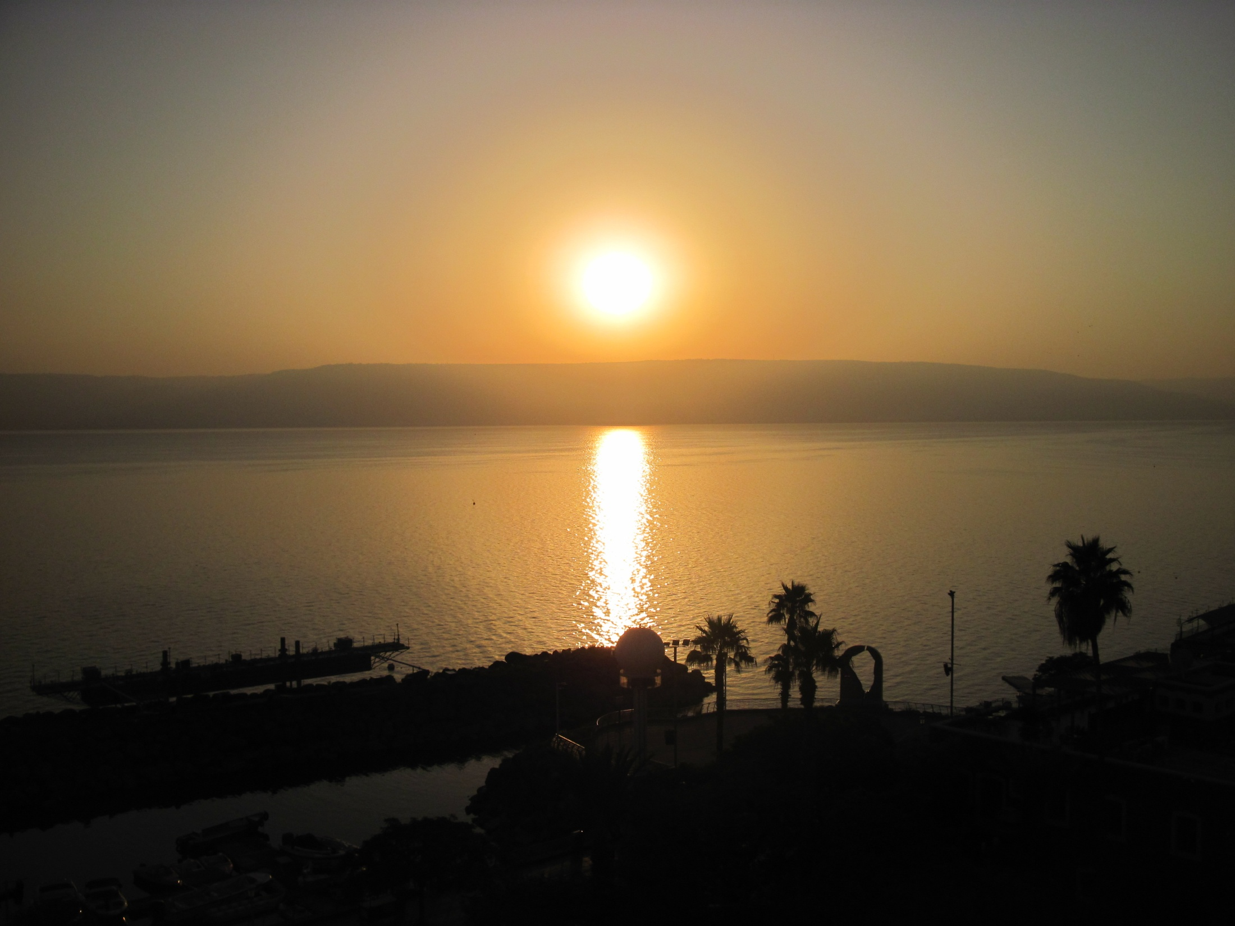
Sea of Galilee

Slide 31
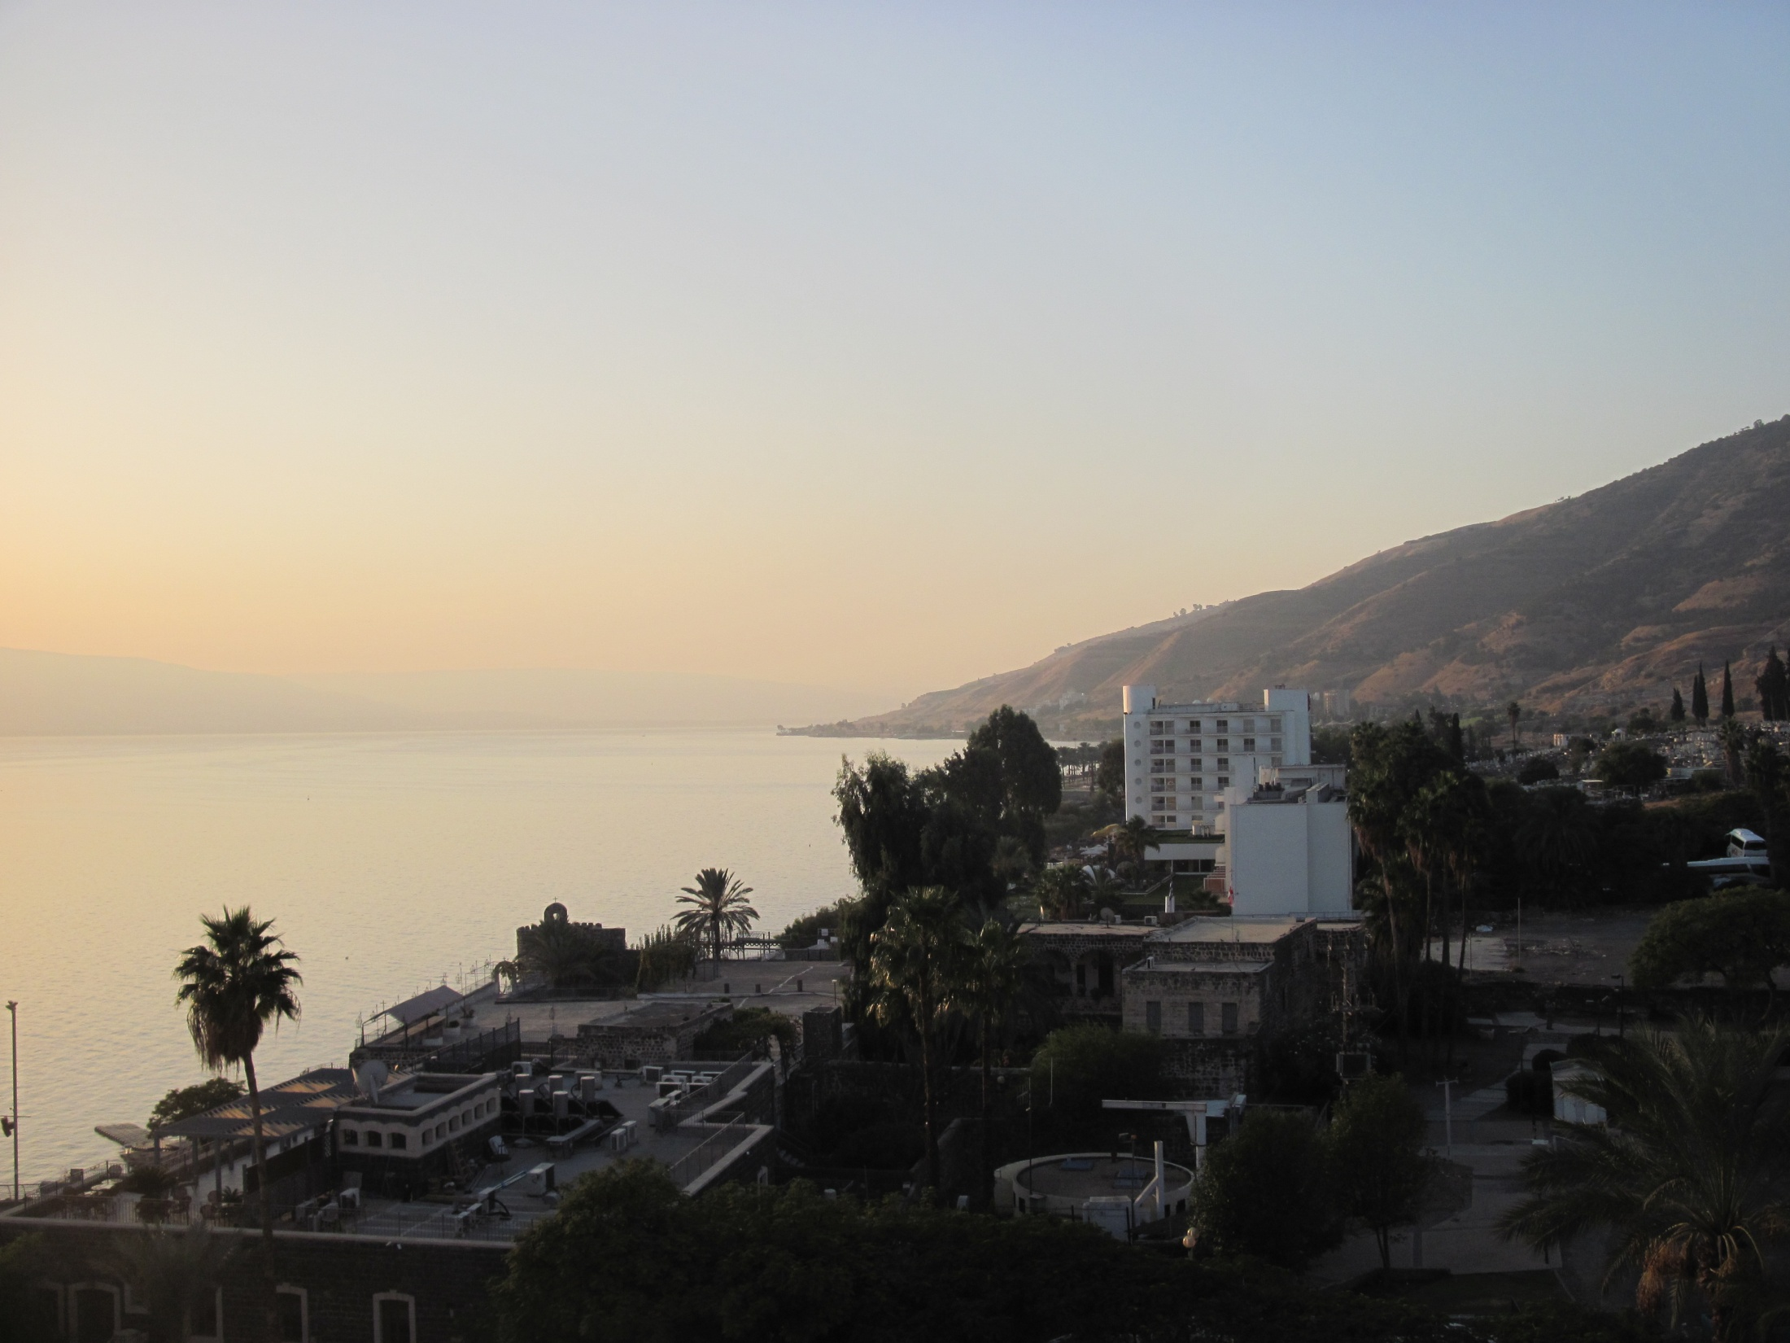
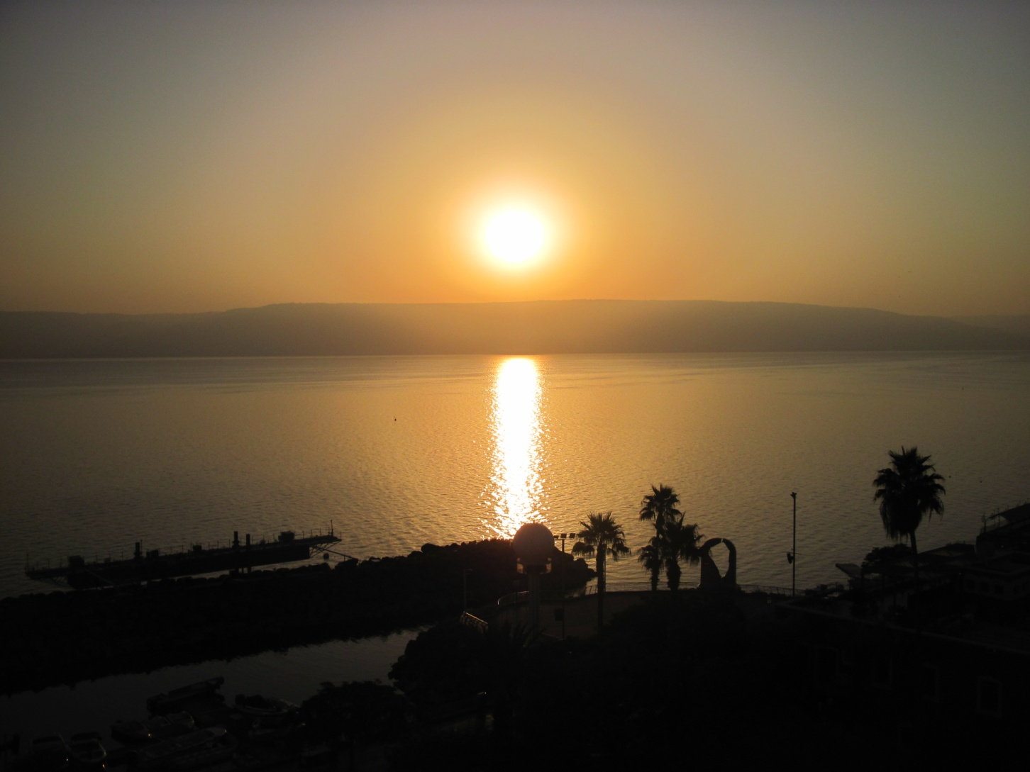

Slide 32
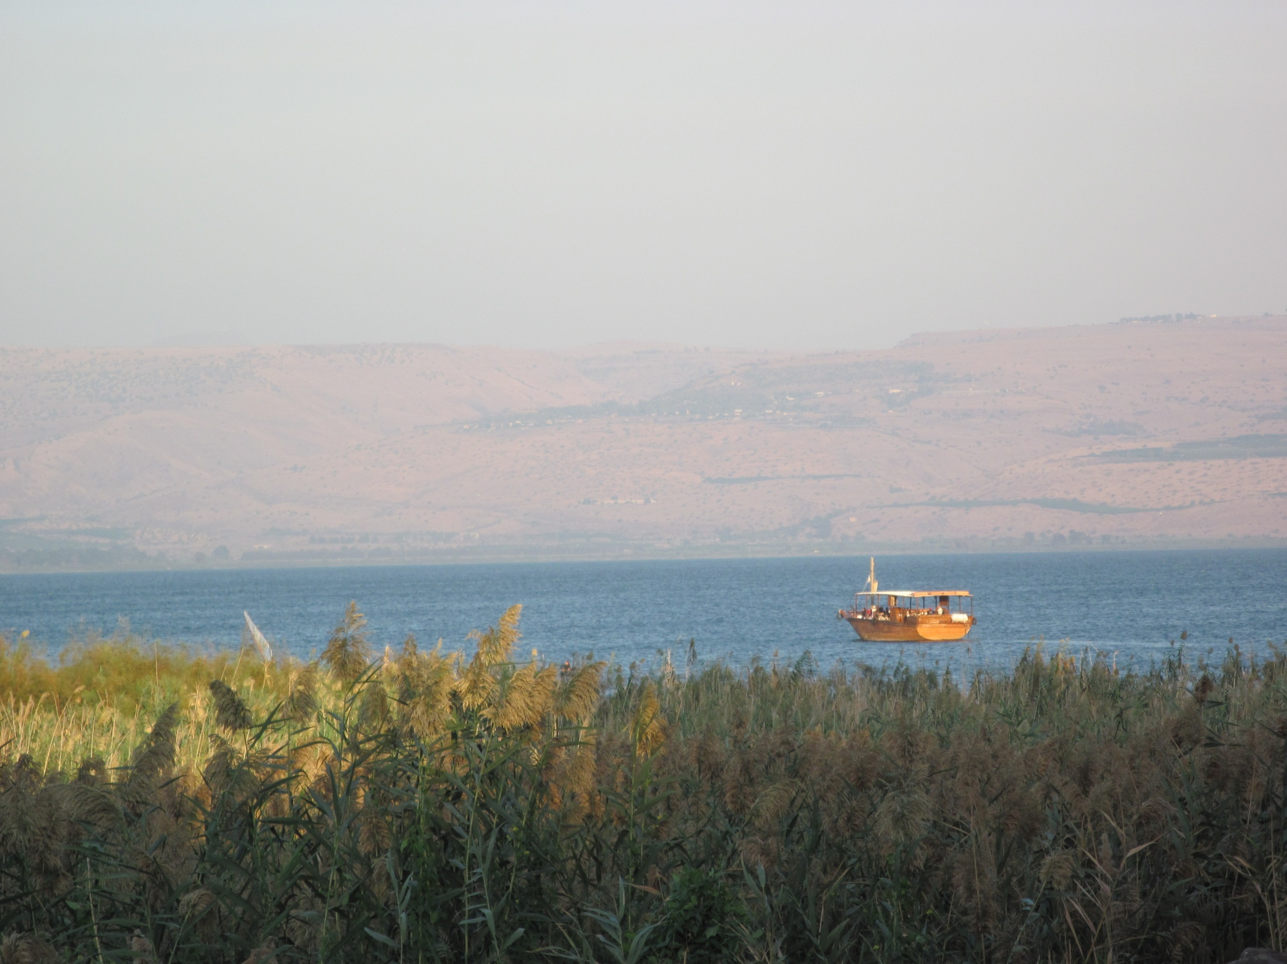

Slide 33
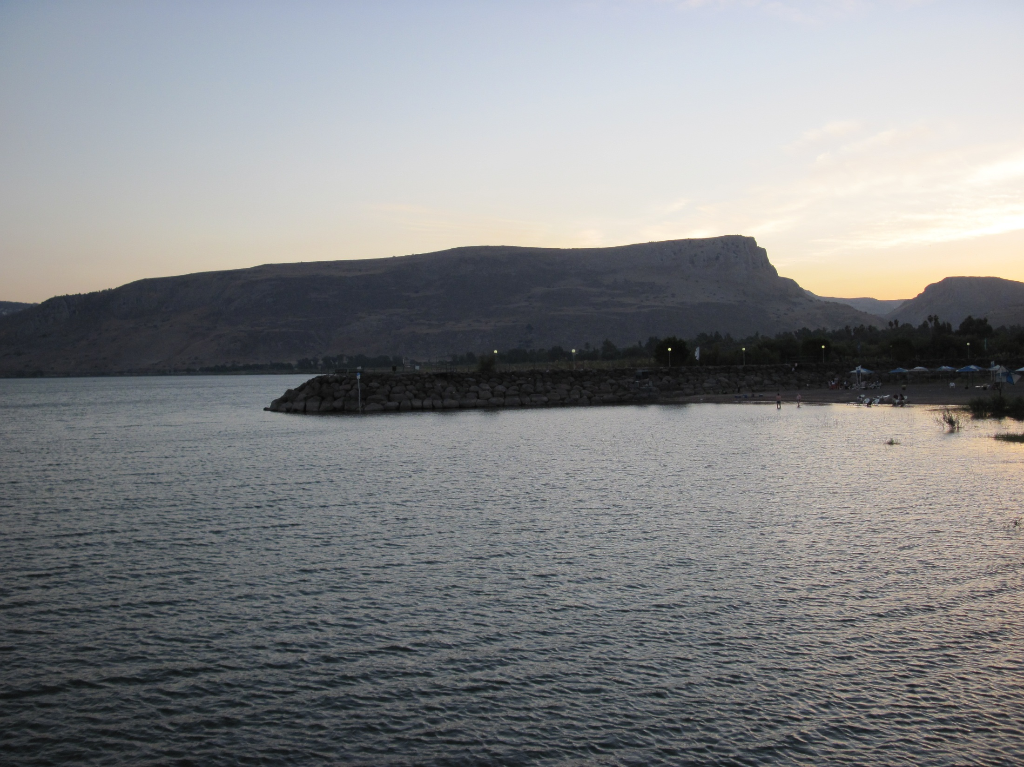
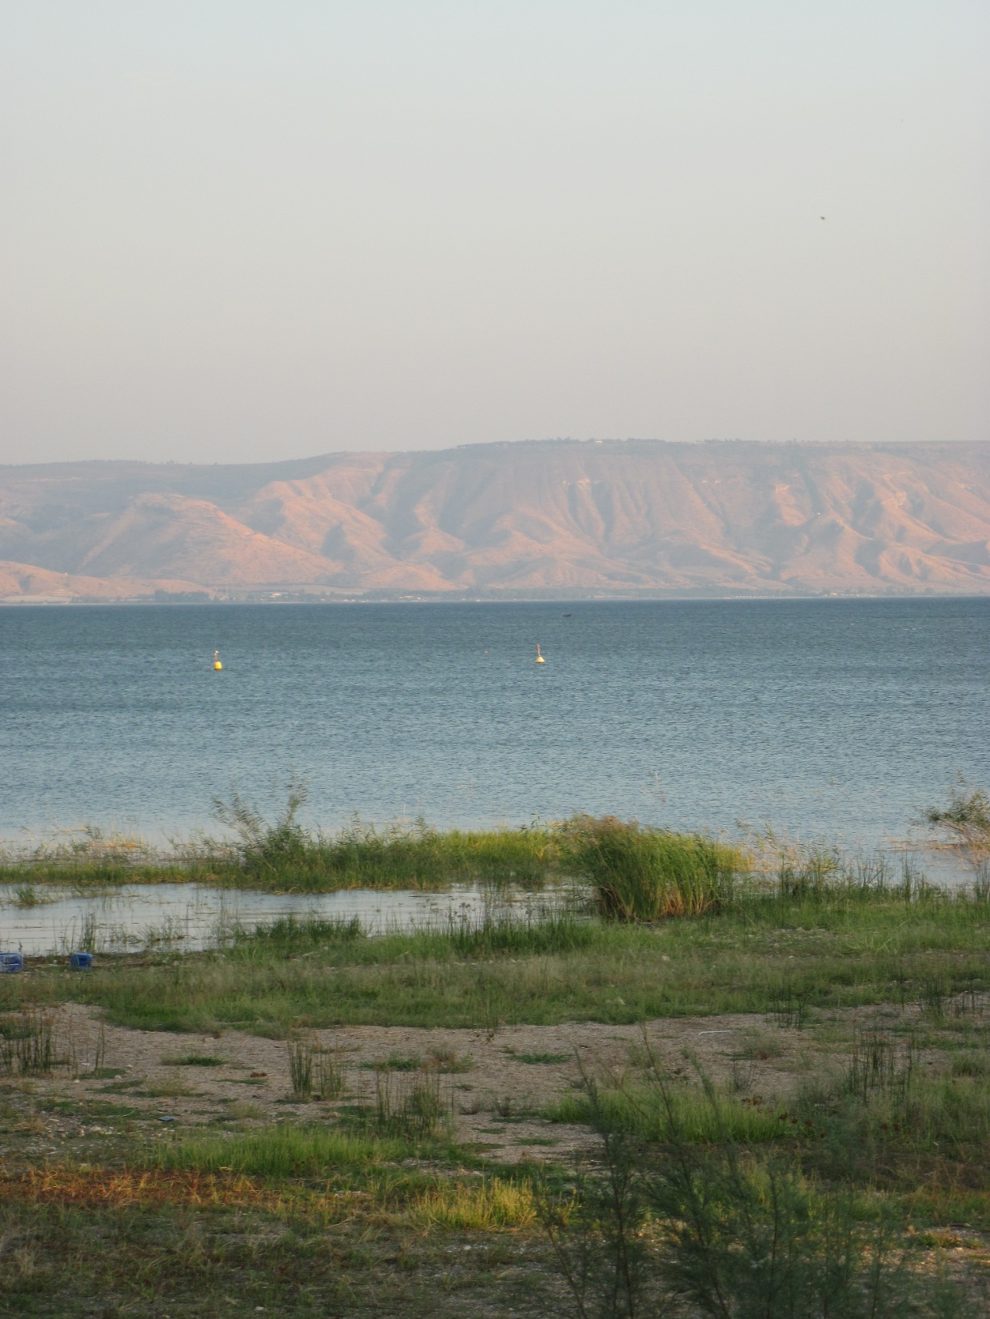

Slide 34
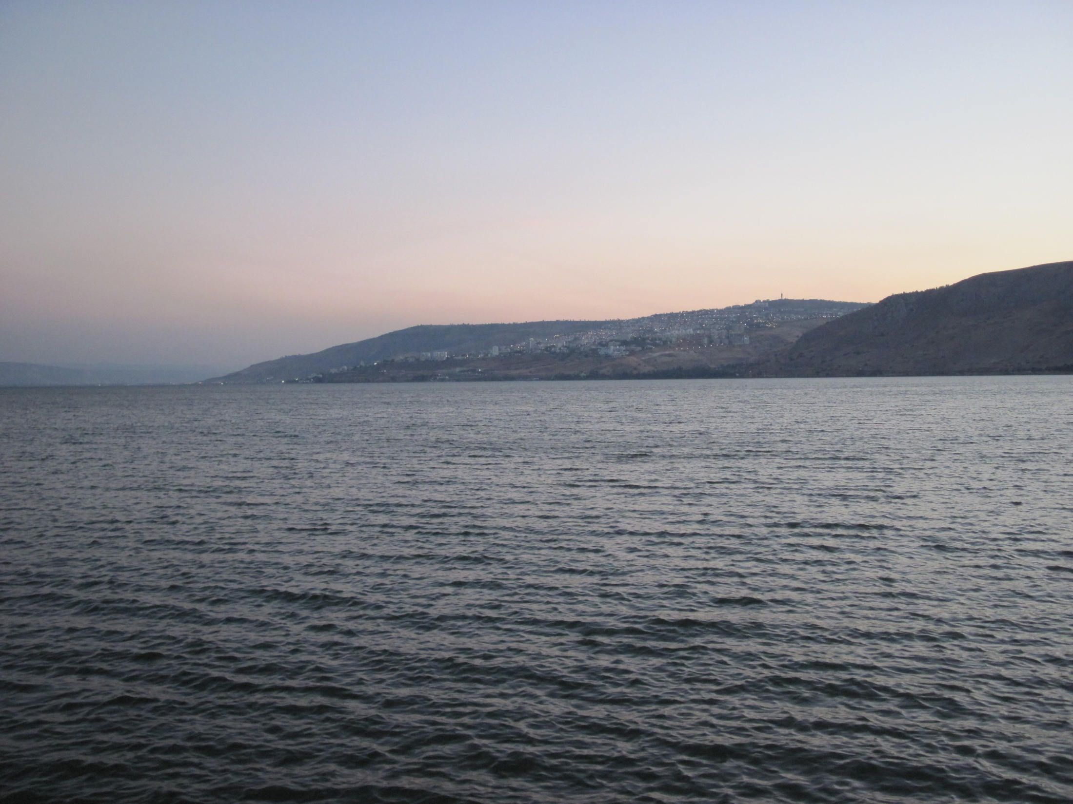

Slide 35
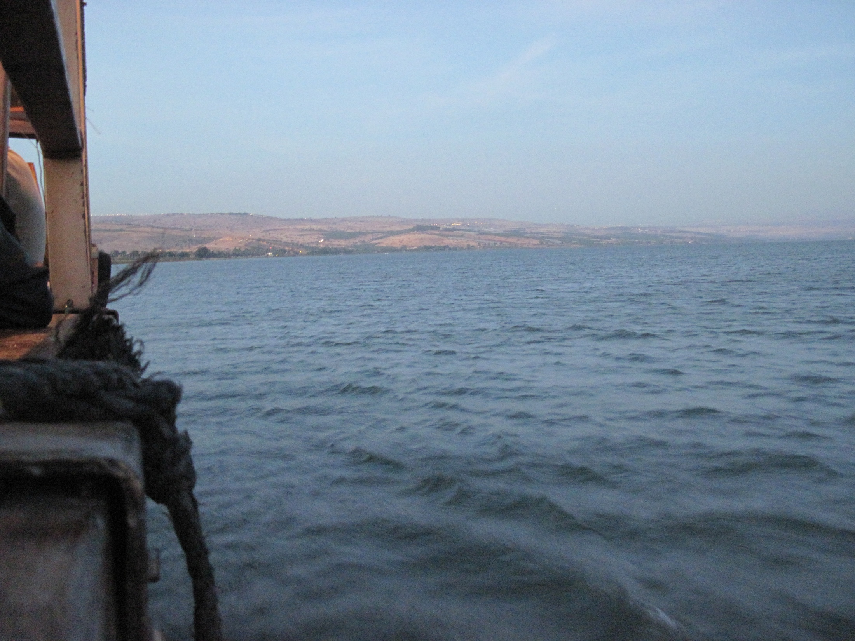

Slide 36
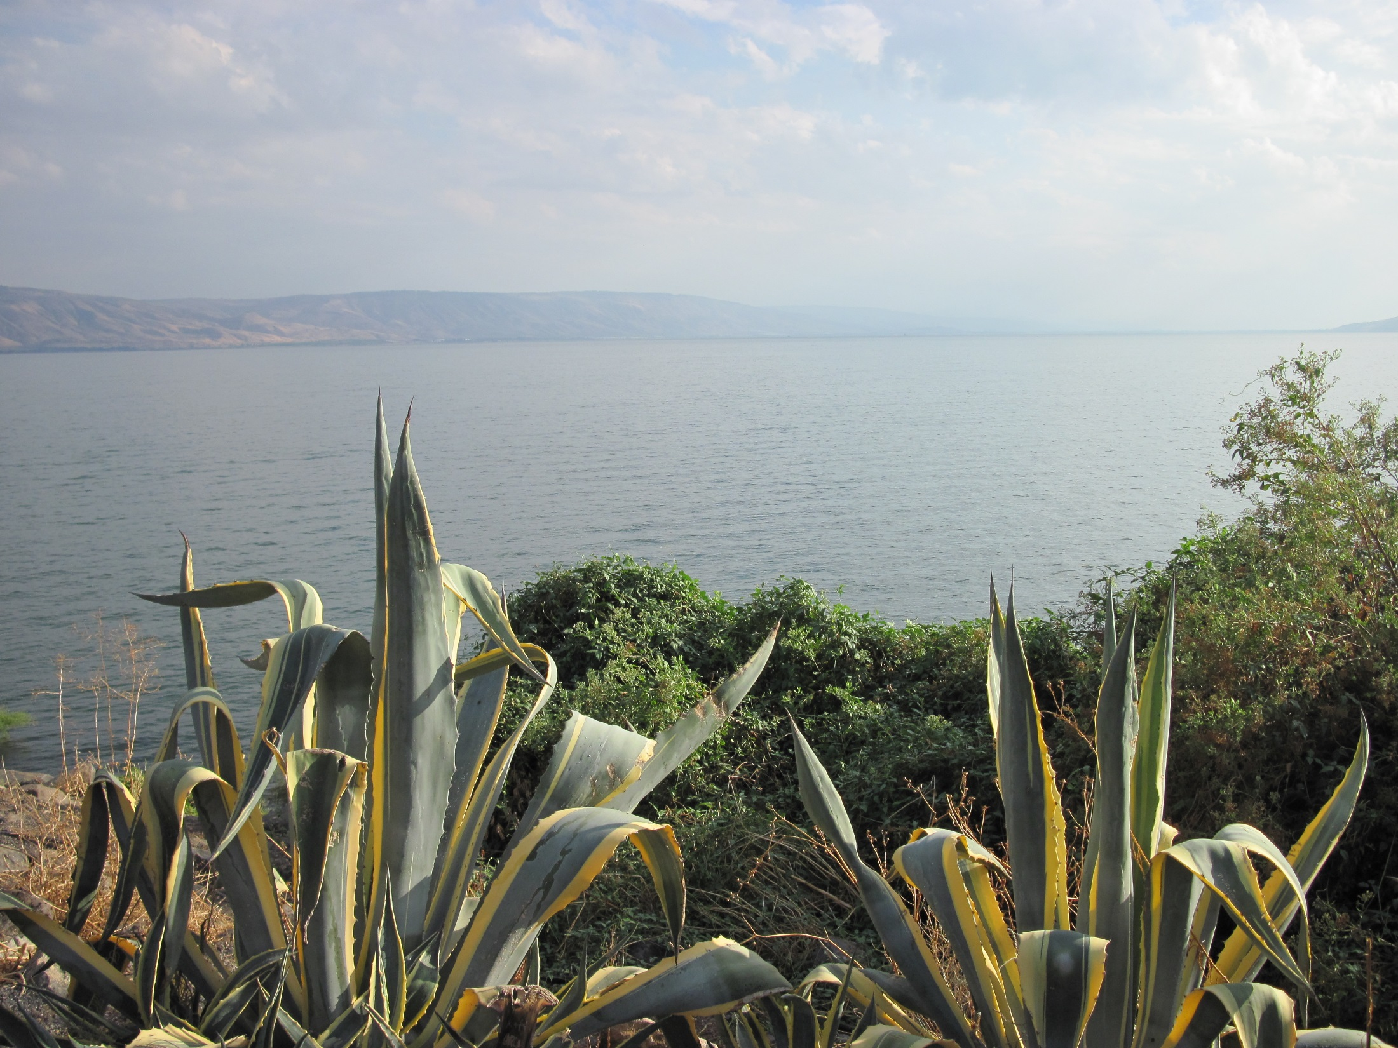

Slide 37
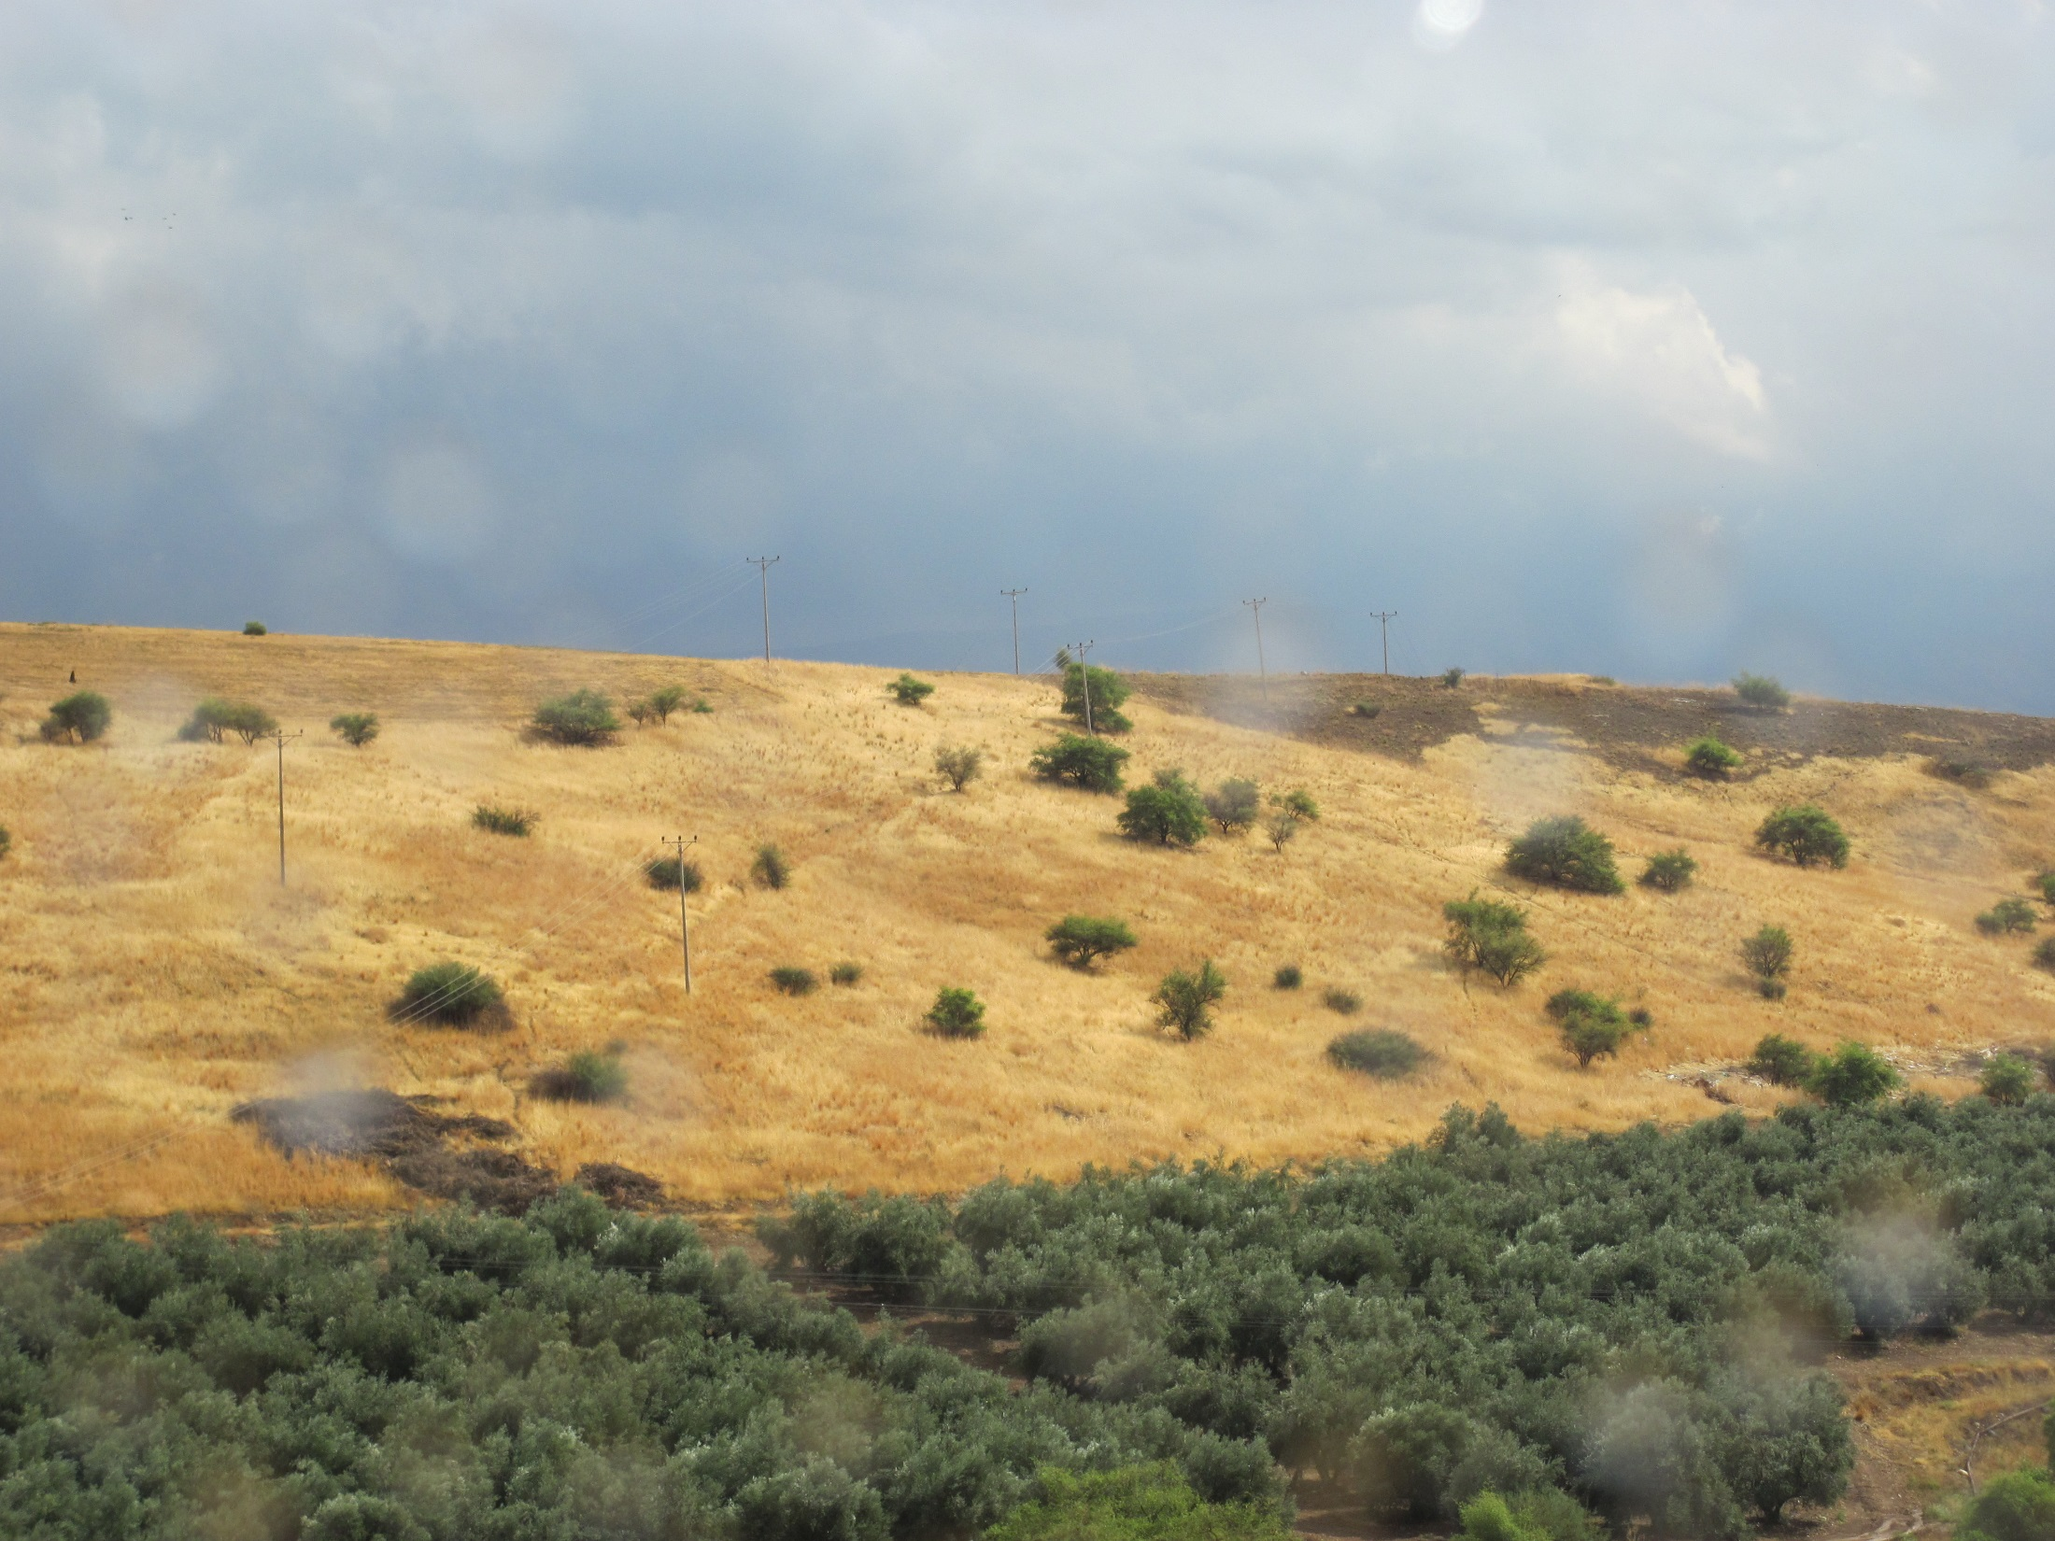
Possible “Sermon on the Mount” site

Slide 38
Chapter 23 Notes
Jesus invites…
  Underline all of the invitations that happen on the bottom of pg. 324.
  How has Jesus invited you to follow Him?
    Baptism!
    He tells Nicodemus – a Pharisee – to be born of water and the Spirit!
Woman at the Well
  Spoke to a Samaritan woman! GASP!
  Jews and Samaritans hated each other
  Women were 2nd-class citizens
  “Living water” - Jesus

Slide 39
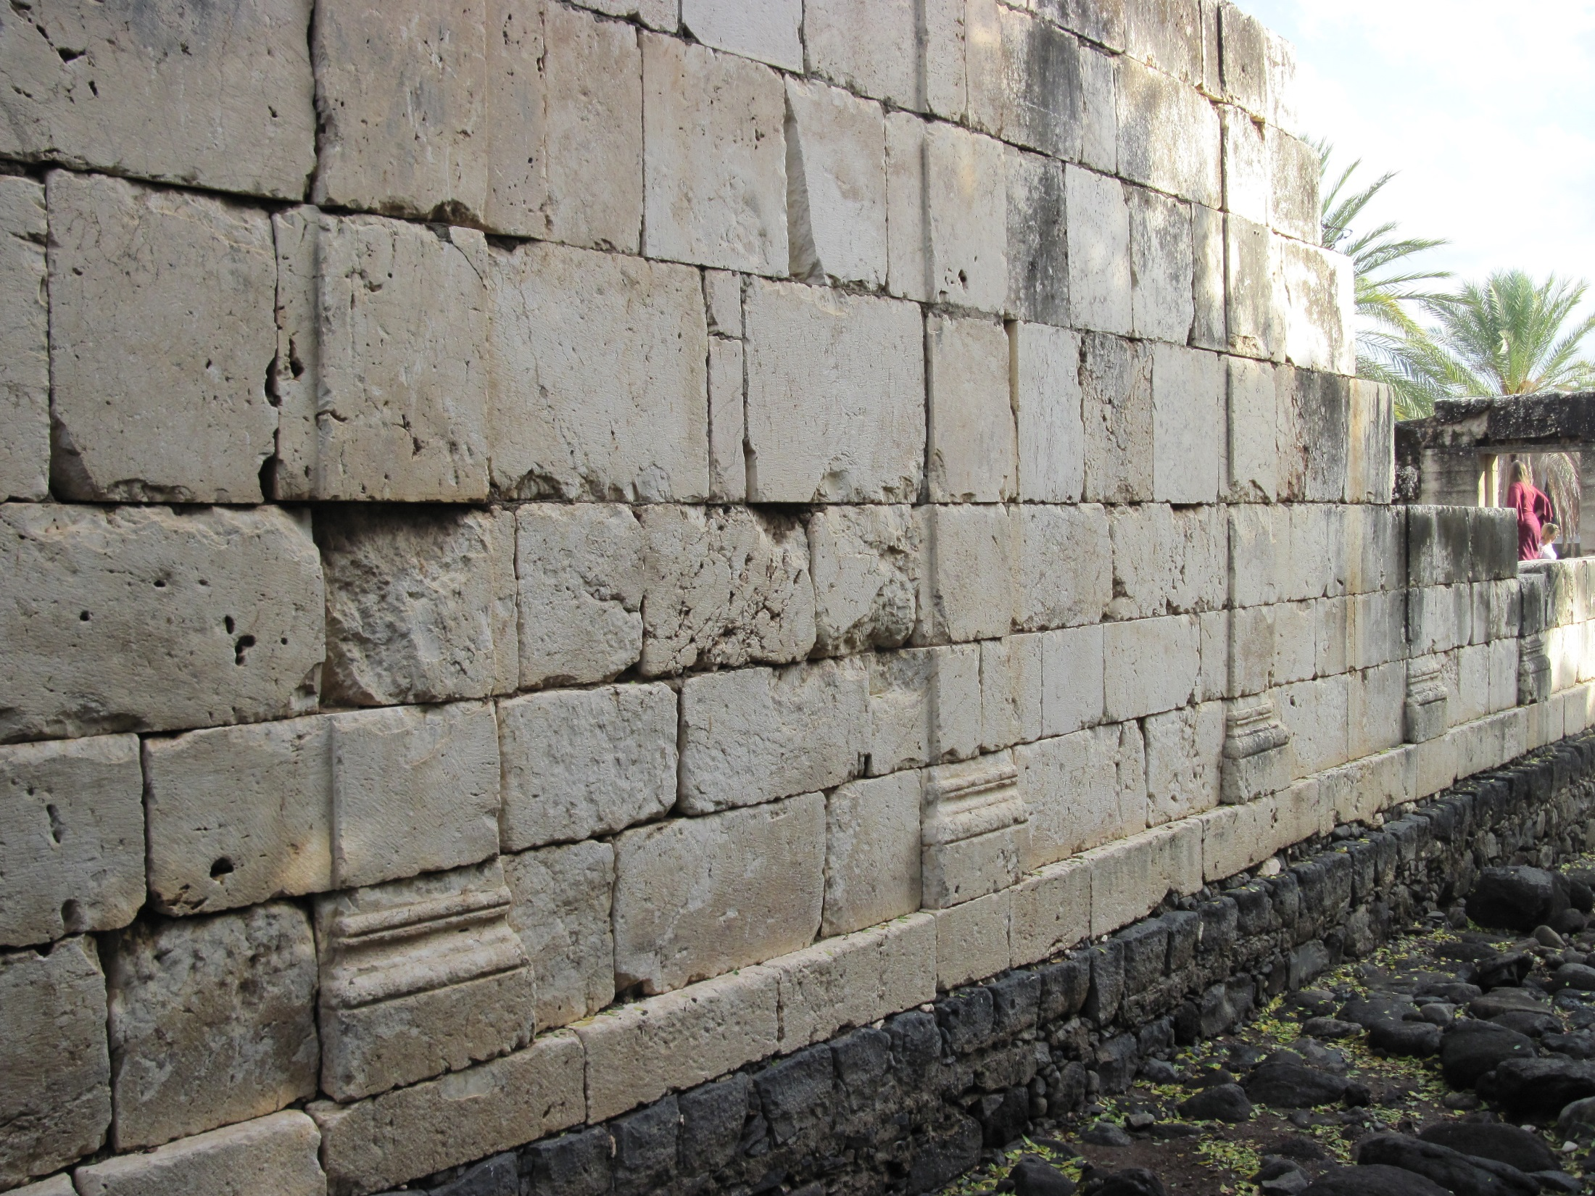
The synagogue in Capernaum
Jesus walked on the black foundation!

Slide 40
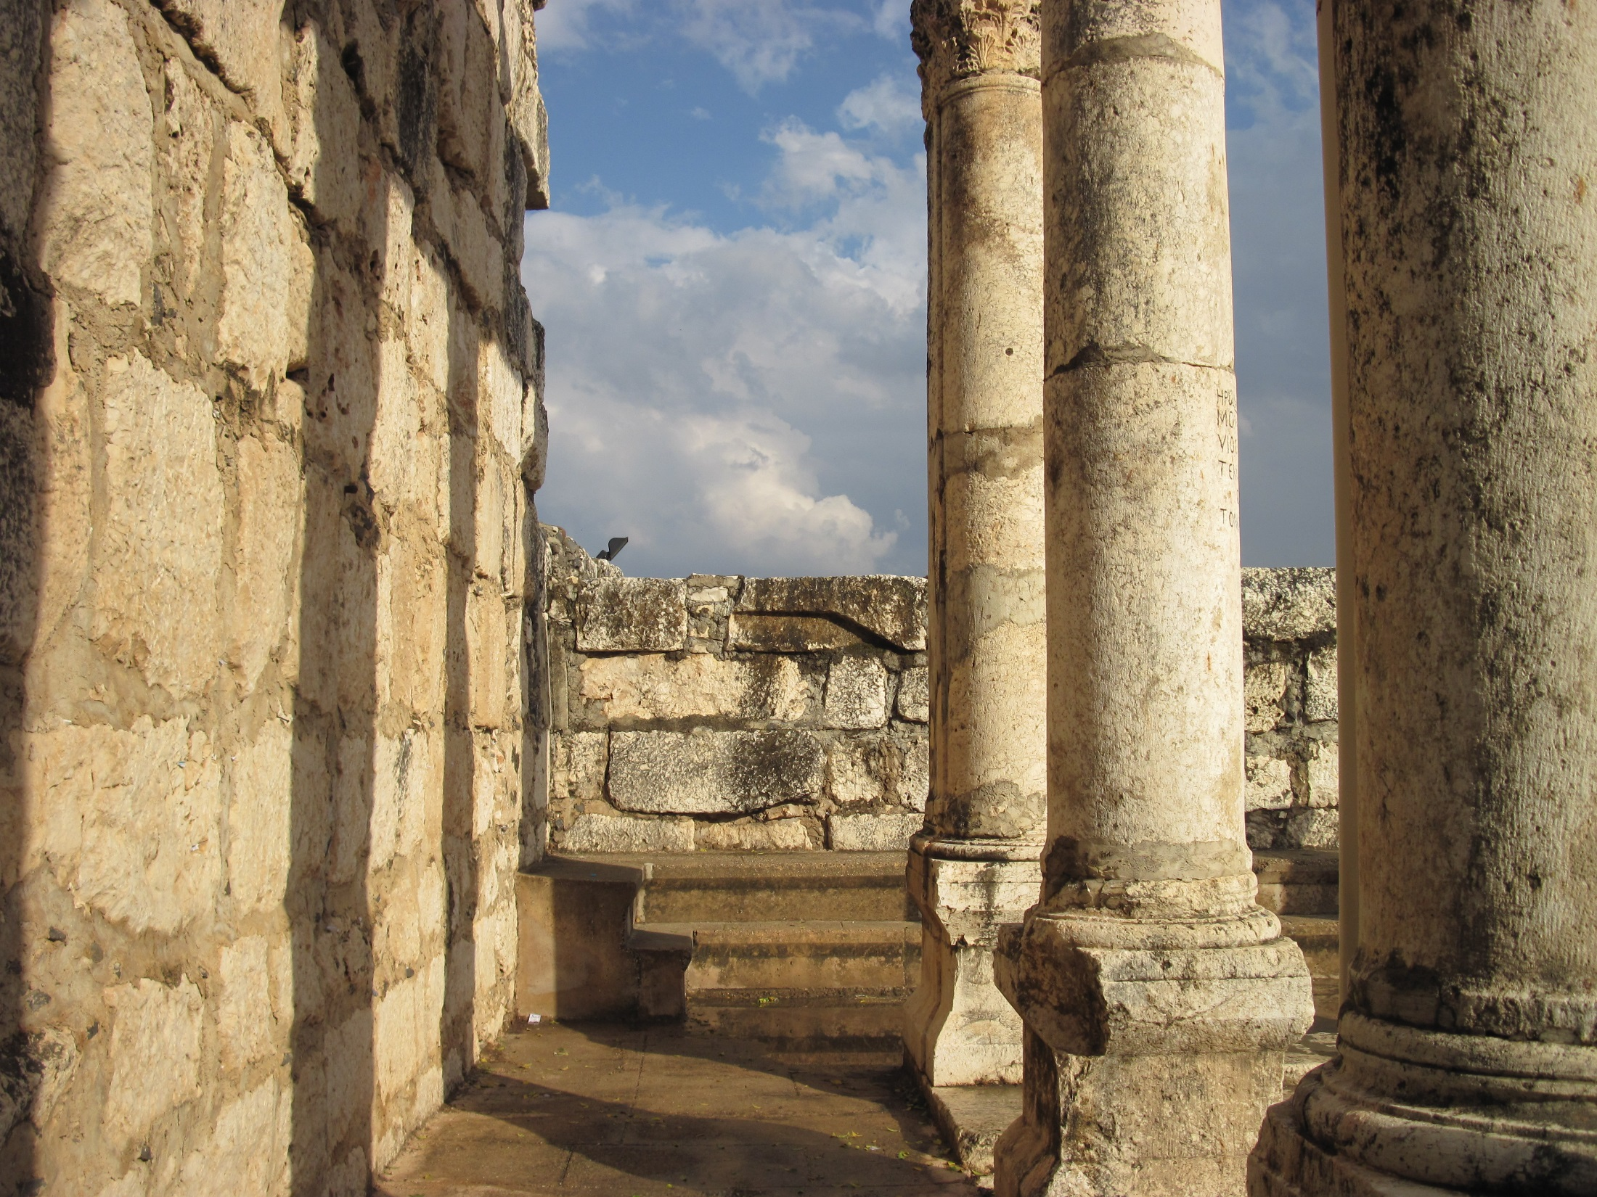

Slide 41
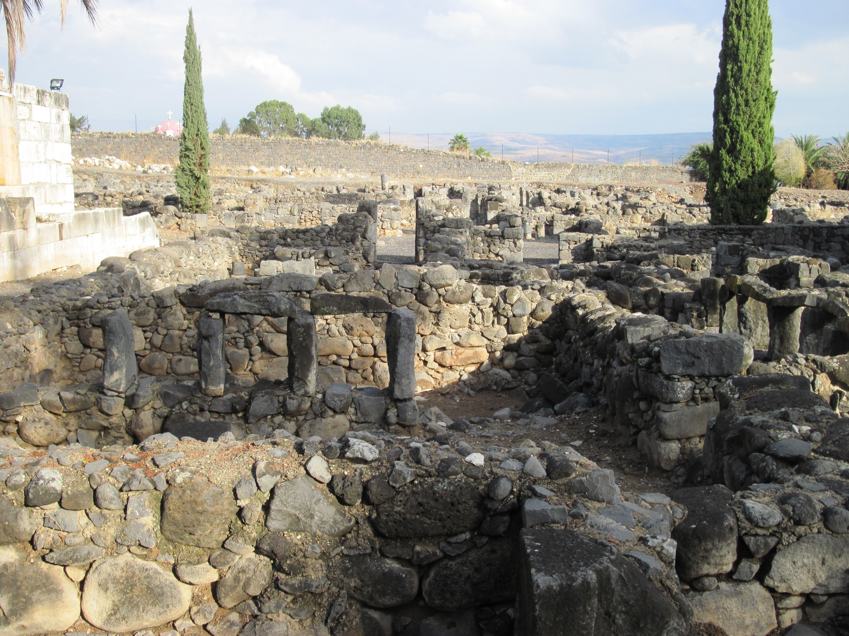


Slide 42
Chapter 23 Notes
Jesus’ miracles
  Water into wine at Wedding in Cana (1st miracle)
  Drove out demons
  Healed diseases
  Cured paralyzed man
  People came from all over to be healed and hear his teachings
  Teachers of the law didn’t like him. They began to plot to kill him, why?
He talked and ate with sinners
  “I have not come to call the righteous but sinners.”

Slide 43
On your worksheet…
Under “Join The Story,” answer one of the questions.

Slide 44
Discussion Questions

Slide 45
Why do you think Jesus’ disciples were so willing to leave everything and follow him?

Slide 46
Why do you think it was significant that Jesus fasted and was tempted by the devil?

Slide 47
What kinds of people did Jesus usually minister to and spend time with? What does this tell you about him?

Slide 48

For Next Sunday:
Read Ch. 24
Memorize John 6:35
*Pastor Peter will be teaching the remaining lessons.

Slide 49
-THANK YOU to everyone who attended MYSTERY NIGHT!
-Bring 2 dozen homemade cookies to “Sunday Night FLY - Cookies for College Students” next Sunday @ 7pm!

Slide 50
Closing Prayers

