Slide 1

Welcome
Jr. FLY Confirmands!
Mar. 9, 2025

Slide 2
Welcome
&
Opening Prayer

Slide 3
QUIZ
(on Chapter 21)

Slide 4
1. Ezra was a descendant of _____.
Aaron
Abraham
Paul
None of the above

Slide 5
2. _______ was a cupbearer to the king of Persia.
Ezra
Nehemiah
Artaxerxes
Isaiah

Slide 6
3. Nehemiah recruited people to help:
Destroy Israel’s enemies
Rebuild Bethlehem’s walls
Rebuild Jerusalem’s walls
Kill King Artaxerxes

Slide 7
4. Ezra led a ______ at the temple once the walls were finished.
Worship service
Day of fasting
Sermon
Both A & C

Slide 8
5. ________ was the last prophet before John the Baptist.
Nehemiah
Obadiah
Ezra
Malachi

Slide 9
Today’s video was created by Pastor Peter & Steph Johnson… long before they started dating… ;)

Slide 10
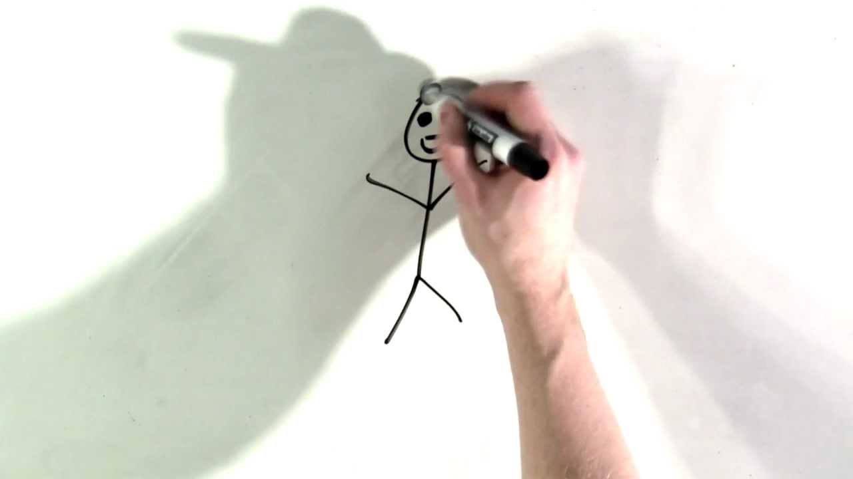

Slide 11
On your worksheet…
Under “See the Story,” create a simple image or symbol that you think best represents
Chapter 22.

Slide 12
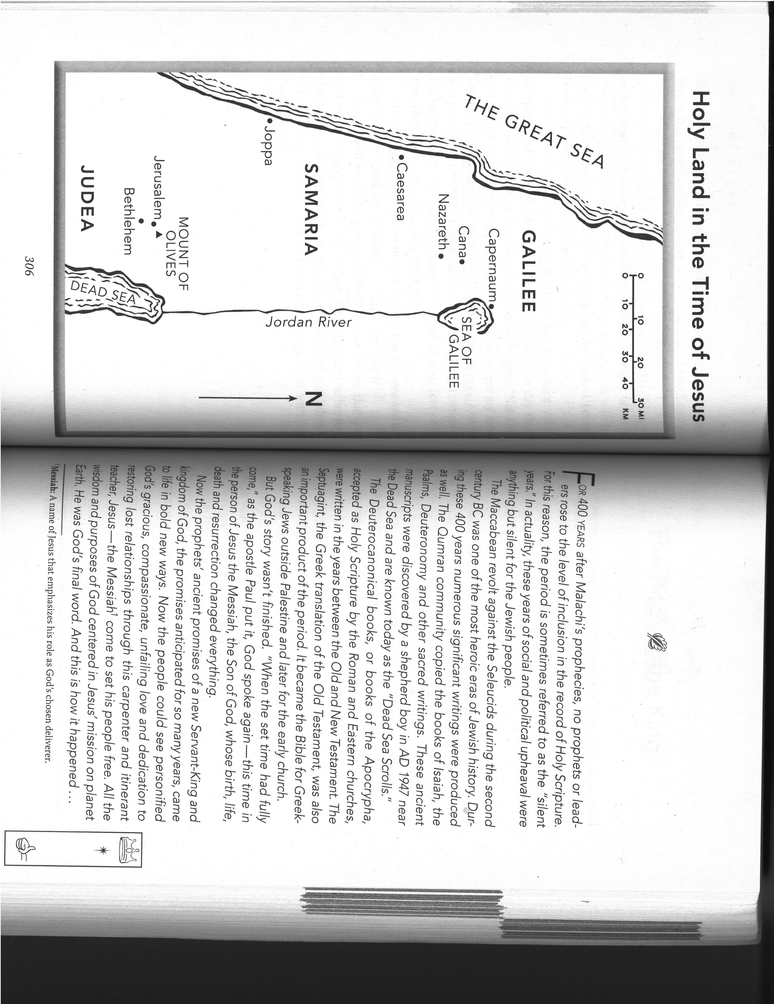

Slide 14
Chapter 22 Notes
“In the beginning was the Word…” – John 1:1
  Points us back to “Let us make man in our image” – Genesis 1:26
  Connection?
  Jesus, God’s Son, has been around forever! Now he’s in the flesh… for us!!
“Law was given through Moses” (pg. 310)
  10 Commandments & other Jewish laws
  Law points us to our sins
“Grace and truth came through Jesus Christ”
  Christ’s death & resurrection
  Gospel points us to forgiveness & eternal life found in Christ!

Slide 15
Chapter 22 Notes
Angel Gabriel
  Appeared to Daniel in the Old Testament and explained visions to him
  Appeared to Zechariah in the New Testament and foretold of his son’s birth (John the Baptist)
  Appears to Mary in the New Testament and foretold of her son’s birth (Jesus)
  What are angels?
    God’s messengers

Slide 16
Chapter 22 Notes
Covenant Connections/Fulfillments
  “The Lord God will give him the throne of his father David, and he will reign over Jacob’s descendants forever; his kingdom will never end.”
    Davidic Covenant
  “He has helped his servant Israel, remember to be merciful to Abraham and his descendants forever, just as he promised our ancestors.”
    Abrahamic Covenant

Slide 17
Chapter 22 Notes
Why did Joseph want to divorce Mary? (pg. 312)
  They were engaged and Mary’s pregnant… doesn’t look good!
  The punishment for being pregnant out-of-wedlock was stoning to death.
  Then an angel appears in a dream and changes Joseph’s mind...
“He will save his people from their sins.”
  Immanuel = God with us!
  God is finally here in the flesh! (Incarnation)
  The prophets were right!
  God has kept his promises!

Slide 18
Chapter 22 Notes
“No guest room available…” what?!
  Not an inn. At the time, no middle-easterner would’ve turned away a pregnant woman.
  “place for guests” – probably stayed with Joseph’s family – who also had to register in the city of their ancestors: Bethlehem.
After Jesus is born, who were told first?
  Shepherds! They had stinky, grueling jobs…
  Did you know? The flocks of sheep reserved for temple sacrifice were kept in the fields near Bethlehem.
  Shepherds spread the news of Jesus!

Slide 19
Chapter 22 Notes
King Herod (ruled 40-4BC)
  Roman client king of Judea (in other words – he worked for Caeser in Rome)
  Great builder
    Built an artificial harbor in Caesarea
    Rebuilt/added on to Temple in Jerusalem
  Paranoid ruler
    Killed members of his family
    Killed boys under age of 2 in Bethlehem

Slide 20
Chapter 22 Notes
Magi (aka Wise Men)
  We don’t know how many there were… never stated.
  Followed star to Israel
  They arrived in Jerusalem first and then Bethlehem
  Knew Micah’s prophecy that the king of Israel would come out of Bethlehem
  They worshiped Jesus perhaps months or years after he was born.
  They didn’t go back to report to Herod and he was furious!
Joseph, Mary & Jesus fled to Egypt until Herod died in 4BC.

Slide 21
Chapter 22 Notes
The Bible is silent about Jesus’ childhood until he’s 12 years old.
  Family celebrated Passover in Jerusalem
  Jesus stayed behind in the Temple “listening and asking questions” of the teachers
  Parents searched for him for 3 days
  “Didn’t you know I had to be in my Father’s house?”

Slide 22
Answer a “Join the Story” question on your worksheet

Slide 23

For Next Sunday:
  Read Chapter 23
  Memorize John 3:16-17

Slide 24
THANK YOU to everyone who helped with our Spaghetti Dinner and Diaper-packing event this past week!

Slide 25
Invite EVERYONE you know to MYSTERY NIGHT TONIGHT @ 7pm!
Discover the mystery activities!
Past mysteries have been: laser tag, bungee basketball, sumo wrestling, bubble soccer, human foosball, and more!

Slide 26


Slide 27
Closing Prayers

