Slide 1
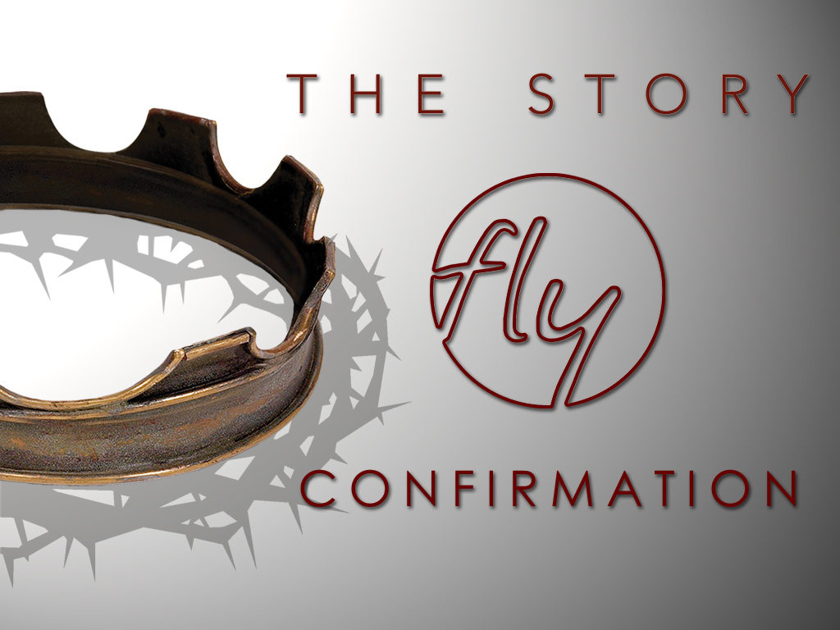
Welcome
Jr. FLY Confirmands!
Feb. 23, 2025

Slide 2
Welcome
&
Opening Prayer

Slide 3
QUIZ
(on Chapter 20)

Slide 4
1. ________ made Esther Queen of Persia.
Nebuchadnezzar
Xerxes
Cyrus
Mordecai

Slide 5
2. ________ was Esther’s family member and looked out for her.
Nebuchadnezzar
Xerxes
Cyrus
Mordecai

Slide 6
3. Mordecai didn’t bow down to ________ (a noble in the king’s court).
Haman
Samuel
Judah
None of the above

Slide 7
4. Haman’s plan was to exterminate the ________.
Amorites
Jews
Persians
None of the above

Slide 8
5. God gave Esther courage to ___________.
Make Mordecai a noble
Return home to Jerusalem
Ask the king to spare her people
None of the above

Slide 9
6. True or False: King Xerxes didn’t grant protection and rights to the Jews.
True
False

Slide 10


Slide 11
On your worksheet…
Under “See the Story,” create a simple image or symbol that you think best represents
Chapter 21.

Slide 12
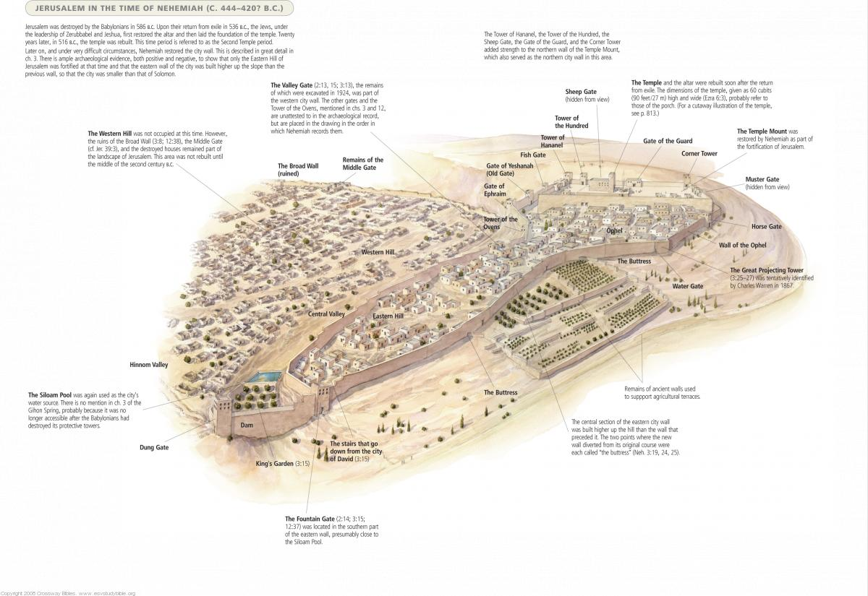

Slide 13
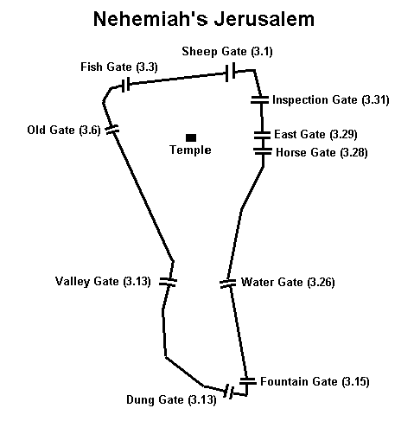

Slide 14
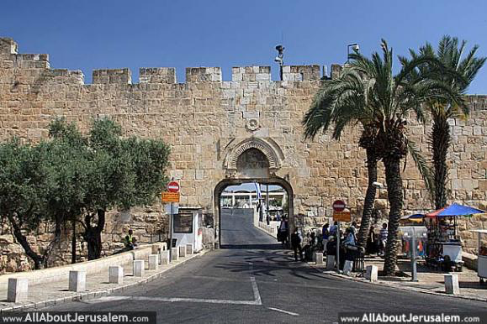
Dung Gate today

Slide 15
Chapter 21 Notes
Ezra
  Descendant of Aaron the High Priest
  Teacher of the Law
  Led thousands of Jews back to Jerusalem from exile
  He discovered Jews intermarrying with neighboring cultures. Ezra wept and confessed Israel’s sins to God. Why?
    Intermarrying opens the doors for idolatry... again!
    Don’t risk a 2nd exile!
    1st commandment issue

Slide 16
Chapter 21 Notes
Nehemiah
  Cupbearer of King Xerxes
    Tasted drinks to find poison before his king drank it
    The king had to trust him
  Appointed governor of Judah to rebuild Jerusalem
  Repaired Jerusalem’s walls in 52 days!
  Armed his workers with weapons. Why?
Faced opposition by Sanballat, Tobiah, Geshem, and others.
  God protected Israel and allowed the walls to be completed.

Slide 17
Chapter 21 Notes
Covenant Renewal (pg. 300)
  Ezra read God’s Word out loud all day
  Renewal celebration lasted months
  It reminded Jews to avoid idolatry, to keep the Sabbath day, and make sacrifices at the Temple
  The community is reformed around the Temple and Torah
    No longer a nation state
    A priestly theocracy w/ Levite priests
    Became “People of the Book” - which book is that??

Slide 18
Chapter 21 Notes
Ezra/Nehemiah’s Main Messages:
  God has kept His promises: remnant, land, temple, city.
  Be faithful to temple service and Torah.
  Avoid sins of ancestors that led to exile.
  You’re still God’s covenant people.
  God is with us!
Malachi
  Last prophet of the Old Testament
  Around 400 BC
  “My name will be great among nations.”
  Read pg. 304 - “Remember the law…”
  Elijah (aka John the Baptist) is coming back before the Lord comes!

Slide 19
On your worksheet…
Answer the two questions under “Hear the Story.”

Slide 20
On your worksheet…
Under “Join The Story,” answer one of the questions.

Slide 21
Discussion Questions

Slide 22
In what ways do you see God’s faithfulness in this story?

Slide 23
Why do you think Nehemiah was so upset that Jerusalem’s walls were never rebuilt?

Slide 24
Why do you think Nehemiah was able to rebuild the city walls so quickly amidst such severe opposition?

Slide 25
What can you do to grow a greater dependence on God in difficult circumstances?

Slide 26
How do you feel when you hear God’s words: “I, the Lord, do not change?”

Slide 27

*NO CLASS next Sunday because of the Church-wide Service Project at 9:45am in the Auditorium! Come & serve!

Slide 28
Our next class will be Mar. 9:
-Please read Chapter 22
(the first chapter of the New Testament!)

Slide 29
You’re invited to Sunday Night FLY “Low Battery” TONIGHT @ 7pm!
-Large group discussion, snacks & games! Bring a friend!

Slide 30
Help us at our Spaghetti Dinner on Wed, Mar. 5!
Setup @ 3:30-4:30
Food Prep @ 3:30-5:30
Servers @ 5:15-6:30
Dinner @ 5:30-6:30
Clean-up @ 6:15pm until Completed
Sign-up on the FLY bulletin board!

Slide 31


Slide 32
Closing Prayers

