Slide 1
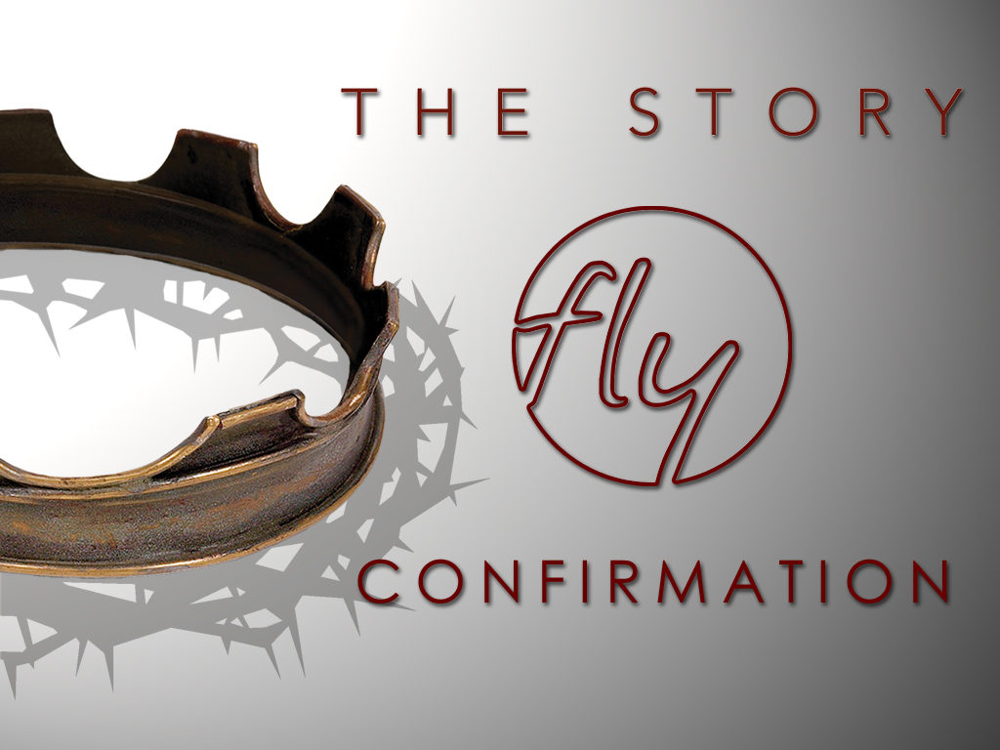
Welcome
Jr. FLY Confirmands!
Feb. 9, 2025

Slide 2
Welcome
&
Opening Prayer

Slide 3
QUIZ on last week’s Chapter 18

Slide 4
1. ______ helped King ______ interpret his dreams.
Ezekiel, Nebuchadnezzar
Daniel, Nebuchadnezzar
Cyrus, Shadrach
Abednego, Cyrus

Slide 5
2. ______ was made ruler of the province of Babylon.
Shadrach
Jeremiah
Daniel
Meshach

Slide 6
3. ______ men walked around unharmed inside the furnace.
2
3
4
5

Slide 7
4. What did Daniel do when he heard about King Darius’ decree about worshiping the king?
He threw himself into a lion’s den.
He prayed with his windows open.
He didn’t bow down to King Darius.
None of the above.

Slide 8
5. Which prophet said, “For I know the plans I have for you… plans to prosper you and not to harm you, plans to give you hope and a future.”
Jeremiah
Isaiah
Ezekiel
Obadiah

Slide 9
6. This king permitted Jewish exiles to return to Jerusalem.
Nebuchadnezzar
Cyrus
Belshazzar
Hezekiah

Slide 10


Slide 11
On your worksheet…
Under “See the Story,” create a simple image or symbol that you think best represents
Chapter 19.

Slide 12
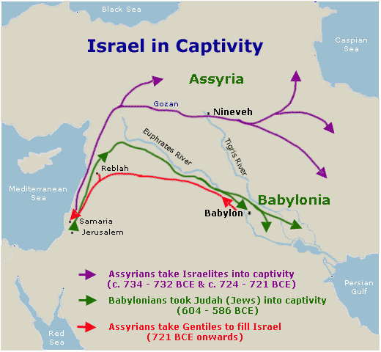

Slide 13
Chapter 19 Notes
“The LORD moved the heart of Cyrus king of Persia…” (pg. 263) to rebuild God’s Temple and allow the Israelites to go back home!
  The King ordered people to give the Israelites money, goods, and livestock to help in the effort.
  The items that Nebuchadnezzar carried out of the Temple years earlier, were given back to the Israelites.
Who was Zerubbabel?
  Grandson of Jehoiachin (<—who was he?)
  In the line of David
  Made governor of Judah
  Good guy! Started rebuilding the Temple.

Slide 14
Chapter 19 Notes
“Despite their fear of the peoples around them… they sacrificed burnt offerings...” (pg. 264)
  Why were the Israelites fearful?
Israel was worshiping God again in the Promised Land. But their neighbors had other intentions...
  Read the last 3 paragraphs on pg. 265
  Israel’s enemies were trying to disrupt God’s ministry
  The work on the Temple came to a standstill (pg. 266)
  Who tries to disrupt you from doing God’s work?
    Satan, the world, and our sinful nature!
    Praise Jesus He conquered them for us!

Slide 15
Chapter 19 Notes
Opposing forces hindered the temple reconstruction for 6 years and stopped it for another 10 years.
God helped jump start the project by sending his prophets: Haggai and Zechariah
Haggai’s main message: God had not forgotten his covenant with Abraham. Be strong for I am with you.
Zechariah’s main message: The temple is a sign and symbol of something greater coming. Watch for the day when God will bless Jerusalem once again.

Slide 16
Chapter 19 Notes
“Now I will not deal with the remnant of this people as I did in the past,” declares the LORD. (pg. 269)
  Is this good news?! Why?
Tattenai – another governor in Persia
  Questioned the Jews and King Cyrus on why the temple was being rebuilt.
  King Cyrus told Tattenai not to interfere with the efforts, but to financially support the rebuilding! If not, Tattenai would be killed.
  Tattenai obeyed. And the Temple was completed!

Slide 17
On your worksheet…
Answer the two questions under “Hear the Story.”

Slide 18
On your worksheet…
Under “Join The Story,” answer one of the questions.

Slide 19
Discussion Questions

Slide 20
Why did God rescue the Israelites again?

Slide 21
In what ways have you experienced the rescuing power of God?

Slide 22
What did the Israelites do to deserve the mercy they received?

Slide 23
What reason does God have for being merciful to you?

Slide 24
The Jews returned home to rebuild the temple, the dwelling place of God on earth. Why was it important for them to do this?

Slide 25
Where does God dwell on earth today?

Slide 26

For Next Sunday:
Read Ch. 20 of The Story
No memory work

Slide 27
*NO Sunday Night FLY Tonight!
-Enjoy the Big Game!
*Sign-up on the FLY bulletin board to help with our Spaghetti Dinner on Mar. 5!

Slide 28
Closing Prayers

