Slide 1
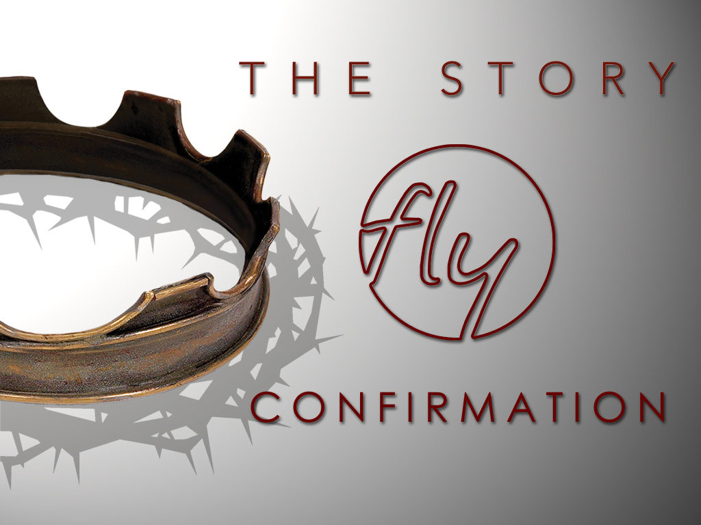
Welcome
Jr. FLY Confirmands!
Feb. 2, 2025

Slide 2
Welcome
&
Opening Prayer

Slide 3
QUIZ on last week’s Chapter 17

Slide 4
1. This king was Hezekiah’s son who later repented of his sins and came to know the Lord…
Jehoiakim
Josiah
Manasseh
None of the above

Slide 5
2. During this king’s reign, the Book of the Law of Moses was rediscovered and Judah and enjoyed peace for 31 years…
Jehoiakim
Josiah
Manasseh
None of the above

Slide 6
3. This Babylonian king conquered Judah and led Jerusalem to exile…
Nebuchadnezzar
Cyrus
Caesar
None of the above

Slide 7
4. The prophet ________ preached this message, “Unbelief leads to doom.”
Jeremiah
John the Baptist
Isaiah
Ezekiel

Slide 8
5. The prophet ________ was known as the “weeping prophet.”
Jeremiah
John the Baptist
Isaiah
Ezekiel

Slide 9
6. Ezekiel’s vision of dry bones coming back to life means…
Ezekiel will be resurrected like Lazarus
The nation of Israel will come back to life
Babylon will provide hope
None of the above

Slide 10
This Week’s
Memory Work:
Jeremiah 29:11
Recite it to someone sitting near you.

Slide 11
This Week’s Memory Work: Jer. 29:11
- “For I know” – God knows his people. He hasn’t forgotten them.
- “Prosper” - God wants his people to thrive and grow in Him alone.
- “Plans to give you hope” - He has a perfect plan for his people.
-Upper Story connection?

Slide 12


Slide 13
On your worksheet…
Under “See the Story,” create a simple image or symbol that you think best represents
Chapter 18.

Slide 14
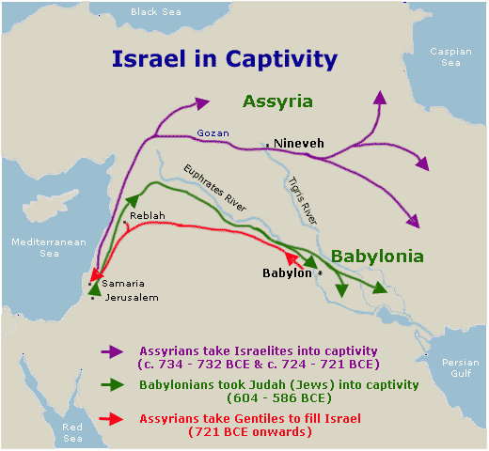

Slide 15
Chapter 18 Notes
“A faithful remnant (from Judah) survived in faraway Babylon…” (pg. 249).
  Daniel, Shadrach, Meshach, and Abednego were taken into exile in 605 BC from Judah in the 1st deportation
  Were healthy men – selected to serve in King Nebuchadnezzar’s palace.
  4 men didn’t eat royal food – still followed Jewish law
  God gave them knowledge & Daniel could understand visions and dreams.
  Daniel interpreted the king’s dream
  Babylon is just one minor part of God’s grand story! (Pg. 253)

Slide 16
Chapter 18 Notes
Daniel was made ruler over the province of Babylon.
The king’s statue of gold – 90 feet tall
  Everyone had to worship it or die in a furnace.
  Who didn’t worship it?
    Shadrach, Meshach, and Abednago
  What was their response? (read on pg. 255)
  They were thrown in the furnace.
  What did the king see?
    Four men… the fourth “looks like a son of the gods.”
  Did they survive?
  YES!
  The King decreed that all people shouldn’t say anything against God.

Slide 17
Chapter 18 Notes
King Nebuchadnezzar lost power…
Then King Belshazzar lost power and was conquered by the invading Persians... (pg. 257)
Now King Darius (also written as Cyrus) is in charge.
Daniel served him and didn’t pray to him… oh oh
  Other governors schemed against him. Forced Darius to make a law against people who didn’t pray to Darius.
  Did Darius want to hurt Daniel?
  NO! Darius was determined to save Daniel. (pg. 258)
  Who saved Daniel in the lion’s den?
  GOD!

Slide 18
Chapter 18 Notes
Jeremiah’s words to the exiled Jews…
  Read pg. 261
  What are some of God’s promises to His people?
70 years after the first deportations to Babylon... King Cyrus permitted the exiled Jews to return home to Jerusalem...
Upper Story connections from this chapter?
What will happen next?

Slide 19
On your worksheet…
Under “Join The Story,” answer one of the questions.

Slide 20
Questions?

Slide 21

For Next Sunday:
Read Chapter 19 of The Story!
No memory work

Slide 22
THANK YOU to everyone who volunteered and attended our Coffee House on Friday!
*No Sunday Night FLY next Sun.

Slide 23
Closing Prayers

