Slide 1

Welcome
Jr. FLY Confirmands!
Jan. 26, 2025

Slide 2
Welcome
&
Opening Prayer

Slide 3
QUIZ TIME!
On Ch. 16

Slide 4
1. Assyria conquered Israel and deported the Israelites to:
Egypt
Assyria
Judah
Rome

Slide 5
2. The Israelites were taken into exile because…
The Israelites sinned.
King Hezekiah worshiped false gods.
King David said so.
None of the above.

Slide 6
3. True or False: Hezekiah trusted in God.
TRUE
FALSE

Slide 7
4. ______ killed 185,000 Assyrian men in their army.
Hezekiah
Judah
Sennacherib
The Angel of the Lord

Slide 8
5. The prophet, _______, began his 60 year ministry in Jerusalem.
Hosea
Obadiah
Isaiah
Elijah

Slide 9
6. Isaiah’s answer to his ministry call was:
No.
Here am I. Send me!
I don’t speak well.
Send someone else.

Slide 10
7. One of Isaiah’s main messages was:
The Israelites would return home someday.
Judah will be lost forever.
King David’s throne is lost.
None of the above.

Slide 11
This Week’s
Memory Work:
Lamentations 3:22-23
Recite it to someone sitting near you.

Slide 12
Lamentations 3:22-23
- “Great love” – The Hebrew for this phrase is plural and is about the Lord’s loving faithfulness to his covenant promises.
-What are His promises to you?
-What does this mean to you?

Slide 13
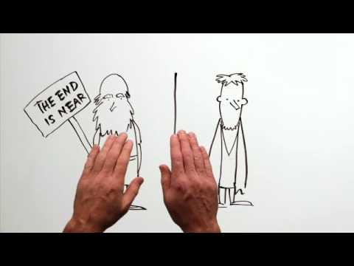

Slide 14
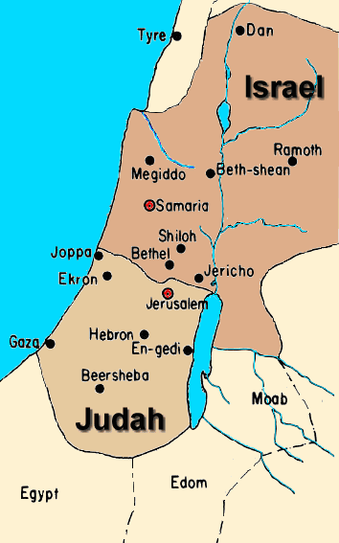

Slide 15
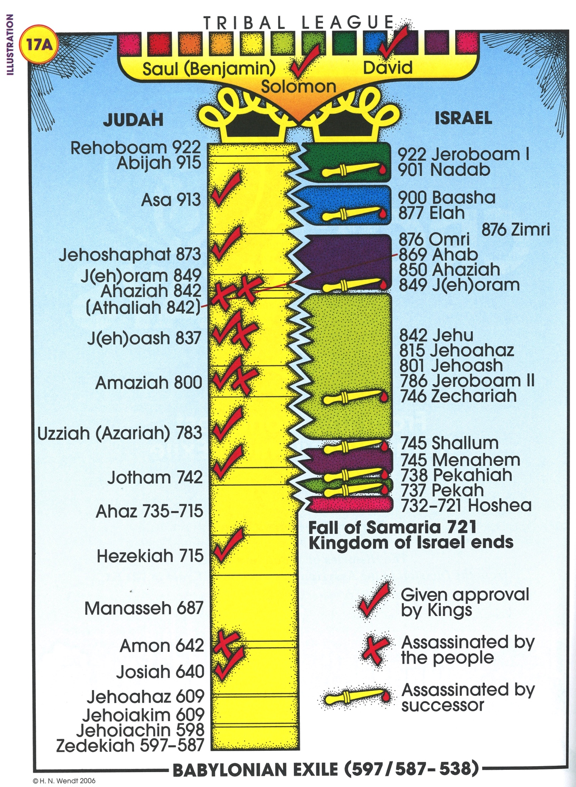
Chapter
17

Slide 16
Chapter 17 Notes
Babylon overtook Assyria and is at Jerusalem’s doorstep… (pg. 231).
  Israel is in exile. Judah remains.
  “Manasseh led them astray, so that they did more evil than the nations the LORD had destroyed before the Israelites,” (pg. 232). Why would the author say this?
  God says, “I will wipe out Jerusalem as one wipes a dish, wiping it and turning it upside down,” (pg. 232). WOAH!
  Manasseh was captured, a hook was put in his nose, and was brought to Assyria.
  He prayed and was brought back to Jerusalem.
  He “knew that the Lord is God.”

Slide 17
Chapter 17 Notes
King Amon reigned for 2 years. Bad king.
  Was assassinated.
King Josiah reigned for 31 years. Good king.
  Rediscovered the “Book of the Law of Moses.”
King Jehoahaz reigned 3 months. Bad king.
King Jehoiakim reigned 11 years. Bad king.
  Babylonians & friends invaded Judah.
King Jehoiachin reigned 3 months. Bad king.
  Nebuchadnezzar carried away almost EVERYONE and EVERYTHING out of Jerusalem.

Slide 18
Chapter 17 Notes
Ezekiel was a young priest carried off into exile.
  Main prophetic message: unbelief leads to doom.
  God gave him indescribable visions.
  God says, “I will spare some, for some of you will escape the sword,” (pg. 236). GOOD NEWS!
Jeremiah was called to be a prophet.
  His answer to ministry: “I am too young.”
  God reminds him that He is with him.
  Connection to your life today?

Slide 19
Chapter 17 Notes
Jeremiah was known as the “weeping prophet.”
  Why?
  He felt the burden of the people’s sin and the coming judgment.
  Two main messages:
    Jerusalem will be completely destroyed.
    God’s mercy never fails.
Nebuchadnezzar made Jehoiachin’s uncle the new king of Judah. King Zedekiah. (pg. 234)
  Reigned for 11 years. Bad king.
  Babylon finally destroyed everything in Jerusalem. Burned down the temple. Jerusalem had fallen.

Slide 20
Chapter 17 Notes
God’s messages of hope for His exiled people.
  “I will cleanse you from all your impurities.” (pg. 246)
  “I will put my Spirit in you.”
  “I will resettle your towns.”
  “The desolate land will be cultivated.”
Ezekiel’s vision of dry bones (pg. 246-247)
  What happened?
  The meaning: God will make the dead nation of Israel alive again!
  Upper story meaning: We, too, will rise from the dead on the last day and live forever!

Slide 21
On your worksheet…
Under “Join The Story,” answer one of the questions.

Slide 22

For Next Sunday:
Read Chapter 18 of The Story!
Memorize Jer. 29:11

Slide 23
Sunday Night FLY “REMIX” is TONIGHT @ 7-8:45pm
  -YOU will VOTE for 1 lesson and 1 game we’ll do together tonight!
  -Bring your friends!

Slide 24
Sign-up to volunteer at our Coffee House variety show on Friday, Jan. 31!
Lots of crews to be a part of!

Slide 25
Volunteer to help @ the 32nd Coffee House!
Wed, Jan. 29 @ 6-8pm - Stage & Lights Setup Crew
Fri, Jan. 31:
  Setup Crew @ 4:30pm
  Kitchen Crew @ 5:45pm
  Servers @ 6pm
  Clean-up Crew following the show

Slide 26
Closing Prayers

