Slide 1

Welcome
Jr. FLY Confirmands!
Jan. 19, 2025

Slide 2
Welcome
&
Opening Prayer

Slide 3
This Week’s
Memory Work:
Isaiah 53:5
Recite it to someone sitting near you.

Slide 4
Isaiah 53:5
-Who is Isaiah prophesying about?
-How are we healed?

Slide 5


Slide 6
On your worksheet…
Under “See the Story,” create a simple image or symbol that you think best represents
Chapter 16.

Slide 7
On your worksheet…
Answer the two questions under “Hear the Story.”

Slide 8
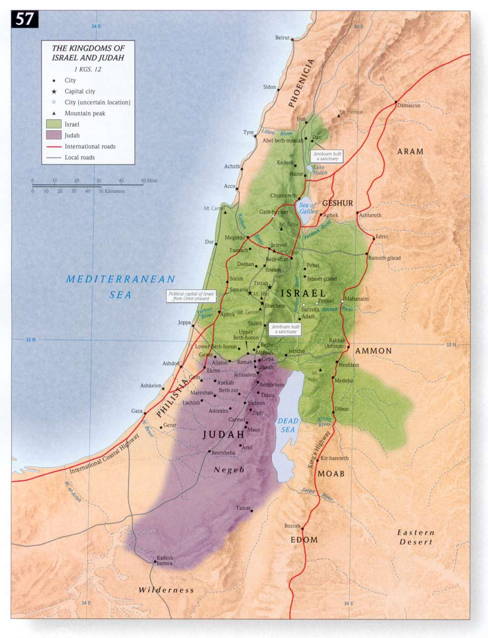

Slide 9
Chapter 16 Notes
In the 9th year of Hoshea’s reign, Assyria conquered Israel and deported the Israelites to Assyria (pg. 219).
  “All this took place because the Israelites had sinned against the LORD their God,”(pg. 219).
  They were taken into exile.
Meanwhile, King Hezekiah reigned in Judah.
  “He did what was right in the eyes of the LORD,” (pg. 220).

Slide 10
Chapter 16 Notes
An Assyrian commander tried to intimidate King Hezekiah and God’s people
  What happened?
  The largest army on earth was on Judah’s doorstep
  Hezekiah trusted in God’s Word spoken through the prophet, Isaiah
  God said to Hezekiah, “I will defend this city and save it, for my sake and for the sake of David my servant,” (pg. 224).
  That night the angel of the LORD went out and killed 185,000 Assyrian men in their army. Sennacherib withdrew.
  Sennacherib was killed by his sons.

Slide 11
Chapter 16 Notes
The Prophet Isaiah
  Began his 60 year ministry in Jerusalem in 740 BC
  Became well-known during Hezekiah’s reign
  Isaiah’s answer to his ministry call – “Here am I. Send me!”
  His main messages:
    Jerusalem will fall. God’s judgment.
    The Israelites would return home someday. God’s promise.
    The Israelites would rebuild. God’s promise.
    All people will be saved. God’s Messianic Promise.
    God’s kingdom will last forever. God’s promise.
King Hezekiah died and his son, Mannaseeh, was bad… oh oh...

Slide 12
On your worksheet…
Under “Join The Story,” answer one of the questions.

Slide 13
Discussion Questions

Slide 14
Why do you think Hezekiah experienced so much opposition?

Slide 15
Do you think obedience to God guarantees success or freedom from hardship? Why?

Slide 16
How does God give his followers confidence in the face of adversity? How does he give you confidence?

Slide 17
What were some of the main themes in Isaiah’s prophecies? How would you have responded if you were an Israelite?

Slide 18
How did God show mercy to his people in spite of their actions?

Slide 19
How has God shown mercy to you?

Slide 20
Questions?

Slide 21

DUE Today:
-One Thing I Learned Paper
-email to flypenfield@gmail.com
For Next Sunday:
Read Chapter 17 of The Story!
Memorize Lamentations 3:22-23

Slide 22
Sunday Night FLY “REMIX” next Sunday, Jan. 26 @ 7-8:45pm
  -YOU will VOTE for 1 lesson and 1 game we’ll do together!
  -Bring your friends!

Slide 23
Sign-up to volunteer at our Coffee House variety show on Friday, Jan. 31!
Lots of crews to be a part of!

Slide 24
Volunteer to help @ the 32nd Coffee House!
Wed, Jan. 29 @ 6-8pm - Stage & Lights Setup Crew
Fri, Jan. 31:
  Setup Crew @ 4:30pm
  Kitchen Crew @ 5:45pm
  Servers @ 6pm
  Clean-up Crew following the show

Slide 25
Closing Prayers

