Slide 1
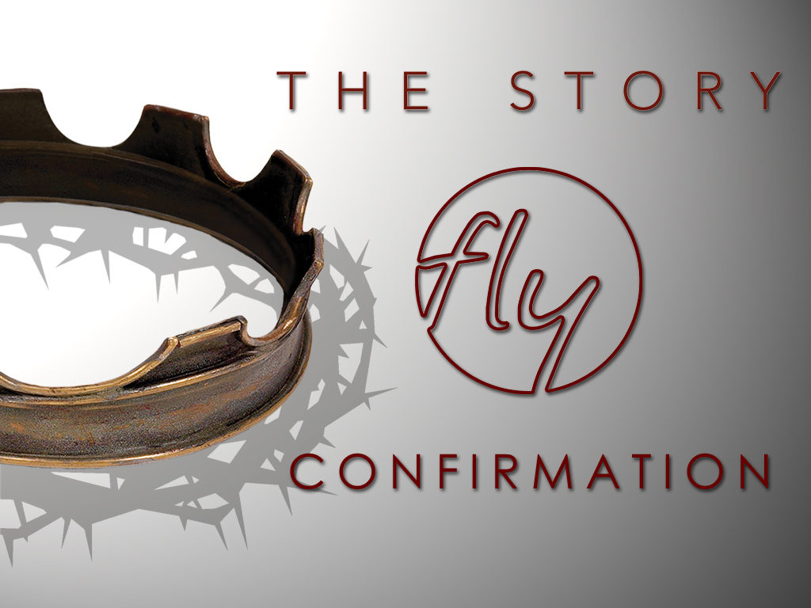
Welcome
Jr. FLY Confirmands!
Nov. 17, 2024

Slide 2
Welcome
&
Opening Prayer

Slide 3
QUIZ TIME!

Slide 4
1. The message of Joshua’s life was:
Be faithful and fight
Be strong and courageous
Be peaceful and worship God
Be lazy and do nothing

Slide 5
2. Two Israelite spies were hidden by a prostitute named…
Delilah
Ruth
Rahab
Naomi

Slide 6
3. Rahab lived in the city of…
Jericho
Nun
Ai
Makkedah

Slide 7
4. God made these objects stand still while Israel fought the Amorites…
Sun
Moon
Chariots
Spears
Both A & B

Slide 8
5. The Lord fought for Israel
TRUE
FALSE

Slide 9
6. Joshua gave the conquered land to the 12 tribes of Israel.
TRUE
FALSE

Slide 10


Slide 11
On your worksheet:
Under “See the Story,” create a simple image or symbol that you think best represents
Chapter 8.

Slide 12
On your worksheet:
Answer the two questions under “Hear the Story.”

Slide 13
Chapter Notes
Israel’s Cycle
  Worship false gods
  God would punish them
  Israel would cry out for help
  God sent a judge to save them
  Israel worshiped God again until the judge died
God chose Gideon to save his people… again
  A farmer from the weakest clan
  Questioned God (pg. 108)
  God gave him a mission to “strikedown all the Midianites.”

Slide 14
Chapter Notes
Israelites vs. Midianites (pg. 110-11)
  32,000 Israelite fighters
    God said anyone who is fearful should leave
  10,000 remained
    Went down to the water to drink
    Those who lapped water like dogs remained
  300 remained and confused the Midianites w/ loud noises
  Midianites were defeated and Israel enjoyed peace for 40 years.

Slide 15
Chapter Notes
Samson the Nazirite (pg. 112+)
  Married a Philistine woman
  Tore a lion apart with his bare hands
  Gave a riddle to the Philistines, his wife explained it to her people
  Samson burned down their fields with torches tied to foxes!
  Philistines killed his wife and her father
  Samson wanted revenge!
  He killed 1,000 men with a donkey’s jawbone!

Slide 16
Chapter Notes
Philistines tricked Delilah into finding the secret of Samson’s strength (pg. 116)
  After 3 unsuccessful attempts, Delilah got Samson to tell her his secret… “if my head were shaved my strength would leave me...” (pg. 117)
  Philistines captured him and placed him in prison
  God gave him strength once more and Samson pushed the Philistine’s temple down and killed 3,000 Philistine leaders, men, and women
  Upper Story: God’s strength is your strength because Christ lives in you!

Slide 17
On your worksheet…
Under “Join The Story,” answer one of the questions.

Slide 18
Discussion Questions

Slide 19
Why do you think the Israelites kept repeating their downward cycle of sin and rebellion?

Slide 20
Why do you think God uses people who are uncertain or weak like Gideon?

Slide 21
What did Samson’s decision to die accomplish for God’s purpose? What might this teach you about sacrifice?

Slide 22

For Next Sunday:
-Please read Chapters 9 & 10 (don’t worry, they’re short - total of 26 pages)
-No memory work

Slide 23
Sunday Night FLY is NEXT Sun. @ 7pm
-Theme: “Half-Truths”
-We’ll discuss popular sayings that kinda sound Christian… but they’re not.
-Invite a friend! Enjoy games, too!

Slide 24
Closing Prayers

