Slide 1

Welcome
Jr. FLY Confirmands!
Nov. 3, 2024

Slide 2
Welcome
&
Opening Prayer

Slide 3
QUIZ TIME on Chapter 5!

Slide 4
1. God gave Moses the 10 Commandments on which mountain?
Mount of Olives
Mt. Sinai
Mt. Everest
Temple Mount

Slide 5
2. What is the First Commandment?
Remember the Sabbath day by keeping it holy.
Do not murder.
You shall not misuse the name of the Lord your God.
You shall have no other gods
before me.

Slide 6
3. God told the Israelites to make a _________ for him to dwell in.
Golden calf
Tabernacle
Cave
Solomon’s Temple

Slide 7
4. The Israelites had Aaron build a ___________ for them to worship.
Golden calf
Tabernacle
Cave
Solomon’s Temple

Slide 8
5. There are consequences when we sin.
TRUE
FALSE

Slide 9
6. God led the people through the desert wilderness.
TRUE
FALSE

Slide 10
Memory Work
Take turns reciting it to someone sitting near you.

Slide 11
This Week’s
Memory Work:
Deut. 6:4-5

Slide 12
This Week’s Memory Work:
Deut. 6:4-5
These verses are known as the “Shema” – the Hebrew word for “hear.”
It’s become the Jewish confession of faith
Recited daily by many Jews today
Upper Story: Jesus cites this in the Gospels - see Matthew 22:37

Slide 13
Next Week’s
Memory Work:
Joshua 1:9

Slide 14
This week’s video:
Wandering

Slide 15


Slide 16
On your worksheet…
Under “See the Story,” create a simple image or symbol that you think best represents
Chapter 6.

Slide 17
On your worksheet…
Answer the two questions under “Hear the Story.”

Slide 18
What were the key events from chapter 6?

Slide 19
What was most meaningful to you from this story?

Slide 20
Chapter Questions
Why were Moses & Aaron not allowed to enter the Promised Land?
  They disobeyed God. Moses struck a rock, instead of telling it to produce water.
True or False: Joshua & Caleb wanted to enter into the Promised Land.
  True

Slide 21
Chapter Questions
Why did the Israelites wait 40 years to enter the Promised Land?
  The Israelites who were older than 20 and didn’t want to enter Canaan (because they didn’t trust in God) had to die… Except some leaders and those younger than 20 at the time.
Why did Moses make a bronze snake on a pole?
  Israelites who were bitten by snakes could be healed just by looking at the pole.

Slide 22
Chapter Questions
What animal spoke to Balaam the pagan?
  Donkey
  Then saw an angel of the Lord
  Gained courage to speak to his leader, Balak
  Told Balak that Israel would be blessed, Moab would not

Slide 23
Discussion Questions:
1. What do you think was the main cause of most of the Israelites’ problems?

Slide 24
2. How did God respond to the people’s lack of faith?

Slide 25
3. What do you learn about Moses’ leadership throughout this difficult period? How did he display both frustration and faith?

Slide 26
4. Why didn’t the Israelites trust God to bring them safely into Canaan?

Slide 27
5. Have you ever been afraid to do something, even though you knew it was what God wanted for you? Explain.

Slide 28
6. Have you ever felt as if you were “wandering in a desert” – spiritually or emotionally? Explain.

Slide 29
7. How do you think trusting God’s promises can help you in difficult times?

Slide 30
On your worksheet…
Under “Join The Story,” answer: What are you thankful for? Have you ever been ungrateful for something you received?

Slide 31
Questions?

Slide 32

For next Sunday:
Read Chapter 7 of The Story!
Memorize Joshua 1:9
Mark will be teaching!

Slide 33
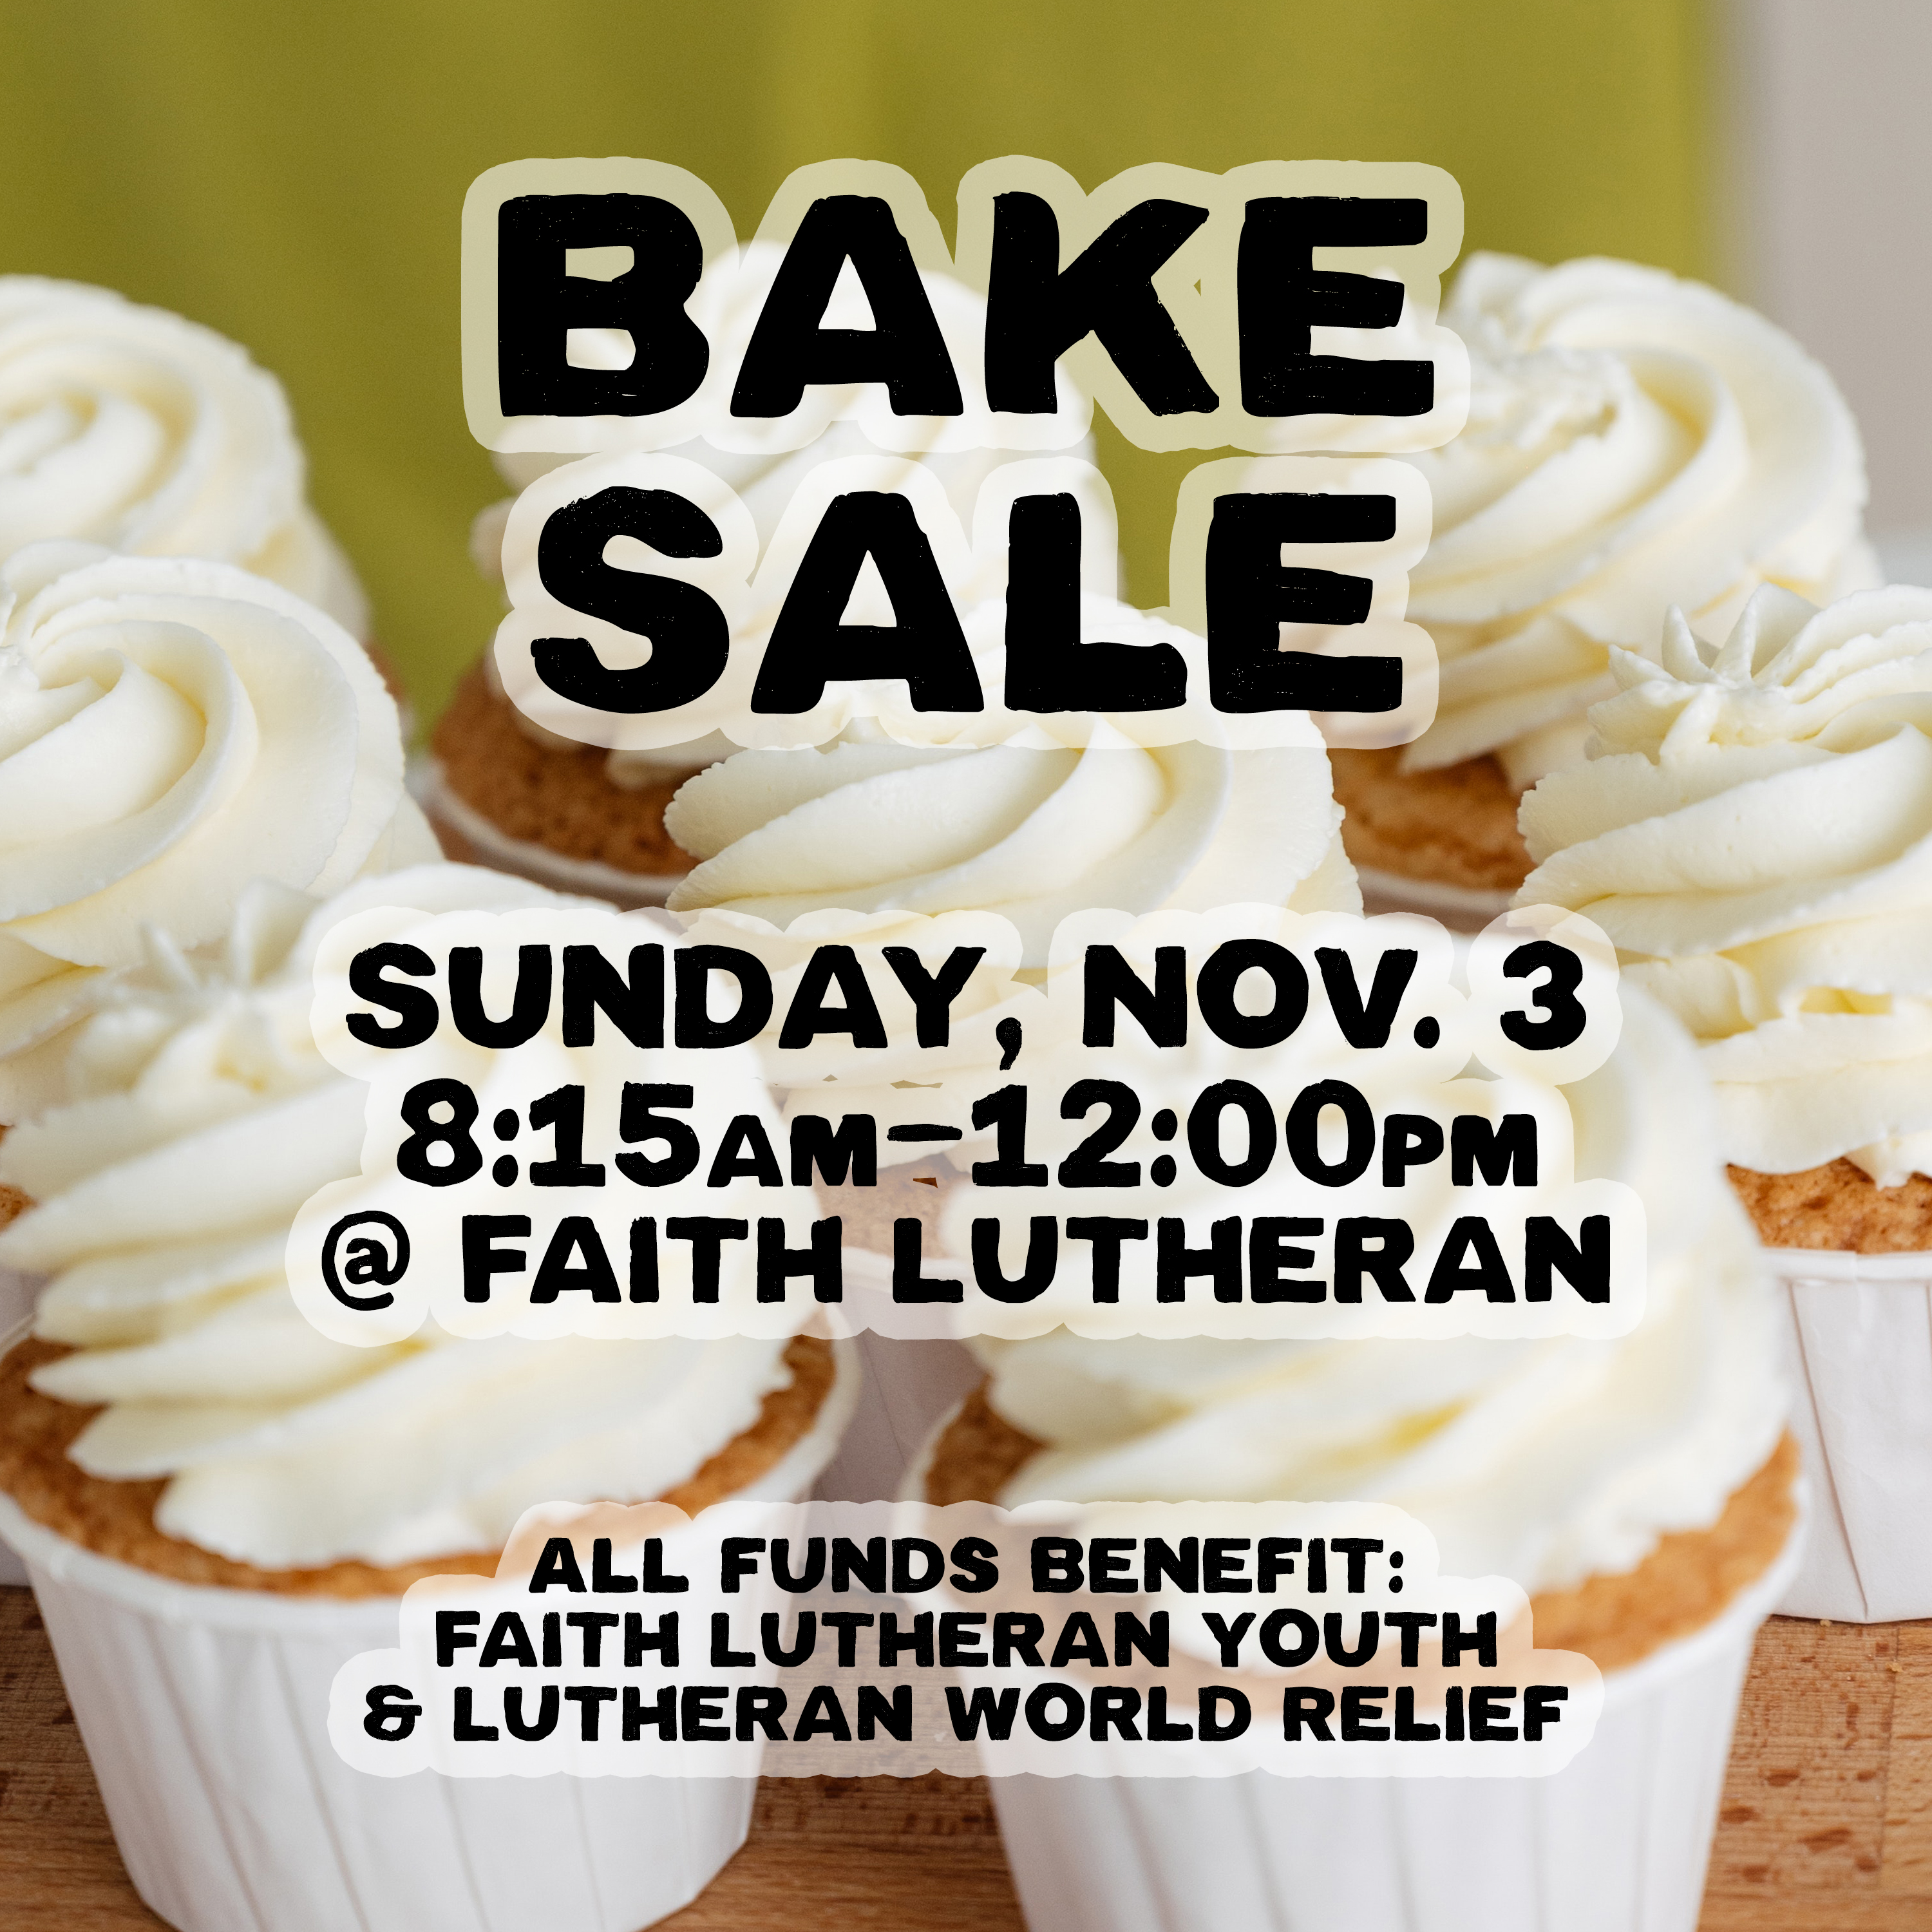
HELP serve at our FLY FUNdraiser TODAY!

Slide 34
Jr. FLY Switch Party! - Next Sun. @ 5:30pm in the FLY Room
Play in MarioKart tournaments!
Enjoy a pizza dinner!
Bring your friends!
This will lead into SNFLY that night!

Slide 35
Sunday Night FLY is next Sunday @ 7pm!
“Cookies for College Students”
Bring 2 dozen homemade cookies
We’ll pack care packages & play games!
Many thanks to everyone bringing friends!

Slide 36
Closing Prayers

Slide 37
Have a great week!

