Slide 1

Welcome
Jr. FLY Confirmands!
Dec. 15, 2024

Slide 2
Welcome
&
Opening Prayer

Slide 3
Share something great that happened this past week!

Slide 4


Slide 5
On your Chapter 13 worksheet…
Create a simple image or symbol that you think best represents the chapter.

Slide 6
On your Chapter 13 worksheet…
Answer both Hear the Story questions.

Slide 7
Chapter 13 Notes
David made his son, Solomon, king after he died.
God told Solomon, “Ask for whatever you want me to give you,” (pg. 176).
  What did Solomon ask for?
    Wisdom
  God also gave him wealth and honor
Solomon wrote many Proverbs.
  Catchy insights into many life issues.
  “Trust in the Lord…” (pg. 180)
Under Solomon’s direction, Israel completed the Lord’s Temple.

Slide 8
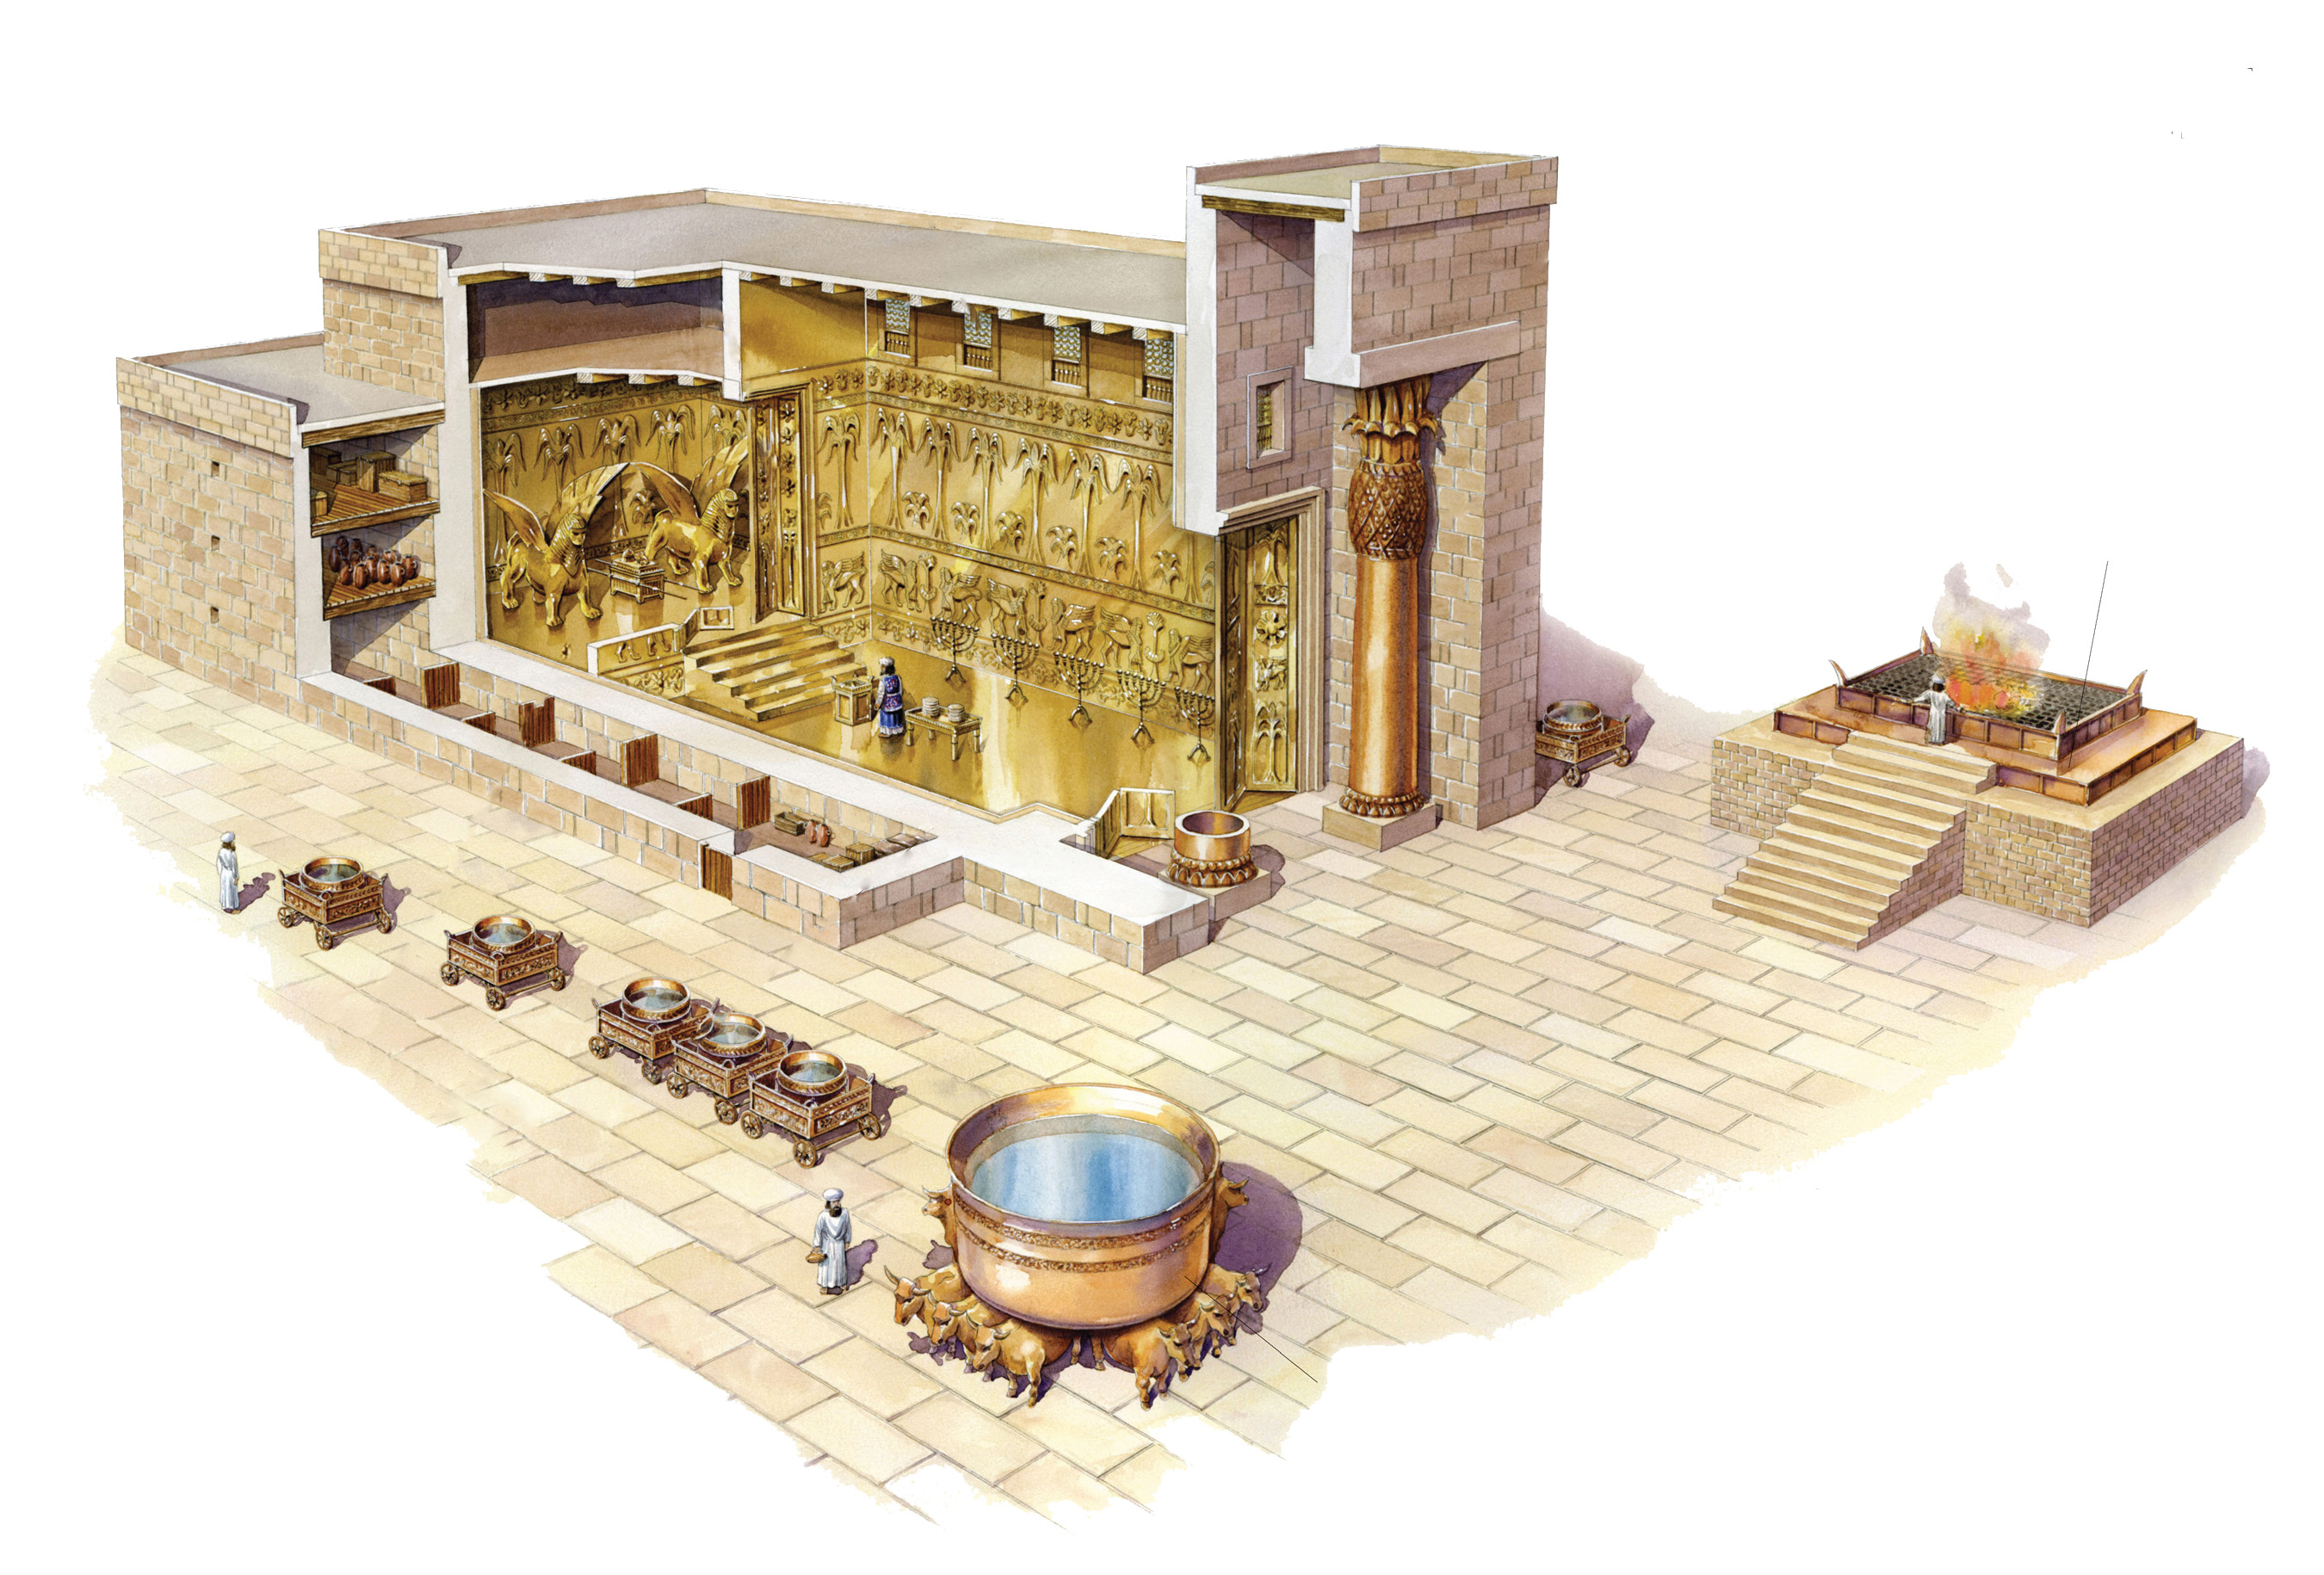
Solomon’s Temple

Slide 9
Chapter 13 Notes
Read God’s warning to Solomon (pgs. 188-189).
  Follow God = peace in Israel
  Follow false gods = Israel will be uprooted; temple destroyed
“King Solomon was greater in riches and wisdom than all the other kings of the earth,” (pg. 191).
Solomon had 700 wives & 300 concubines! Oh oh…
  He followed after their gods... Oh oh...
  God became angry and told him that Israel will split after Solomon’s death...
  Oh no.....

Slide 10
Discussion Questions

Slide 11
In your opinion, how is wisdom different from knowledge and intellect?

Slide 12
Why is it important to gain wisdom? How do you gain wisdom?

Slide 13
God asks Solomon to follow him “faithfully with integrity of heart.” What do you think this means?

Slide 14
What distractions in your life pull you away from following God?

Slide 15
On your Chapter 13 worksheet…
Answer both Join the Story questions.

Slide 16

For Next Sunday:
Read Chapter 14 of The Story
No Memory Work

Slide 17
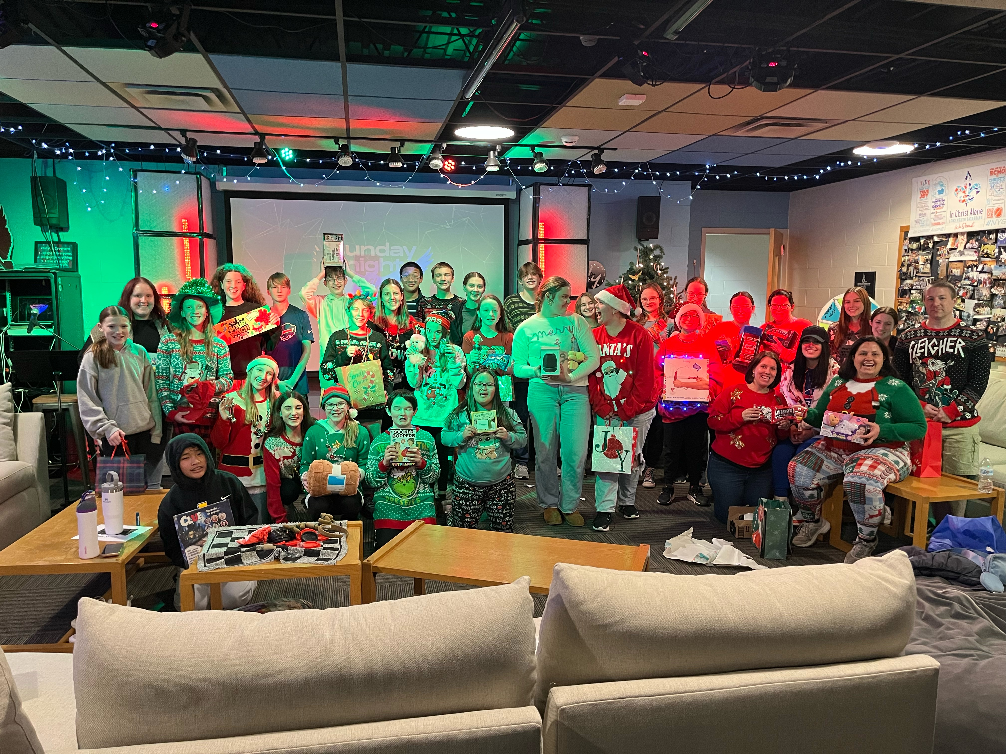
Thank you to everyone who came to our Christmas Party!

Slide 18
Closing Prayers

