Slide 1

Welcome
Jr. FLY Confirmands!
Oct. 6, 2024

Slide 2
Welcome
&
Opening Prayer

Slide 3
Sermon Notes
The main points need to be specific.
  Why? Who? What?
How does the sermon or text apply to my life?
Talk about it with your parent/guardian and then have them sign it
It’s OK to listen to recorded sermons online (in case you miss a Sunday or need to hear it again to fill in missing details)
  https://faithpenfield.org/sermons/

Slide 4
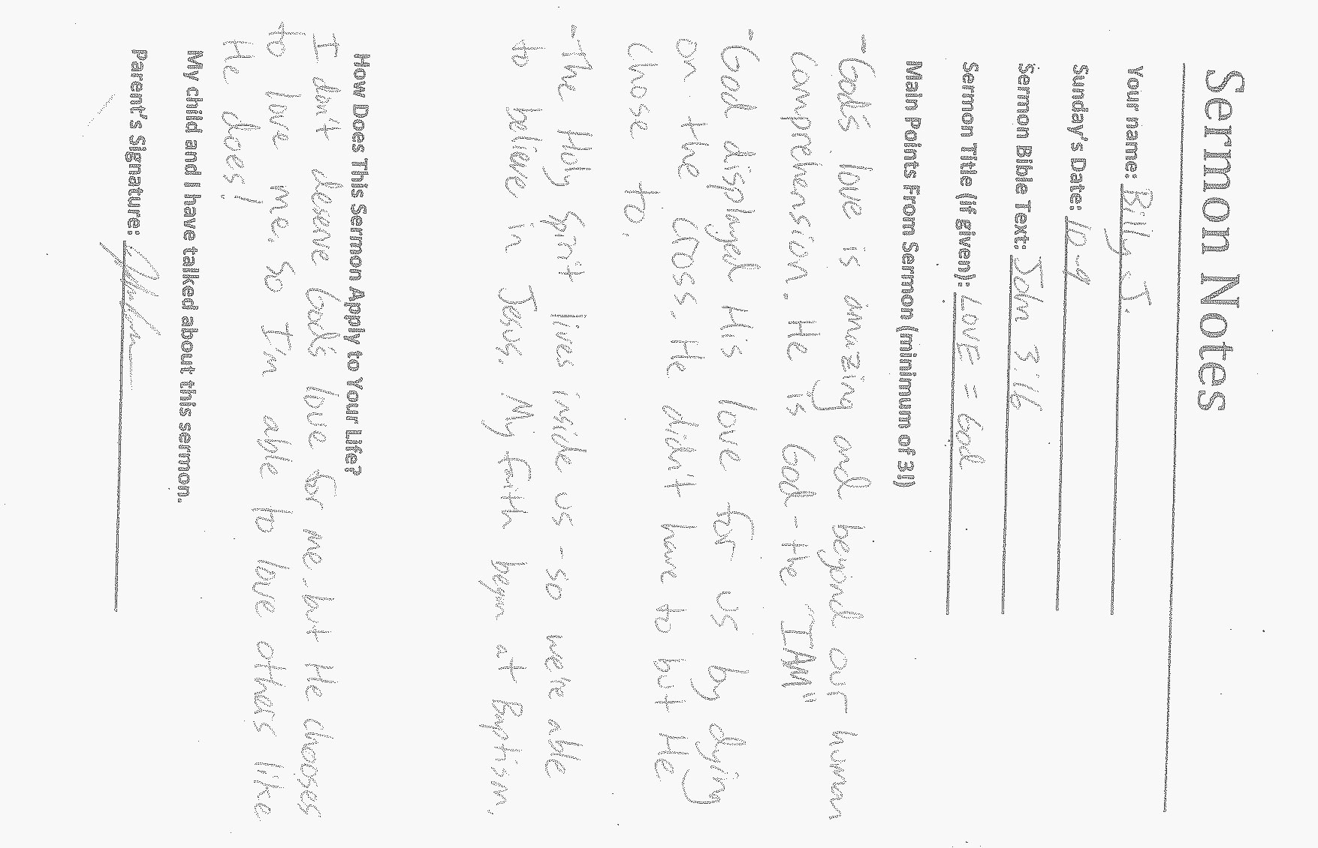

Slide 5
QUIZ TIME!

Slide 6
1. Which brother was sold into slavery because his brothers were jealous?
Reuben
Joseph
Benjamin
Judah

Slide 7
2. Who bought Joseph from the Ishmaelites?
Pharoah
Prison warden
Potiphar
Potiphar’s wife

Slide 8
3. Who did Joseph run away from – leaving his cloak behind?
Pharoah
Prison warden
Potiphar
Potiphar’s wife

Slide 9
4. What did Pharoah’s dreams mean?
7 years of food & 7 years of famine
7 years of peace & 7 years of war
7 months of food & 7 months of famine
None of the above

Slide 10
5. Who sent the brothers to buy food in Egypt?
Joseph
Judah
Benjamin
Jacob

Slide 11
6. Did the brothers recognize Joseph right away?
Yes
No

Slide 12
7. Chapter 3 ended with…
Pharoah hurting Joseph
Another famine
Joseph forgiving his brothers
Moses’ birth

Slide 13
Memory Work
Take turns reciting it to someone sitting near you.

Slide 14
This Week’s
Memory Work:
Exodus 3:14

Slide 15
Next Week’s
Memory Work:
Exodus 20:2-3

Slide 16
This week’s video:
“Deliverance”

Slide 17


Slide 18
On your worksheet…
Under “See the Story,” create a simple image or symbol that you think best represents
Chapter 4.

Slide 19
With a partner…
Answer the two questions under “Hear the Story.”

Slide 20
What were the key events from chapter 4?

Slide 21
What was most meaningful to you from this story?

Slide 22
Chapter Notes
“God heard their groaning and he remembered his covenant…” (pg. 45)
  Who was groaning? Why?
  What’s the covenant?
  Upper Story Connection: “While we were still sinners, Christ died for us,” Romans 5:8
  In the middle of our sinfulness, God hears us (because He LOVES us) and He does something about our situation... He forgives us through Jesus!

Slide 23
Chapter Notes
“Holy” (pg. 45) means “set apart”
“God said to Moses, “I AM WHO I AM.” (pg. 46)
  The name by which God wished to be known and worshiped in Israel. No other name like it!
“The LORD” – the Hebrew name is “Yahweh” (aka “He is.”)
Moses couldn’t speak well. So God sent Moses’ brother, Aaron, to speak.
“Redeem” (pg. 48) means “to rescue from captivity.”
  Upper Story: God rescued us from sin through Jesus.

Slide 24
The 10 Plagues
Nile to blood – against Apis, Isis, Khnum, & Osiris – gods of the Nile
Frogs – against Heqet – frog-headed goddess
Gnats – against Set – god of the desert
Flies – against Uatchit, the fly god
Death of livestock – against Hathor and Apis – cattle gods
Boils – against Sekhmet, Sunu, - the gods of health & disease

Slide 25
The 10 Plagues
7. Hail – against Nut – the sky goddess; Osiris – the crop fertility god; and Set – the storm god
8. Locusts – against Nut, Osiris, & Set
9. Darkness – against Re – the sun god symbolized by Pharaoh himself
10. Death of firstborn males – against Isis – the protector of children

Slide 26
Chapter Notes
What was the role of the Passover lamb? (pgs. 51 & 52)
  Perfect lamb had to be killed = Jesus.
  Blood was spilled = Jesus.
  Israelites were saved = We are saved through Jesus.
  Passover meal = Holy Communion

Slide 27
Chapter Notes
God delivered them out of Egypt through water. He will later deliver them into the Promised Land through water.
  Upper Story Connection – God delivered you out of sin through water and the Holy Spirit in your Baptism.
The Israelites grumbled against God and Moses (pgs. 55-57). Did God still provide for their needs?
  Yes! Water, manna, and quail.
  Exactly enough to fulfill their needs.
  God takes care of our needs today. What are some examples?

Slide 28
On your worksheet…
Under “Join The Story,” answer the 2 questions.

Slide 29
Discussion Questions:
1. How did God show concern for the Israelites after hearing their cries for help?

Slide 30
2. Do you think Moses was qualified to lead the people? In what ways did he feel he wasn’t qualified?

Slide 31
3. Have you ever felt unqualified or unable to do something? How did you handle it?

Slide 32
4. Do you believe God performs miracles today? Why or why not?

Slide 33
5. Why do you think God “hardens Pharaoh’s heart?” What might this mean?

Slide 34
6. What does this story say about the character of God?

Slide 35
7. What does the idea of “deliverance” mean in our world today? Where is God’s rescue needed?

Slide 36

For Next Sunday:
Read Chapter 5 of The Story!
Memorize Exodus 20:2-3

Slide 37
Be sure to check out the Confirmation Projects in the Concourse today!

Slide 38
Everyone is invited to Sunday Night FLY next Sunday, Oct. 13 @ 7-8:45pm.
-We will discuss our identity in Christ and play some games together!
-FLY Café & Switch is open from 6:30-9pm!

Slide 39
Closing Prayers

Slide 40
Have a great week!

